Slide 1
RNASeq
Gary Williams

Slide 2
Short-read sequencing
Pre-publication access to modENCODE data from LaDeana Hillier et al. (WashU St.Louis)
Short-read 36 bp Illumina sequencing of coding transcripts from 14 C.elegans life-stages:
early_embryo, embryo_him-8, late_embryo, lin-35_n745_mid-L1, male_mid-L4, L1, L2, L3, L4,Young_Adult, Adult_spe-9, dauer_daf-2, dauer_entry_daf-2, dauer_exit_daf-2,
454 reads from Makedonka Mitreva

Slide 3
454 reads from Makedonka Mitreva
These were supplied to us as 35,486 contigs of reads.
We have treated them as a special form of EST in the Build pipeline and curation tool.
They have therefore been used as evidence in curation for the last year.
There are at least 100 sequence changes that have been made using this data in the last year.

Slide 4
RGASP
Project based on EGASP to evaluate RNA-Seq methods.
Used the Hillier/Waterston short read data
We have been involved in evaluating the elegans analysis submissions.
First meeting in December had 12 groups submitting results from 9 data-sets analysed in many different ways.
No conclusive results. No winner.
RGASP 2 meeting will be in March using fewer data-sets and tighter judging criteria.
3000 regions for curation highlighted by analyses.

Slide 5
Impact of the RNASeq data
In the last year it has revolutionised the way we do manual curation.
We now always look at the wiggle plots on the UCSC browser to check what the Hillier data shows.

Slide 6
Use of the data
Not only curating genes using 6137 new splice junctions (6% increase), but also:
New TSL, polyA features
Finding new genes
Genome sequence errors
TSS, TES boundaries of genes

Slide 7
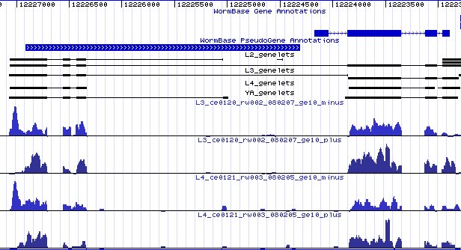
Curation example
Pseudogene – ignored by all
Notes:
Short read data gives an intron linking the pseudogene and the following gene. Pseudogenes are largely ignored and not re-checked.

Slide 8
Curation example
Transposon
Notes:
Inspection shows a transposon in the enclosing gene. Gene structure now matches the C. briggsae homolog.

Slide 9
Hillier analysis
Only unique alignments using MAQ or cross-match to genomic or transcript sequences were used.
Introns found by aligning reads across introns splice sites in predicted and curated transcripts.
polyA sites found by trimming polyA/T sequences from reads before aligning.
TSL sites found by trimming the leader sequence from reads before aligning.

Slide 10
New Features
Confirmed splice junctions from 70,000 to 98,000 (40% increase)
Including 6,137 splice junctions not used in previous gene models – new isoforms.
SL1 from 7,000 to 11,000 (57% increase)
SL2 from 2,000 to 2,600 (30% increase)
polyA from 1,500 to 6,000 (300% increase)
TSS from 0 to 7,000
TES from 0 to 7,000

Slide 11
New genes!
We usually add about 80 new coding genes per year, often as a result of splitting existing genes.
About 80 possible new coding genes are predicted!
Many of these have now been created.

Slide 12
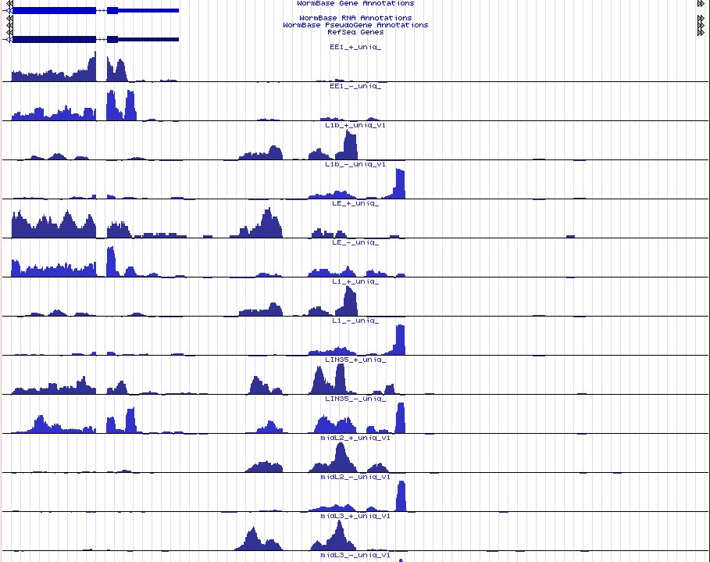
New gene example 1
New pseudogene

Slide 13
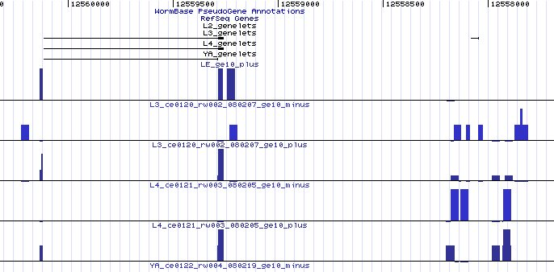
New gene example 2
New 4-exon CDS
Notes:
This is expressed at a low level and has a quite good paralog.

Slide 14
Genome Errors
We find about 10 to 20 genome sequence errors per year.
Usually single base errors.
Indicated by protein homology frameshifts or EST mis-alignments
Confirmed by looking at the sequencing trace data.

Slide 15
RNASeq evidence for sequence errors
If the RNASeq reads cannot align you get a gap in the coverage
Reasons for reads not aligning to genome:
No expression, so no reads.
Not a unique region, so reads rejected.
Secondary structure effects?
No reads match the genomic sequence at that position.

Slide 16
Reads aligned to a genome

Slide 17
Reads mis-aligned to a genome
X
X
X
X
X
X

Slide 18
Reads mis-aligned to a genome

Slide 19
Reads mis-aligned to a genome
V – shaped dip

Slide 20
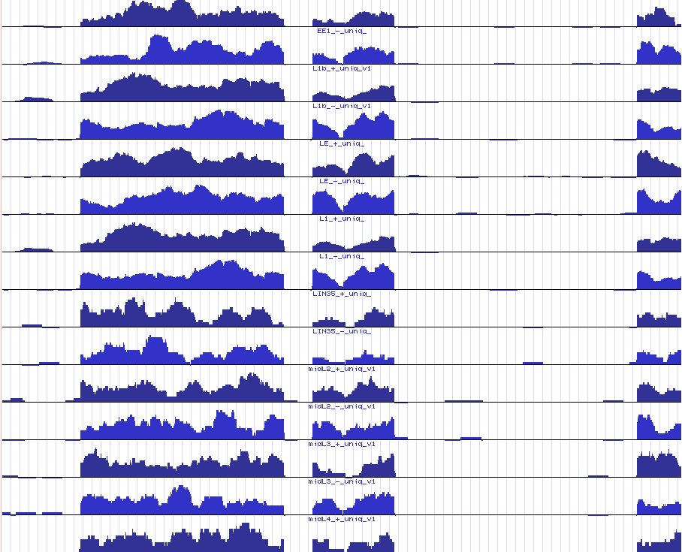
sequence error

Slide 21
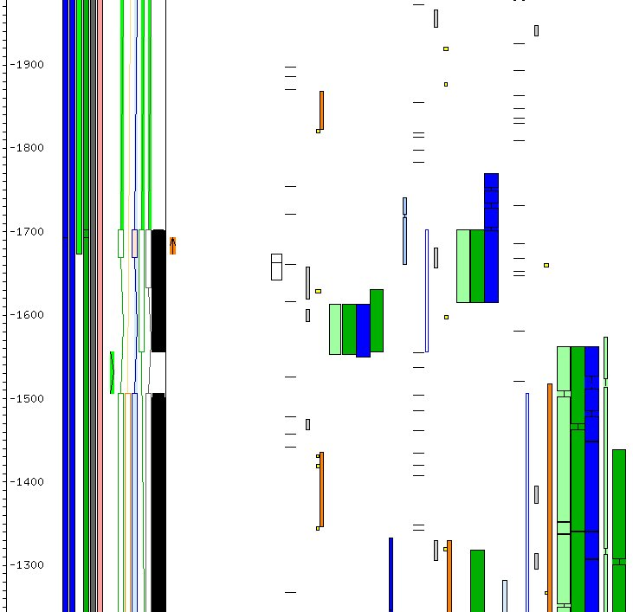
Acedb view of error

Slide 22
Found several error sites
Script to find dips in .wig read coverage files.
154 possible sites found.
29 confirmed by frame-shift or EST mis-alignment
10 pseudogenes can be converted to CDS
151 error sites confirmed by L. Hillier using crossmatch alignments.
Currently added to the database as ‘Genome_sequence_error’ Features.
These sites will be corrected in the next few months.

Slide 23
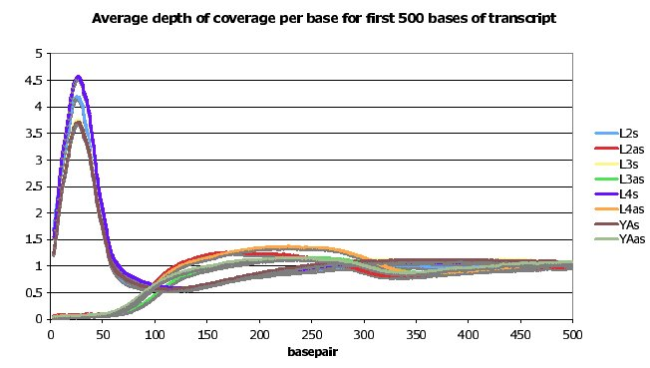
Assymmetric signal at TSS
sense
antisense
Notes:
You also get a weaker signal at the 3’ end.

Slide 24
Transcription start/end signal
Probably a result of the library construction and sequencing method.
Over most of the gene, reads are from both ends of the 200 bp fragments. Near the ends the 36 bp reads can only originate from one strand.
Start/end is of the mature mRNA, but we have been calling it Transcription Start Site/End Site as a shorthand description.

Slide 25
Making short-read data
AAAAAA
mRNA
Sequence ends
Sense reads
AntiSense reads
Sense reads only

Slide 26
TSS signal examples
TSS
Plus and minus reads
TES ?
Notes:
Three examples of read coverage on genome. – wrong intron spotted while preparing talk. – possible multiple TESs on the last example.

Slide 27
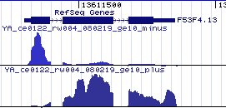
TSS signal examples
TSS
Plus and minus reads
TSS
TESs
Notes:
Three examples of read coverage on genome. – wrong intron spotted while preparing talk. – possible multiple TESs on the last example.

Slide 28
TSS signal examples
TSS
Plus and minus reads
TSS
TESs
TSS
Notes:
Three examples of read coverage on genome. – wrong intron spotted while preparing talk. – possible multiple TESs on the last example.

Slide 29
TSS signal examples
TSS
Plus and minus reads
TSS
TESs
Wrong intron -confirmed by EST
TSS
Notes:
Three examples of read coverage on genome. – wrong intron spotted while preparing talk. – possible multiple TESs on the last example.

Slide 30
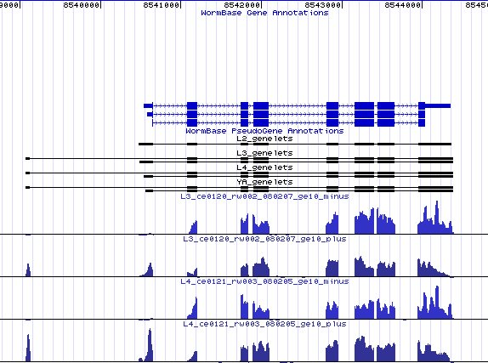
Alternate TSS/TES
TSS
TSS
TESs
TES
TES

Slide 31
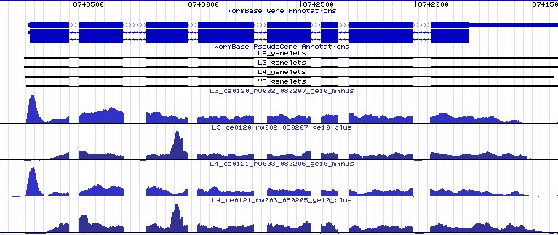
Premature Transcript Ends
TSS
Premature TES ?
Notes:
Here is another example of a premature TES site with no apparent cause. They are quite common

Slide 32
Haemonchus Contortus Genome and Transcriptome Sequencing
Genome :
Sequenced at Sanger Institute – Pathogen Sequencing
Combined worms (ie > 1 worm)
Capillary reads only (new one has 454)
59,707 supercontigs (mean length 5k)
~60Mb genome size(?) (C.elegans = 100Mb)
ftp.sanger.ac.uk/pub/pathogens/Haemonchus/contortus/
RNA seq :
~10m Solexa PE reads from each of 3 life stages

Slide 33
Gene building (ensembl)
Multi-stage process :
Read alignment with exonerate
Rough model generation
Realign reads to transcripts
Refine gene models.
18.5m reads aligned (both ends)
10,360 rough models
6,201 genes - ~3.5 exons / gene

Slide 34
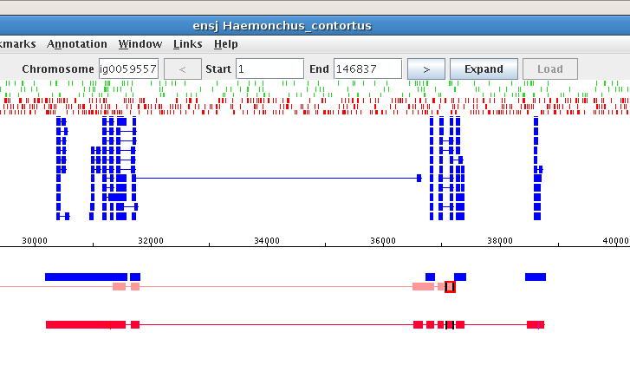
Haemonchus Contortus Gene Set
Genomic alignments
Blast hits (elegans and swissprot)‏
Predicted gene
InterPro Domains
51 Serine/threonine-protein kinase-like domain 42 Peptidase C1A, papain C-terminal 23 RNA recognition motif, RNP-1 18 Zinc finger, C2H2-type 11 Ubiquitin-conjugating enzyme, E2 11 PDZ/DHR/GLGF 10 Peptidase S28 10 Glycoside hydrolase, family 37
10 Peptidase A1 10 Aldehyde dehydrogenase
GO terms
96 proteolysis 67 oxidation reduction 66 intracellular 65 membrane 64 integral to membrane 60 protein amino acid phosphorylation 51 metabolic process 49 nucleus 40 zinc ion binding 40 protein binding
4103 C.elegans blastp hits
807 1:1 homologs to C. elegans named genes (8821)

Slide 35
Future
Can assign expression values to isoforms in different life-stages.
As reads get longer can disambiguate alternate splice sites to predict correct isoform structure.
75 bp paired-end reads now available as part of RGASP from the Sternberg/Wold lab
Should we take Nematode reads from GEO to extract the intron, polyA and TSL etc. information for curation in a consistent way?
How should we use and present new data?

Slide 36
Acknowledgements
Hillier L, Reinke V, Green P, Hirst M, Marra M, Waterston R. (2009) Genome Research, vol. 19, “Massively parallel sequencing of the poly-adenylated transcriptome of C. elegans”.
454 sequences, Makedonka Mitreva (unpublished)

Slide 37
END

Slide 38
Hillier/Waterston data
worms
polyA ds cDNA
Sonicate to 200 bp
Sequence ends
36 base reads
Notes:
Poly-adenylated double-stranded cDNA from various life stages and tissues.Sequence in an Illumina machine.

Slide 39
Odd things
There are more things in this genome than are deamt of …

Slide 40
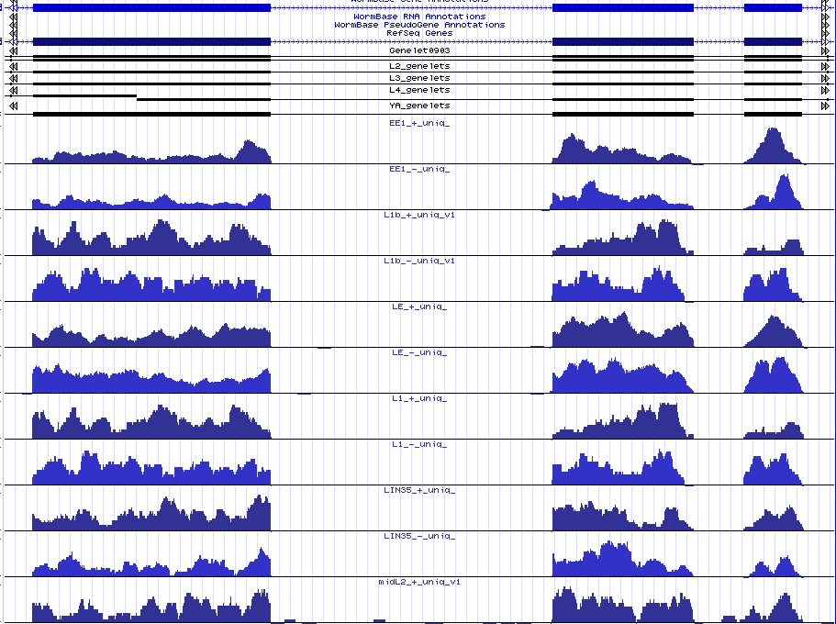
Sloping exons
Notes:
Normal-looking gene with about 15 exons. The first nine have well-defined intron boundaries. The rest have sloping edges. The following genes go back to sharp edges.

Slide 41
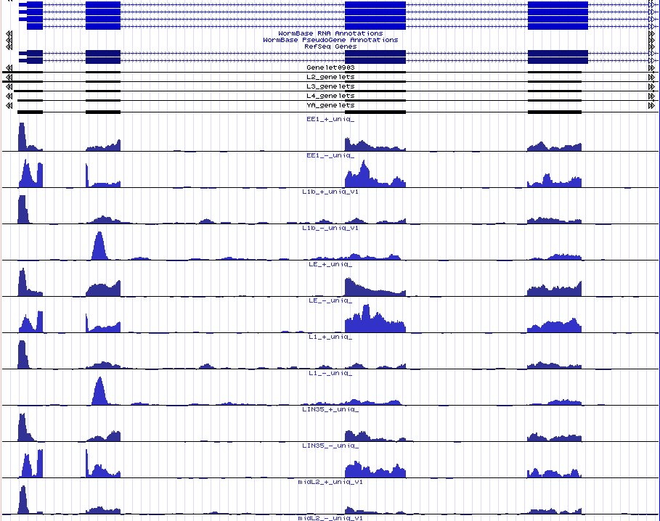
Expression in introns

Slide 42
California Institute of Technology
Paul Sternberg
Igor Antoshechkin
Juancarlos Chan
Wen Chen
Ranjana Kishore
Raymond Lee
Hans-Michael Mueller
Cecilia Nakamura
Andrei Petcherski
Gary Schindelman
Erich Schwarz
Kimberly Van Auken
Daniel Wang
Xiaodong Wang
Karen Yook
John Spieth
Tamberlyn Bieri
Darin Blasiar
Phil Ozersky
Wellcome Trust Sanger Institute
Richard Durbin
Paul Davis
Michael Han
Anthony Rogers
Mary Ann Tuli
Gary Williams
Cold Spring Harbor Laboratory
Lincoln Stein
Norie de la Cruz
Todd Harris
Sheldon McKay
Will Spooner
Zheng Zha
Notes:
42

Slide 44
Getting involved
We have tried to become involved in the project at an early stage.
Disadvantages:
data format and contents changes frequently as the analysis and modENCODE requirements change.
Advantages:
Understand the data better
Able to check the data and author’s assumptions
So we are able to start using it earlier

Slide 45
WormBase transcript problem
Checking the data we found ~1500 introns assigned to the wrong sense
Problem with WormBase release ‘WS170’ UTRs overlapping neighbouring genes
Genes
Wrong transcript
Short-read intron assigned to wrong sense
Notes:
WS170 is two years old – UTR problem was fixed two years ago – the author was notified and the correct sense assigned before publication.

Slide 46
polyA site problems
Found ~1000 polyA sites that appear wrong – in the middle of a gene on an intron splice site with polyA across the intron.
“polyA site” – really intron splice site
(A)n region of exon
(A)n region of reads
Notes:
But the vast majority of the features found appear to be correct

Slide 47
Genelets – Model transcripts
Join exons confirmed and bounded by introns, TSL, TSS, polyA and TES features – called genelets.
The resulting possible transcripts do not disambiguate splicing patterns for genes with alternative isoforms.
We do not intend to use these ‘genelets’ as they are – we will integrate the features into our own Transcript Builder code.

Slide 48
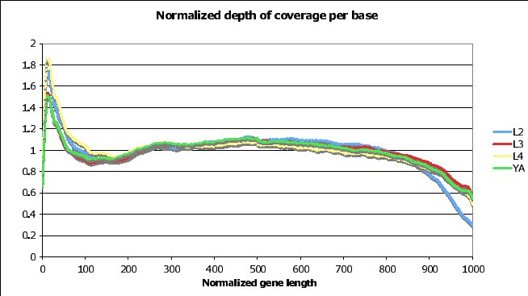
Coverage at start of transcript
Spike in coverage at start

Slide 49
Making short-read data
worms
polyA ds cDNA
Sonicate to 200 bp
Sequence ends
36 base reads
Notes:
Poly-adenylated double-stranded cDNA from various life stages and tissues.Sequence in an Illumina machine.

Slide 50
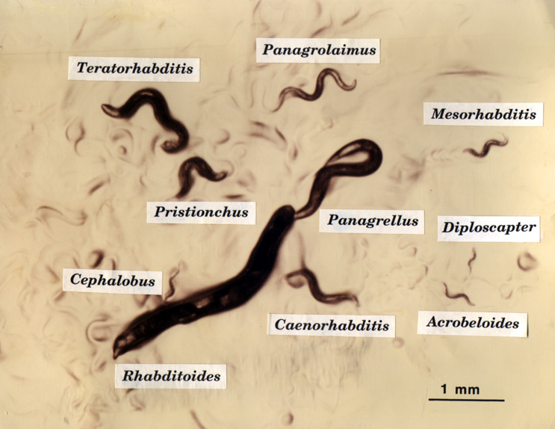

Slide 51
Many more worm genomes
Tier 1
C. elegans
Tier 2
C. briggsae, C. remanei, C. brenneri, C. japonica, Heterorhabditis bacteriophori, Pristionchus pacificus
Tier 3
many more ~40 total
Ascaris lumbricoides, Ancylostoma duodenale, Onchocerca volvulus, Strongyloides ratti, Trichuris trichiura, Wuchereria bancroftii, Necator americanus, Brugia malayi, Trichinella spiralis, Meloidogyne hapla ...

Slide 52
Curation of 1, 6 & 40 genomes
C. elegans will continue to be curated fully
The six “tier 2” genomes will be curated as well as resouces allow
use curation anomalies database
The 40+ “tier 3” genomes will not be curated by WormBase.
Genes automatically predicted
Set up on the web site
We will try Community Annotation
initially just text description, later gene model via Apollo

Slide 53
Some curation anomaly types
Unmatched TSL (start of gene or isoform)
Introns in UTR
Confirmed intron not in gene model
Overlapping exons
Transcript data overlaps an intron
Exon overlaps repeat region
Split gene by protein groups
Mismatched ESTs (genomic sequence error)

Slide 54
Some curation anomaly types
Unmatched exon of twinscan prediction
Unmatched protein alignment
Unmatched WABA coding potential
Split/merge genes by twinscan prediction
Frame-shifted protein alignment
Split/merge by protein alignment
Unmatched mass-spec peptide
Incomplete Pfam motif

Slide 55
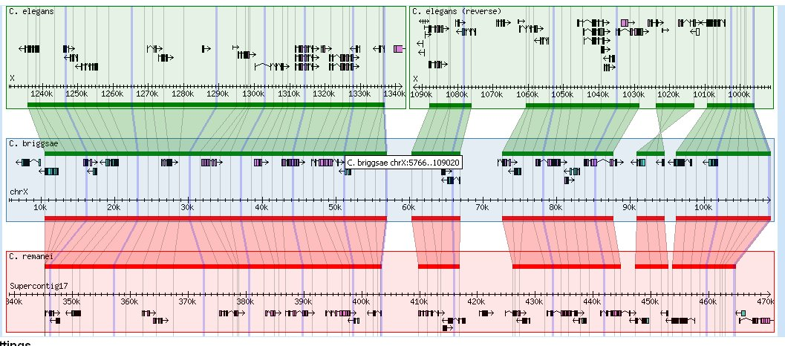
Synteny Browser
Synteny determined by PECAN as part of the Ensembl analysis
www.ebi.ac.uk/~bjp/pecan
Notes:
55
Marked areas show
1) break in synteny between elegans and other species
2) Region of chromosome X inverted in elegans compared to briggsae and remanei.

Slide 56
Tiling Array - new regions
Looked for more examples...
There are 2909 regions with high tiling array expression that do not overlap known transcribed regions.
much of this is “noise” or UTR
There are ~8000 twinscan exons not matching a curated gene structure.
There are 779 twinscan exons that do not match curated gene structures and have high expression.

Slide 57
Tiling Array – twinscan exons
Probably a real exon, protein homology supports this exon

Slide 58
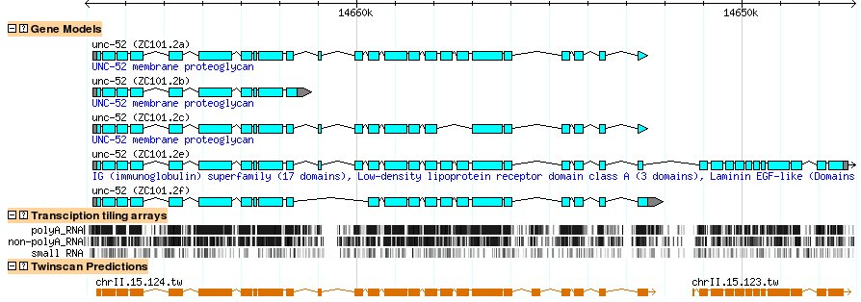
Tiling Arrays are not infallible
Well-studied gene, many ESTs confirm the intron, no protein homology to support a new exon.
Caused by 'noise', duplicated other coding region of the genome.

Slide 59
Integration with WormBase Build
Want to use the short read sequences in our BLAT pipeline like ESTs to define the introns.
Reads are too short: 36 bases
Reads often only have a few bases on the other side of the intron.
BLAT often fails to align correctly so the introns are not defined.
Short reads
Notes:
The reads often only have a few bases on the other side of the intron splice site so BLAT fails with single read sequences.

Slide 60
Integration with WormBase Build
Cluster overlapping reads spanning the intron.
Clustering gives sequences mainly 45 – 70 bases long - sufficient for BLATing
Also make read clusters as evidence for polyA and TSL sites.
Short reads
Clustered read sequence
Notes:
The reads often only have a few bases on the other side of the intron splice site so BLAT fails with single read sequences.

Slide 61
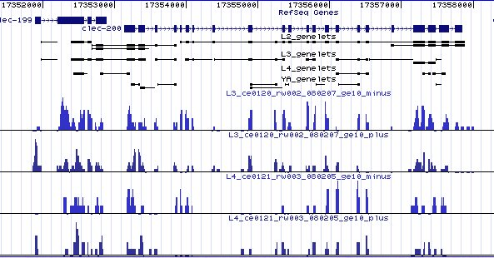
Curation example
Two genes that should be merged
genelets
L3
L4
TSS
No TSS
intron
Notes:
There are distant paralogs of the merged gene that support this. There is an EST that aligns to the end of one gene and has 8 more bases that should align to the next gene, but BLAT misses this alignment.

