Slide 1
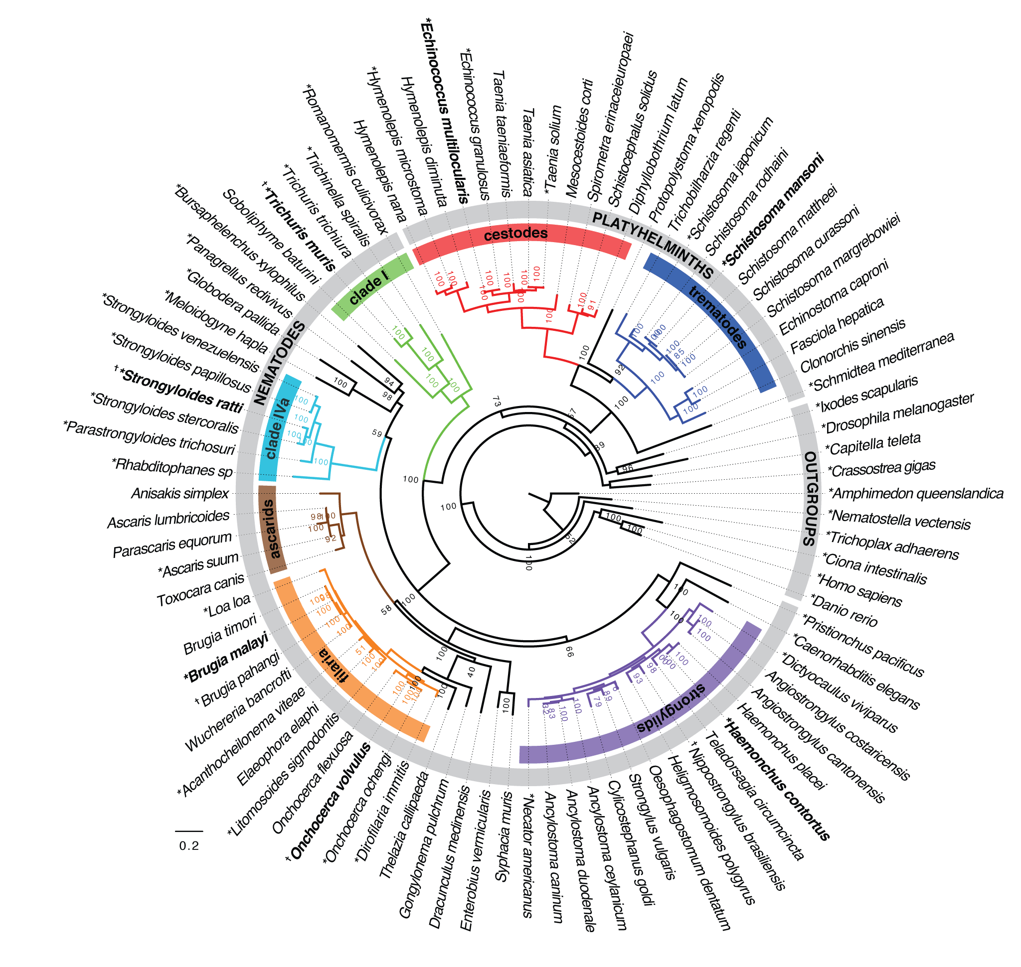
50HG Project Mining the ~100K Compara families
Diogo
17-Mar-2015

Slide 2
Processing
Subtrees merged into supertrees.
Joined subtrees belonging to supertree (created new families.txt)
Merged gene losses and duplications (created new files – duplication values are not exact)
Recalculated gene tree root (created new families_per_taxonomy_level.txt)
Removing the 10 outgroups
Filtered families.txt internally
Filtered gene losses and duplications internally
recalculating gene tree root
Possible to remove any set of species/nodes (e.g. analyzing only nematodes or platyhelminths)

Slide 3
“Phylogenomic” tree
50HG Project. Total 91 species:
- 56 Nematodes (4 Free-living)
- 25 Platyhelminths (1 Free-living)
- 10 Free-living Outgroups

Slide 4
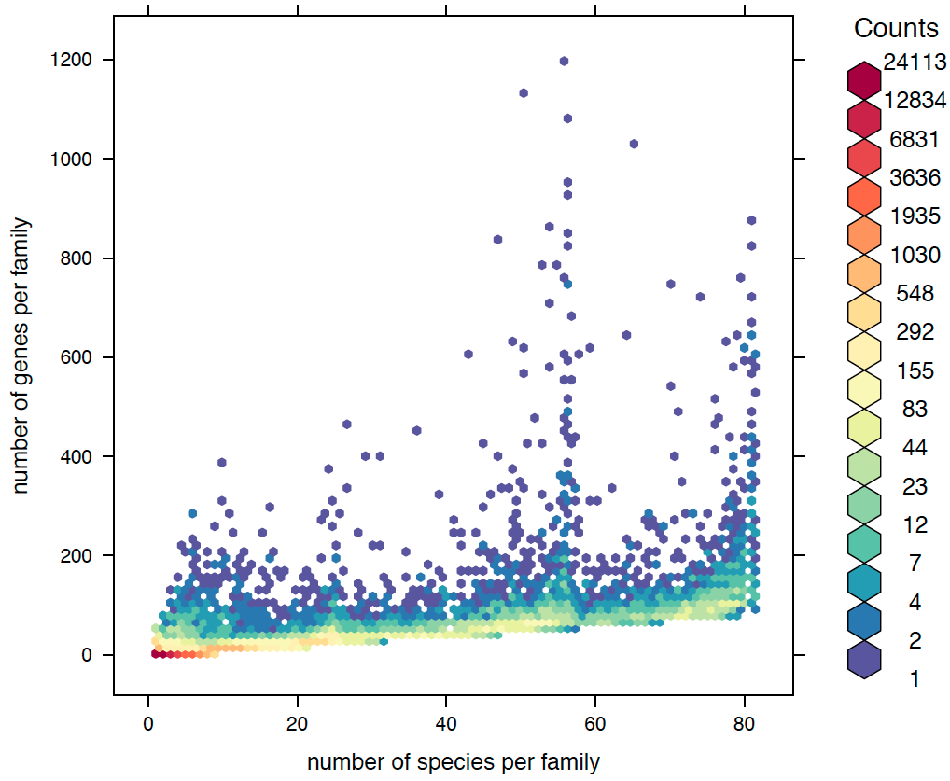
Compara gene families
- Compara data includes total 1,640,841 genes
- of which 1,365,243 genes are clustered into
- 109,571 gene families
Astacins
Biggest family = 1219
Mean family size = 12.4
Median family size = 3
Most compara gene families are single species, and small
- 24179 Single-species families
- 31039 families with only 2 genes
- 1655 families with >100 genes
#_Platyhelminths (25)
#_Nematodes (56)
Note: excluding outgroups
Notes:
This is for supertrees+subtrees. The complete_families.txt
Removing outgroups
(~13K with size 2)

Slide 5
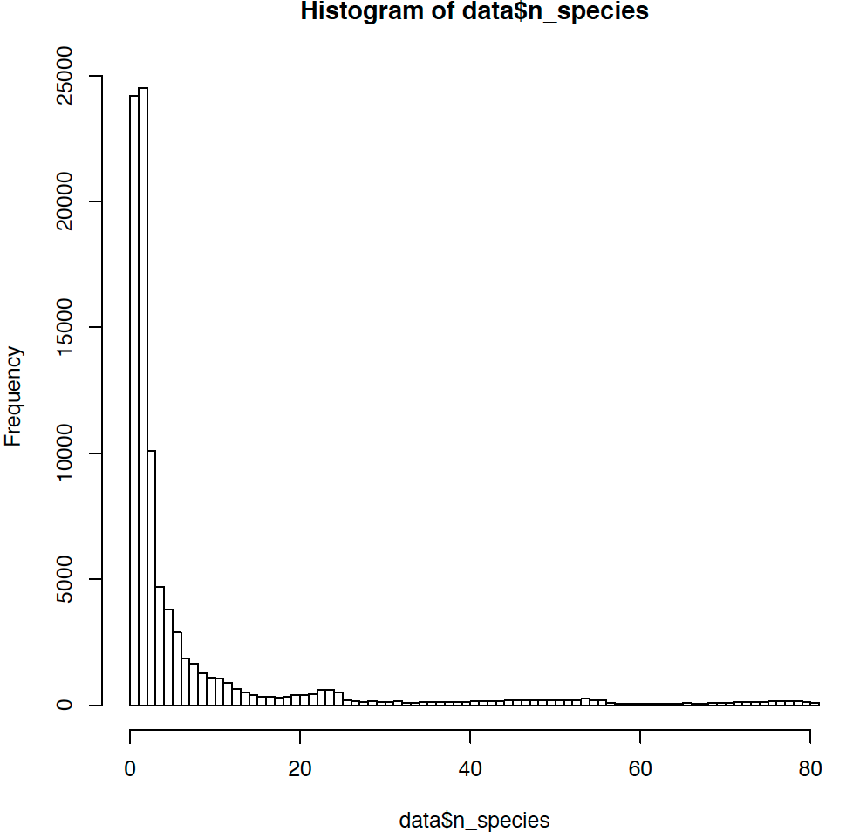
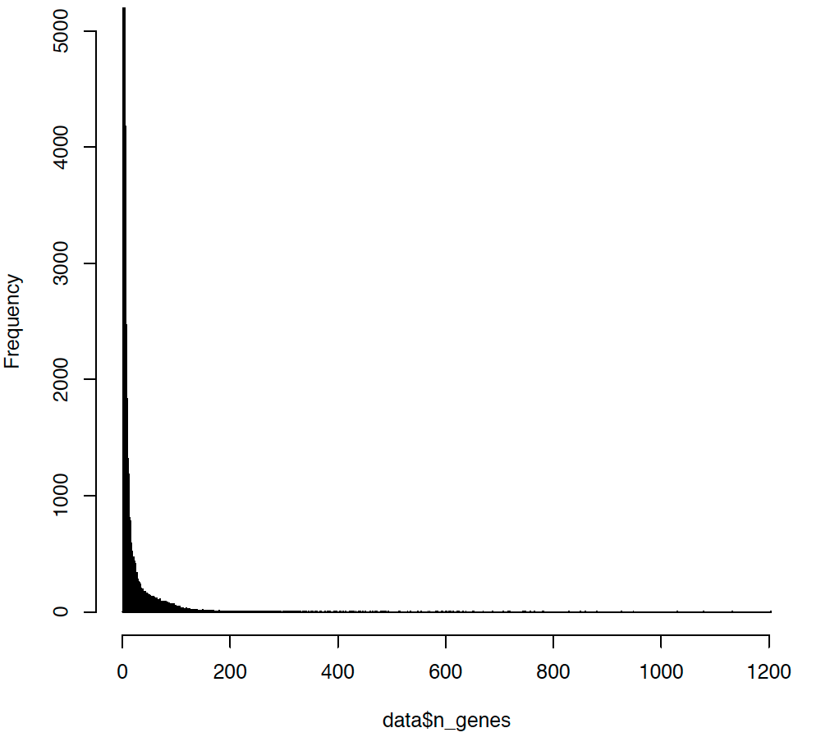
Number of species & genes per family
Families with more than 100 genes: 1655
100
Number species
Number genes
Most compara gene families are single species, and small
- 24179 Single-species families (~13K with size 2)
- 31039 families with only 2 genes
Note: excluding outgroups

Slide 6
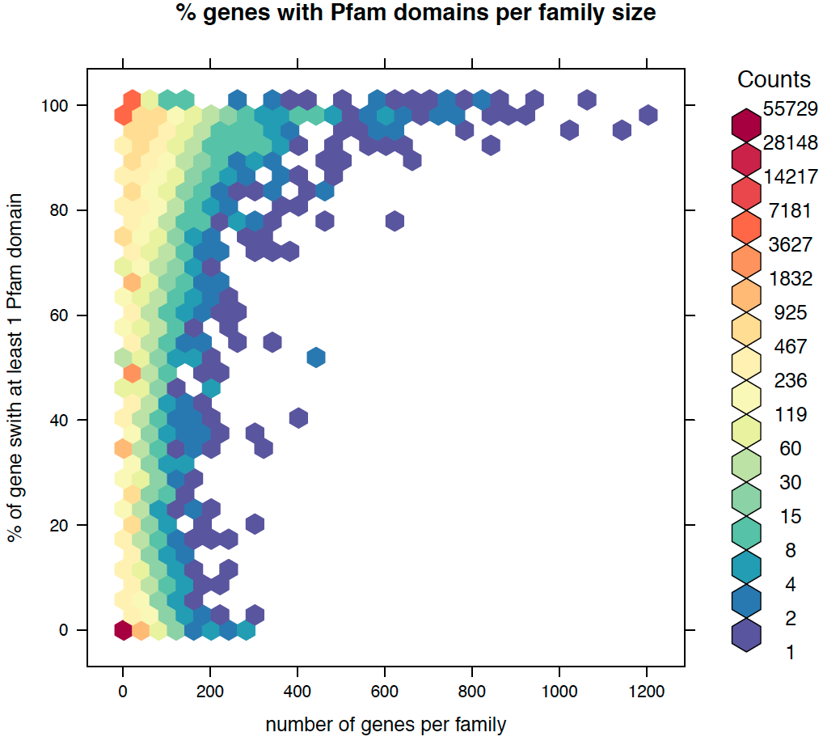
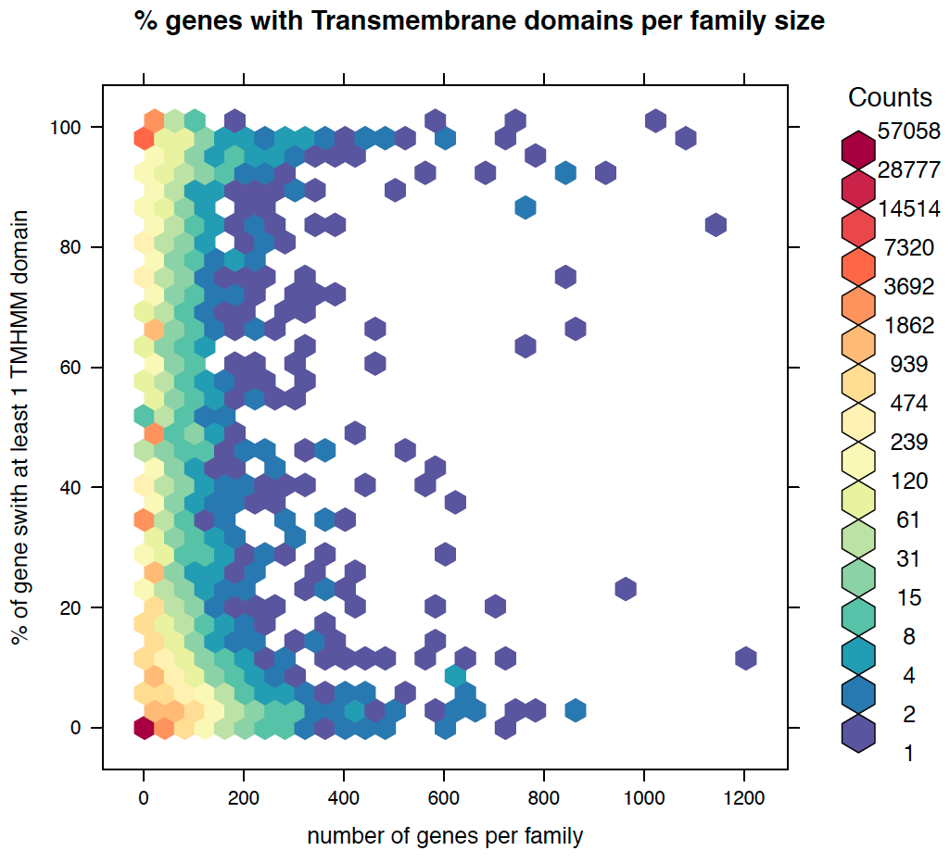
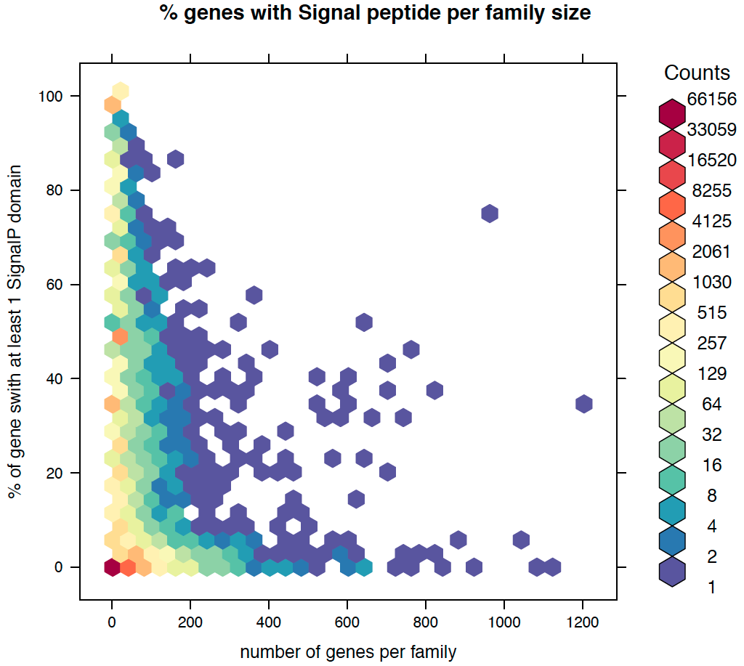
Distributions
% Genes with domains, per family size
Pfam
TMHMM
SignalP
Note: excluding outgroups

Slide 7
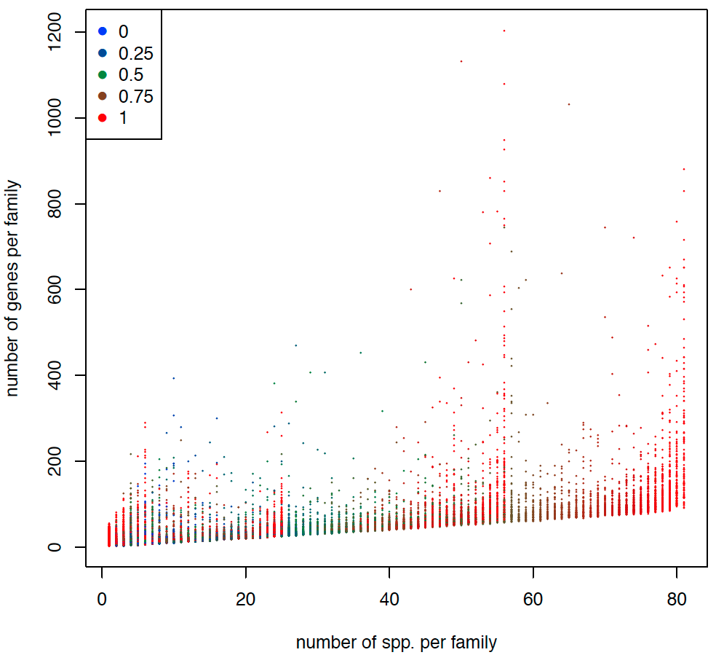
Species Completeness Score
Proportion of species present in family, regarding root of tree.
Useful to identify expansions.
Red dots -> large and widespread families
Red dots -> taxonomically-restricted large families
Bluish dots -> possible multiple expansions
Red dots -> Universal single-copy genes
#_Platyhelminths (25)
#_Nematodes (56)
Note: excluding outgroups
Notes:
/nfs/users/nfs_d/dr7/git/helminth_scripts_python/scripts/R/missingness_plot.R

Slide 8
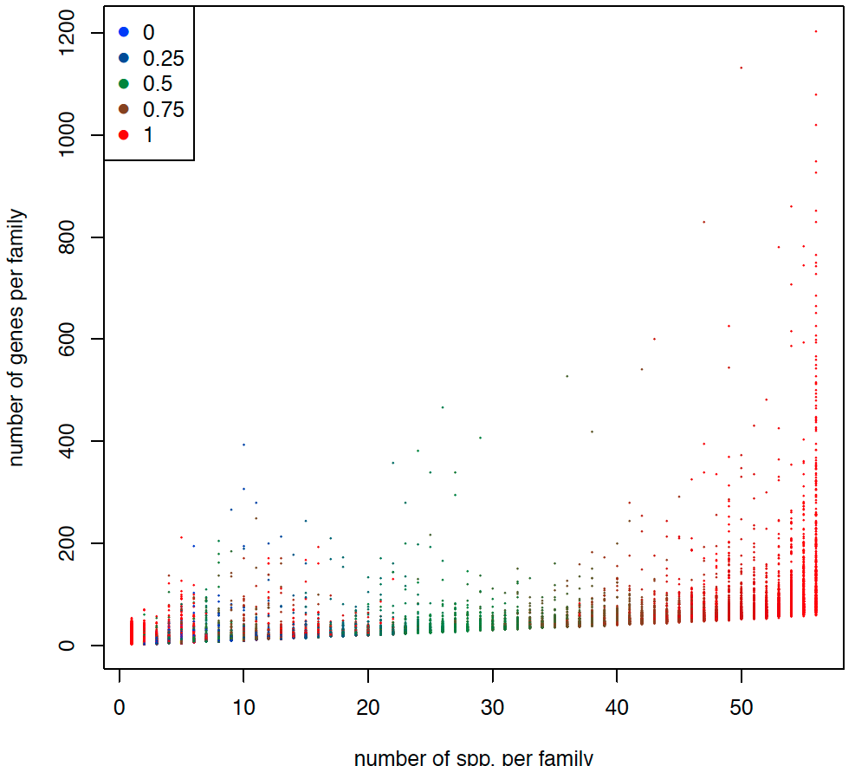
Species Completeness Score
Nematodes only
Red dots -> large and widespread families
Red dots -> taxonomically-restricted large families
Bluish dots -> possible multiple expansions
Red dots -> Universal single-copy genes
Note: excluding outgroups
Notes:
/nfs/users/nfs_d/dr7/git/helminth_scripts_python/scripts/R/missingness_plot.R

Slide 9
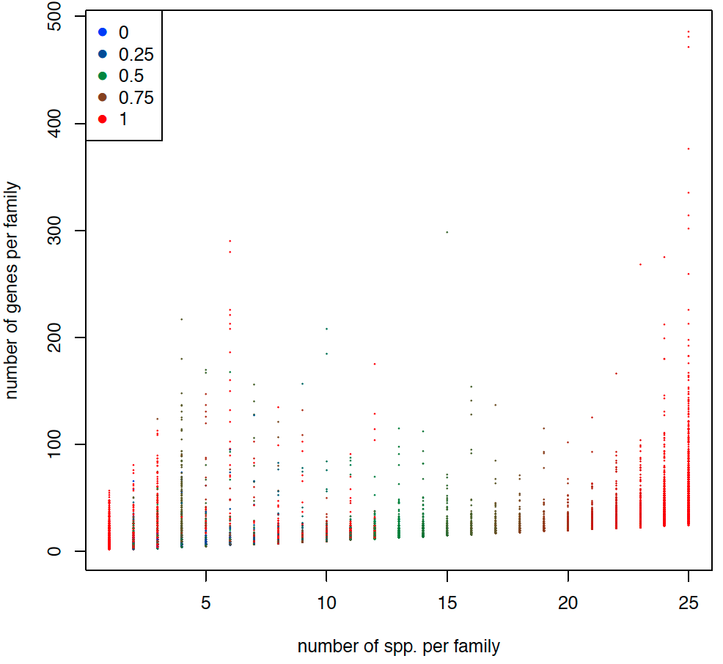
Species Completeness Score
Platyhelminths only
Red dots -> large and widespread families
Red dots -> taxonomically-restricted large families
Bluish dots -> possible multiple expansions
Red dots -> Universal single-copy genes
Note: excluding outgroups
Notes:
/nfs/users/nfs_d/dr7/git/helminth_scripts_python/scripts/R/missingness_plot.R

Slide 10
Measures
familyID -> internal Compara family identifier
Flag -> whether this family should be excluded from analysis (currently from being transposon-related)
#_species -> number of species in each family
#_genes -> number of genes in each family
Mean_genes_per_species -> mean number of genes per species in family
Median_genes_per_species -> median number of genes per species in family
Variation_coefficient_#_genes_per_species -> stdev/mean (of genes per spp)
#_paralogs -> number of paralogs per family = # of genes - # of species
Branch_name -> branch of root of family tree
Completeness_score -> (a.k.a. missingness), % of species (regarding root) present in family
Total_duplications -> total gene duplications in family (compara calculated)
Max_duplications_node -> Species tree node with most duplication events in family
Most_frequent_species -> Species with the highest number of genes in family
FP_distribution -> Distribution of genes in Free-living helminth species
Total_losses -> total gene losses in family (compara calculated)
Median_branch_length -> Median branch length of the gene tree (Notes: values >1000 filtered out; this is always for the full gene tree)
%_genes_with_Pfam -> % of genes in family with at least one pfam domain
%_genes_with_TMHMM -> % of genes in family with at least one TMHMM hit
%_genes_with_SignalP -> % of genes in family with at least one SinalP_EUK hit
Pfam_example -> most common Pfam description, and how many times occurs

Slide 11
A bit of tree mining – part1 (validation)
10 largest families
10 families with higher % TMHMM
10 families with higher % SignalP
Note: excluding outgroups
Filtering: families with > 100 genes
Notes:
/nfs/users/nfs_d/dr7/git/helminth_scripts_python/scripts/R/missingness_plot.R

Slide 12
A bit of tree mining – part2
10 largest families without any pfam annotation
10 families with highest mean genes per species (with completeness == 1)
10 largest families composed of only parasitic-species
Note: excluding outgroups
Filtering: families with > 100 genes
Notes:
/nfs/users/nfs_d/dr7/git/helminth_scripts_python/scripts/R/missingness_plot.R

Slide 13
Families of Interest
From Avril (Strongyloides project):
Astacins (found and plotted, list of families with >100 genes)
SCP/TAPS/CAP-domain (SCP/Tpx-I/Ag2/PR-1/Sc7) (did not find any term)
Receptor-type protein tyrosine phosphatase (RPTP) (found ‘tyrosine phosphatase’ but not ‘receptor-type’. Did not produce data.)
Acetylcholinesterase coding genes (did not find)
Speckle-type POZ protein-like coding genes (found and plotted BTB/POZ domain, is this what we want?)
GPCR/Serpentine/7TM/7 transmembrane receptor (found and plotted, list of families with > 100 genes)
Other categories:
All families with > 100 genes (done)
Most variable families (done for top 20)
Largest families (done for top 50, all-species, nematode-only, platyhelminth-only)
Families with signal peptide (done for top 20)

Slide 14
Script to create heatmap of gene presence (of certain families) throughout 50HG species
usage: comparaHeatmapWrapper.py
Plotting suite for exploring Compara families.
positional arguments:
comparaFamilies Flat file. Compara families file. One family per line,
list of genes/species. Output from
get_all_50HG_families_v75.pl.
familiesOfInterest TSV file. One family per line, first column is
familyID, second column the text one wants to use for
it. E.g. 34467 586X:Lipase (class 3);
cladeFile TSV file. One line per species, first column species
name as in comparaFamilies, second column the clade
name/number, third column either Parasitic or
Freeliving. E.g. loa_loa III Parasitic
speciesTree Species tree in newick format, with branch lengths.
The species of interest will come from this tree. Will
also be used for R dendrogram. Output from
get_species_tree_v75.pl.
outputTag Basename of output files that will be created. Should
be unique each time you run.
optional arguments:
-h, --help show this help message and exit
--verbose verbose Verbose mode (1 = Yes, 0 = No).
--logScale logScale Whether to use log scale or not. If 0 (default), no
scaling performed. If 1, use natural logarithm (ln).
If >1, value is base to use.
--plotTitle plotTitle
Title to apply to plot.
--dendrogram dendrogram
Draw or not dendrograms. Values must be of these:
none, row, col, both. Default = col.
--rowMargin rowMargin
Size of plot right margin. Increase to give more space
to row text. Default is 14.
--scriptsPath scriptsPath
Where to find the scripts. The R script will be in
subfolder "R/ComparaPlots" Default = /nfs/users/nfs_d/
dr7/git/helminth_scripts_python/scripts
- A python script (to prepare data) and a R script (to plot data) wrapped together.
- Runs within seconds, low memory consumption
- Accepts any number of families.
- Accepts any number of species (but species tree needs to be provided).
- Option to log-transform data.
- Option to plot dendrograms (dist/hclust clustering).
Issues:
Still some R plotting issues to solve (black bars)!
Category coloring currently hard-coded for clades

Slide 15
Astacins
Total 2888 astacins spread over 9 families (there is 3 more astacin genes in other non-astacin families)
650 mostly strongyloides-related astacins (in 4 families)
Note: looking at families with < 100 genes: 16 other families with between 25 and 100 genes, where majority of pfam is Astacin
Zoom on pfam domain combinations:
Note: excluding outgroups
Filtering: families with > 100 genes

Slide 16
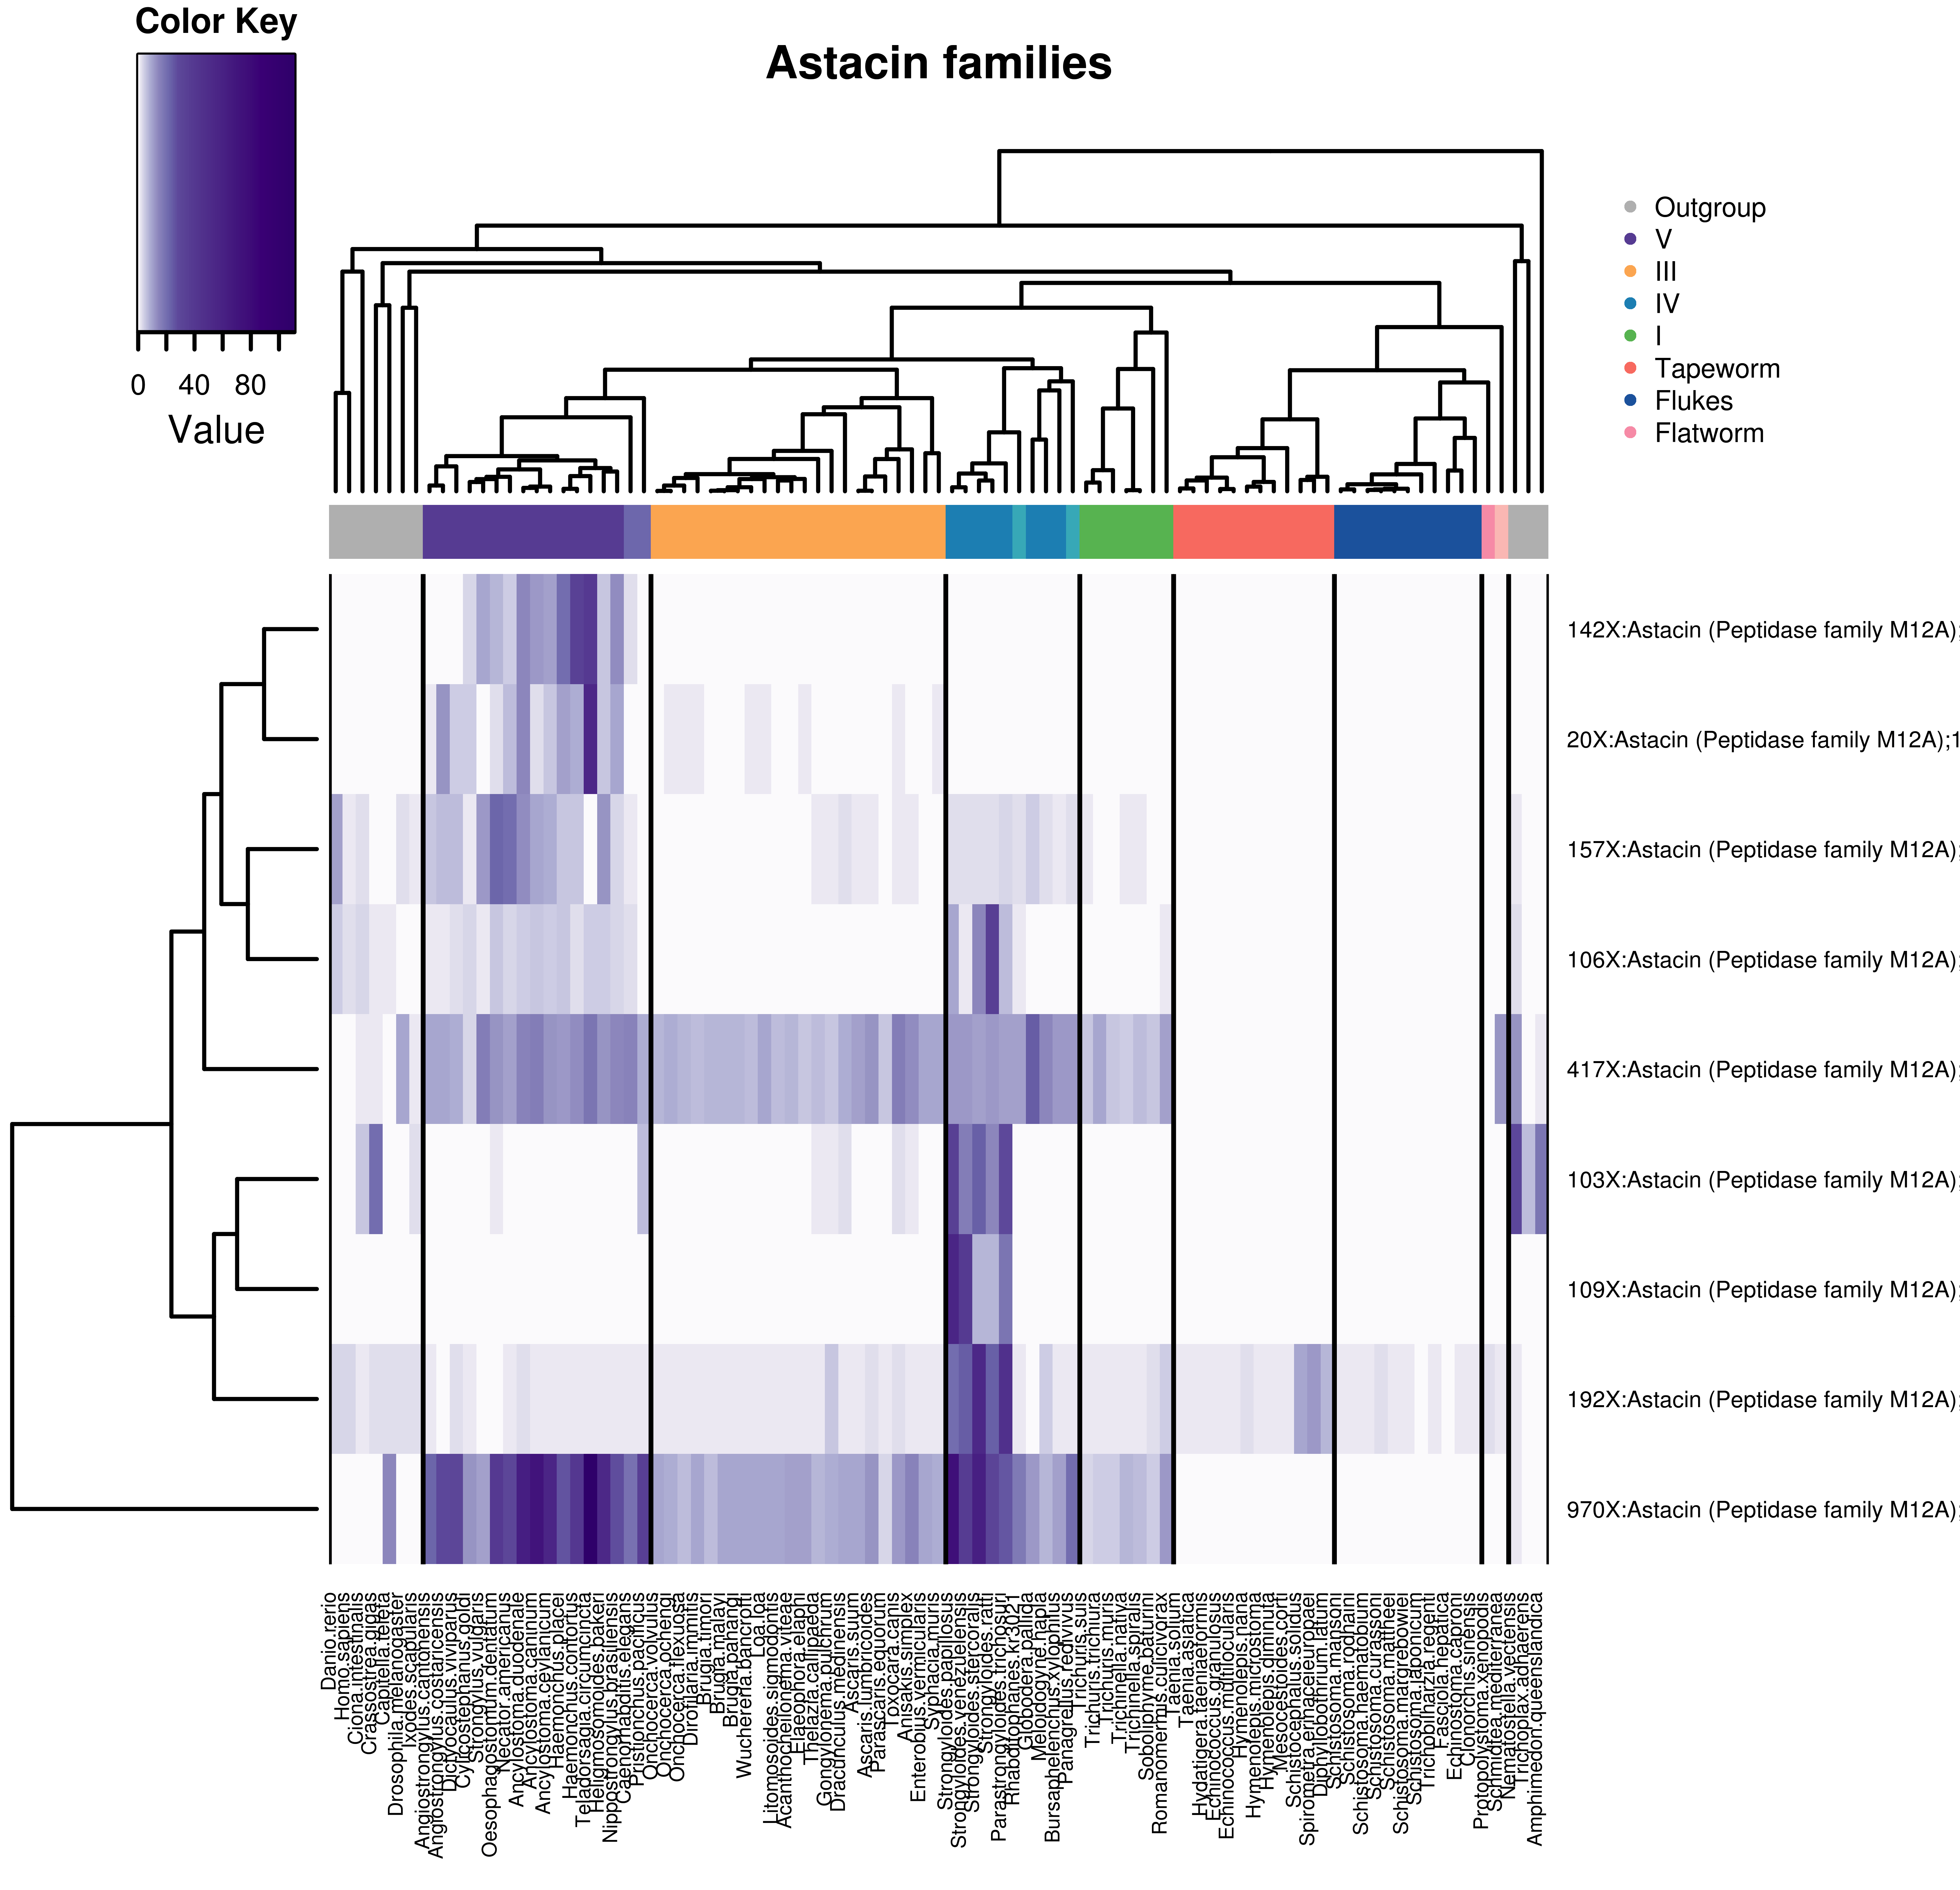
Astacins – all species
Families with > 100 genes where there is at least 5 “Astacin” domains
Column dendrogram -> species tree
Row dendrogram -> distfun = dist, hclustfun = hclust
Species coloring -> dark colors = parasitic, lighter colors = free-living
Scale -> plain values
Filtering: families with > 100 genes

Slide 17
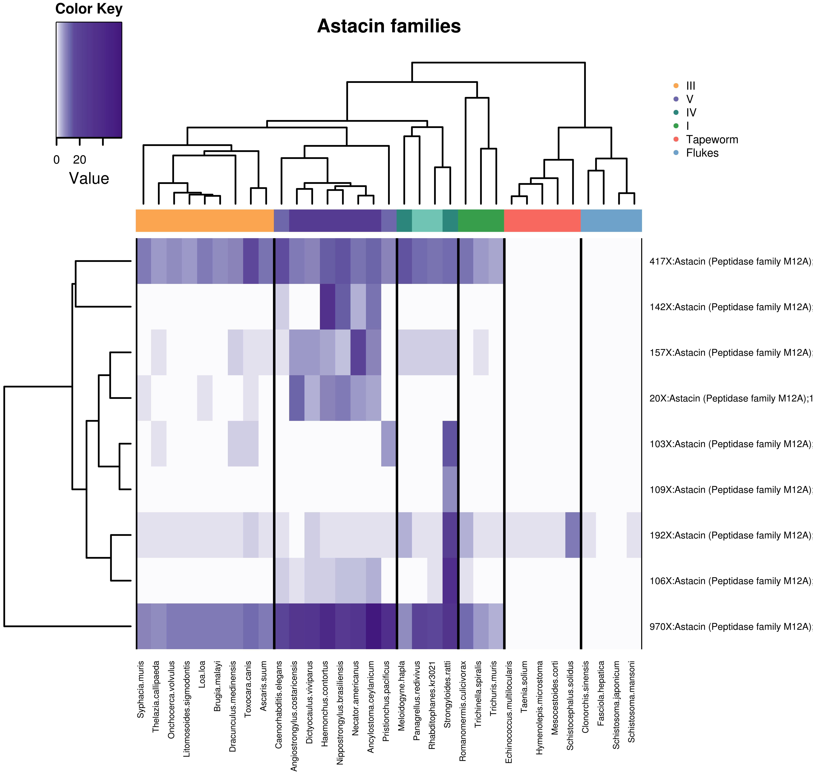
Astacins – 33 species
Families with > 100 genes where there is at least 5 “Astacin” domains
Column dendrogram -> species tree
Row dendrogram -> distfun = dist, hclustfun = hclust
Species coloring -> dark colors = parasitic, lighter colors = free-living
Scale -> plain values
Note: the table and pfam frequencies relate to the full set of species
Filtering: families with > 100 genes

Slide 18
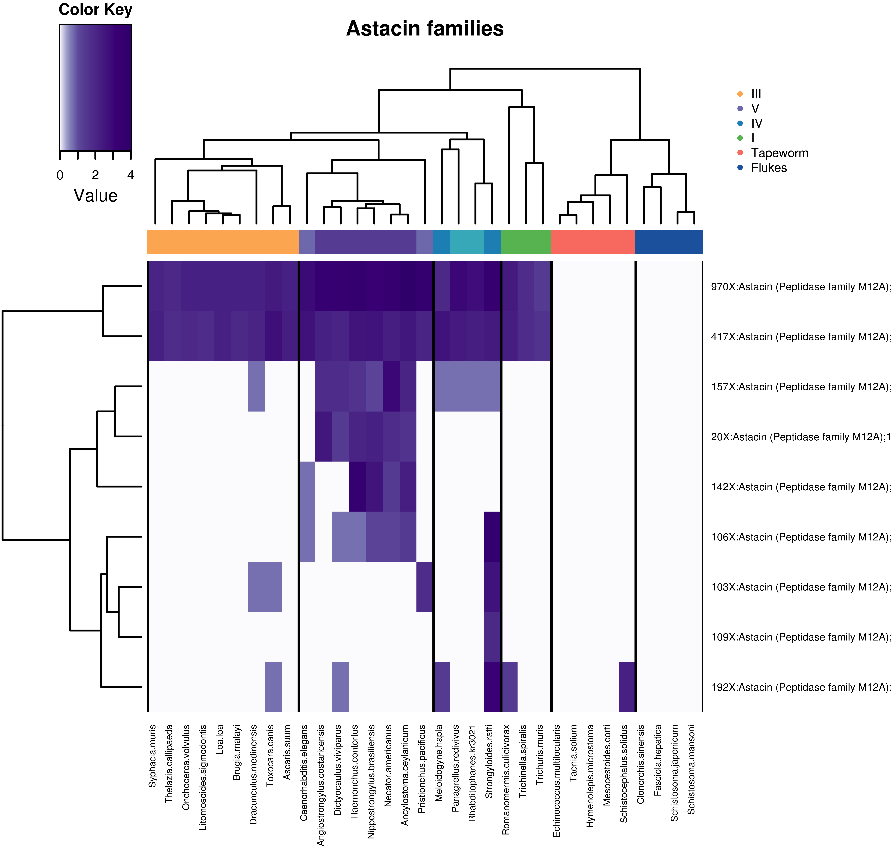
Astacins – 33 species - log
Families with > 100 genes where there is at least 5 “Astacin” domains
Column dendrogram -> species tree
Row dendrogram -> distfun = dist, hclustfun = hclust
Species coloring -> dark colors = parasitic, lighter colors = free-living
Scale -> natural log
Note: the table and pfam frequencies relate to the full set of species
Filtering: families with > 100 genes

Slide 19
Astacins – GO term enrichment
Picking 2883 ‘astacin’ genes from the 9 Compara families (using all species except outgroups)
Using Adam’s R TopGO wrapper script, against all genes with GO terms (excl outgroup spp) in the Compara database (~672K genes)
BP
file | id | term | ann | sig | exp | p
clust1 | GO:0006508 | proteolysis | 29783 | 2610 | 168.06 | < 1e-30
clust1 | GO:0007389 | pattern specification process | 5178 | 225 | 29.22 | < 1e-30
clust1 | GO:0032502 | developmental process | 84566 | 406 | 477.18 | < 1e-30
clust1 | GO:0048518 | positive regulation of biological proces... | 32003 | 277 | 180.58 | 2.10E-14
clust1 | GO:0009653 | anatomical structure morphogenesis | 32249 | 277 | 181.97 | 5.70E-13
MF
file | id | term | ann | sig | exp | p
clust1 | GO:0004222 | metalloendopeptidase activity | 7752 | 2593 | 35.98 | < 1e-30
clust1 | GO:0008270 | zinc ion binding | 34336 | 2136 | 159.37 | < 1e-30
clust1 | GO:0008233 | peptidase activity | 26406 | 2619 | 122.56 | < 1e-30
clust1 | GO:0008237 | metallopeptidase activity | 10889 | 2604 | 50.54 | 4.40E-17
CC
file | id | term | ann | sig | exp | p
clust1 | GO:0005615 | extracellular space | 3830 | 3 | 0.12 | 0.00019
Exp > Sig??
Relevant line of code:
runTest(GOdata,algorithm="weight01",statistic="Fisher")
Filtering: families with > 100 genes

Slide 20
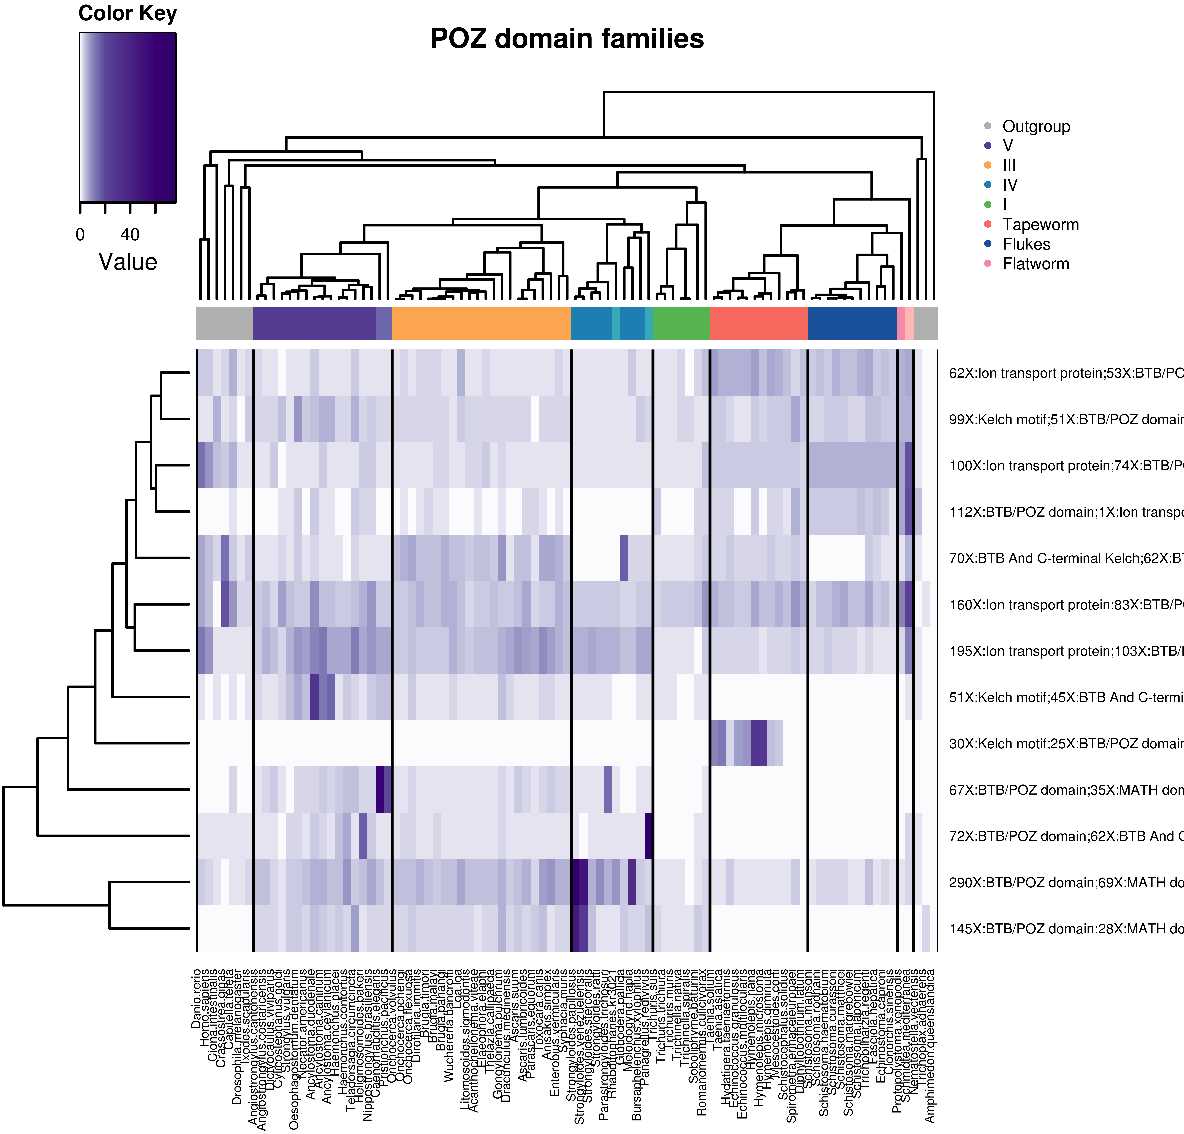
BTB/POZ domain – all species
Families with > 100 genes where there is at least 5 “BTB/POZ” domains
Column dendrogram -> species tree
Row dendrogram -> distfun = dist, hclustfun = hclust
Species coloring -> dark colors = parasitic, lighter colors = free-living
Scale -> plain values
Filtering: families with > 100 genes
Notes:
The BTB/POZ domain is a common structural domain contained within some proteins.
The BTB (for BR-C, ttk and bab)^{[2]} or POZ (for Pox virus and Zinc finger)^{[3]} domain is present near the N-terminus of a fraction of zinc finger proteins and in proteins that contain the Kelch motif and a family of pox virus proteins. The BTB/POZ domain mediates homomeric dimerisation and in some instances heteromeric dimerisation.^{[3]}
The Kelch motif is a region of protein sequence found widely in proteins from bacteria and eukaryotes.^{[2]} This sequence motif is composed of about 50 amino acid residues which form a structure of a four stranded beta-sheet "blade". This sequence motif is found in between six and eight copies per protein which fold together to form a larger circular solenoid structure called a beta-propeller domain.
The MATH domain, in molecular biology, is a binding domain that was defined originally by a region of homology between otherwise functionally unrelated domains, the intracellular TRAF-C domains of TRAF proteins and a C-terminal region of extracellular meprins A and B. Meprins are mammalian tissue-specific metalloendopeptidases of the astacin family implicated in developmental, normal and pathological processes by hydrolysing a variety of proteins.

Slide 21
GPCR families – all species
Search terms: “Serpentine”; “7 transmembrane”
Filtering: families with > 100 genes

Slide 22
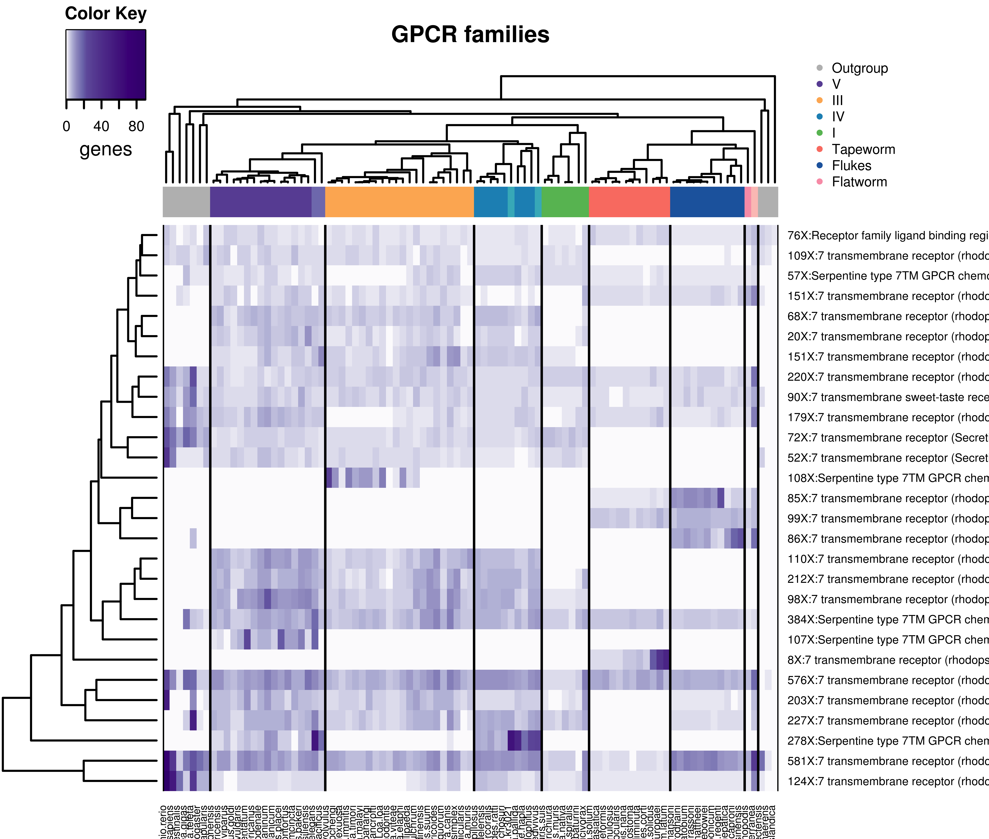
GPCR families – all species
Column dendrogram -> species tree
Row dendrogram -> distfun = dist, hclustfun = hclust
Species coloring -> dark colors = parasitic, lighter colors = free-living
Scale -> plain values
Families with > 100 genes where there is at least 5 “Serpentine” or “7 transmembrane” domains
R graphics problems
Filtering: families with > 100 genes
Notes:
G protein–coupled receptors (GPCRs), also known as seven-transmembrane domain receptors, 7TM receptors, heptahelical receptors, serpentine receptor, and G protein–linked receptors (GPLR), constitute a large protein family of receptors that sense molecules outside the cell and activate inside signal transduction pathways and, ultimately, cellular responses. They are called seven-transmembrane receptors because they pass through the cell membrane seven times.^{[2]}

Slide 23
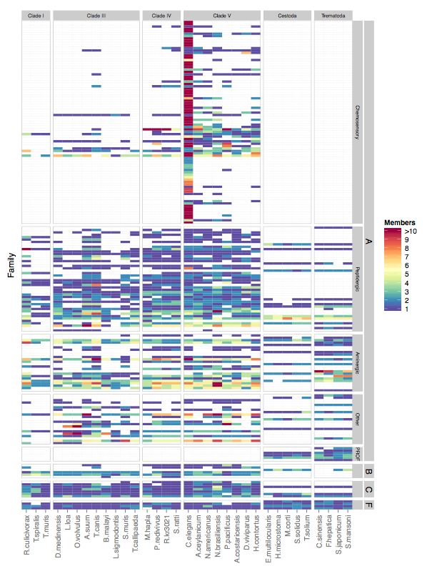
Nic Wheeler’s GPCR Summary Statistics
Image from 10-Apr-2015
24-Feb-2015 (“From old email”)
Species analyzed: 33
Total GPCRs: 5686
Total GPCR families: 197
Class A (Rhodopsin-like) families/members: 179/5185
Class B (Secretin-like) families/members: 6/132
Class C (Glutamate-like) families/members: 8/256
Class F (Frizzled) families/members: 4/112
Notes:
The BTB/POZ domain is a common structural domain contained within some proteins.
The BTB (for BR-C, ttk and bab)^{[2]} or POZ (for Pox virus and Zinc finger)^{[3]} domain is present near the N-terminus of a fraction of zinc finger proteins and in proteins that contain the Kelch motif and a family of pox virus proteins. The BTB/POZ domain mediates homomeric dimerisation and in some instances heteromeric dimerisation.^{[3]}
The Kelch motif is a region of protein sequence found widely in proteins from bacteria and eukaryotes.^{[2]} This sequence motif is composed of about 50 amino acid residues which form a structure of a four stranded beta-sheet "blade". This sequence motif is found in between six and eight copies per protein which fold together to form a larger circular solenoid structure called a beta-propeller domain.
The MATH domain, in molecular biology, is a binding domain that was defined originally by a region of homology between otherwise functionally unrelated domains, the intracellular TRAF-C domains of TRAF proteins and a C-terminal region of extracellular meprins A and B. Meprins are mammalian tissue-specific metalloendopeptidases of the astacin family implicated in developmental, normal and pathological processes by hydrolysing a variety of proteins.

Slide 24
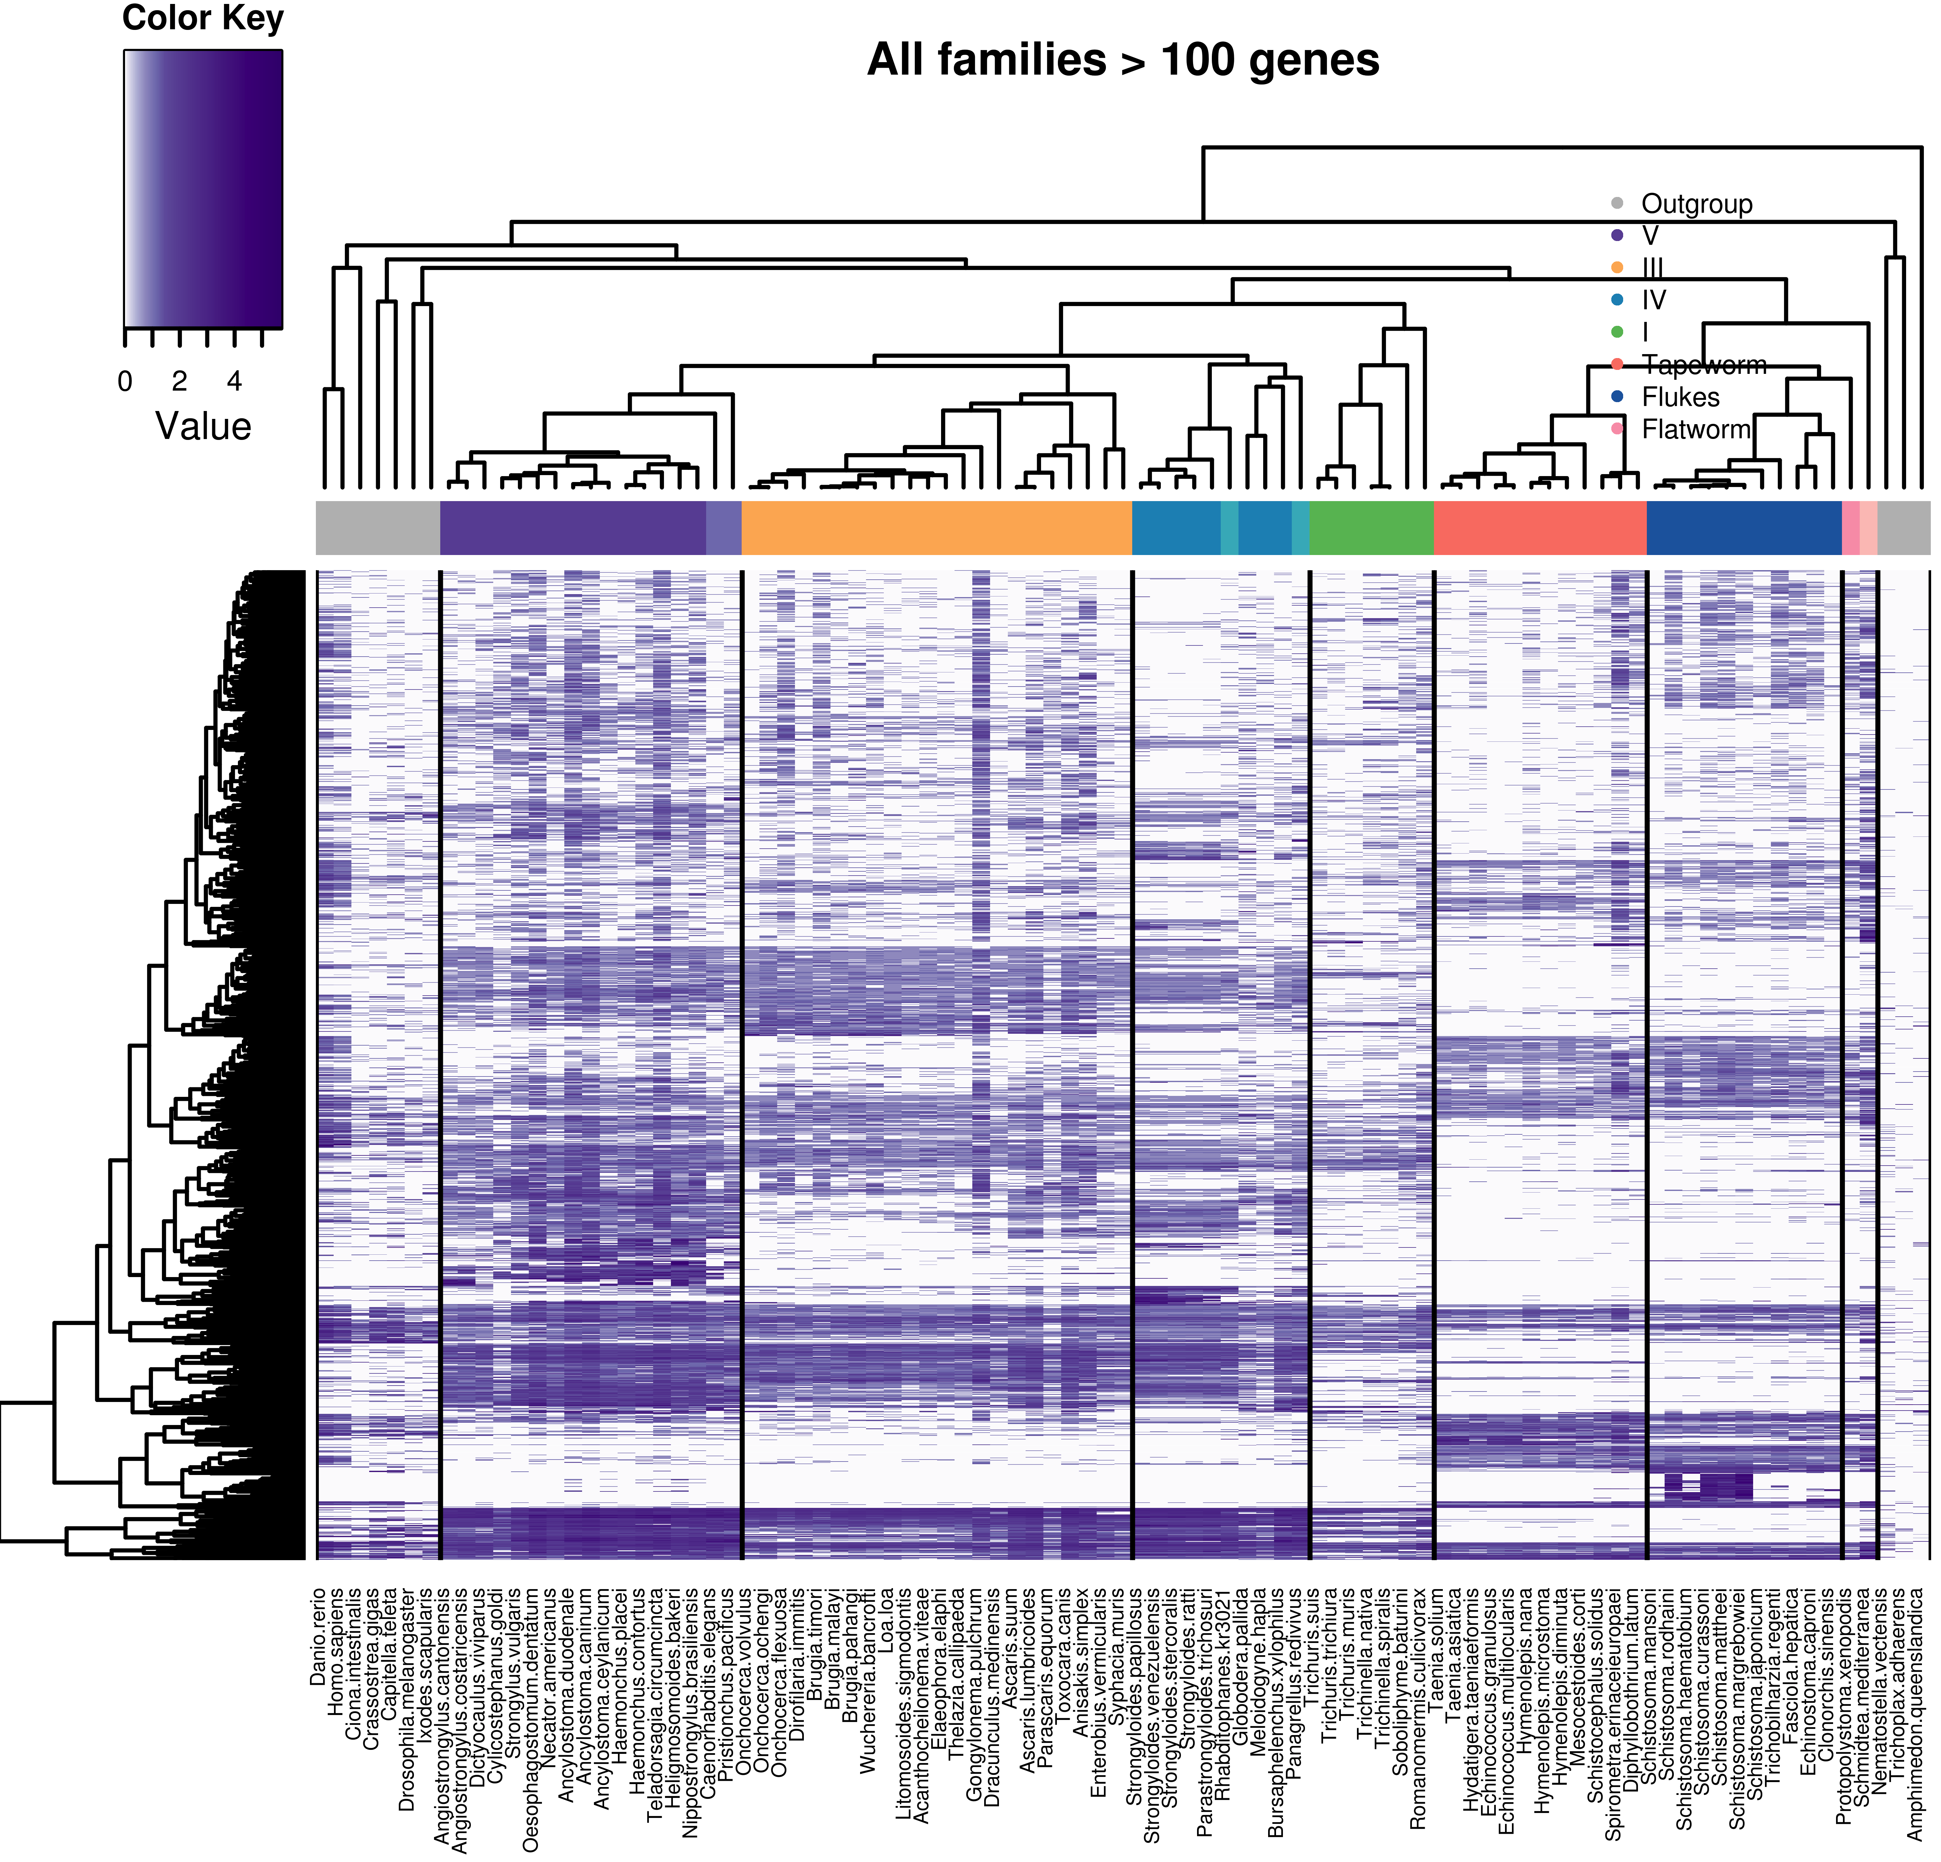
Top 50 families – all species
All families with more than 100 genes (1655 families)
Column dendrogram -> species tree
Row dendrogram -> distfun = dist, hclustfun = hclust
Species coloring ->
dark colors = parasitic
lighter colors = free-living
Scale -> natural log

Slide 25
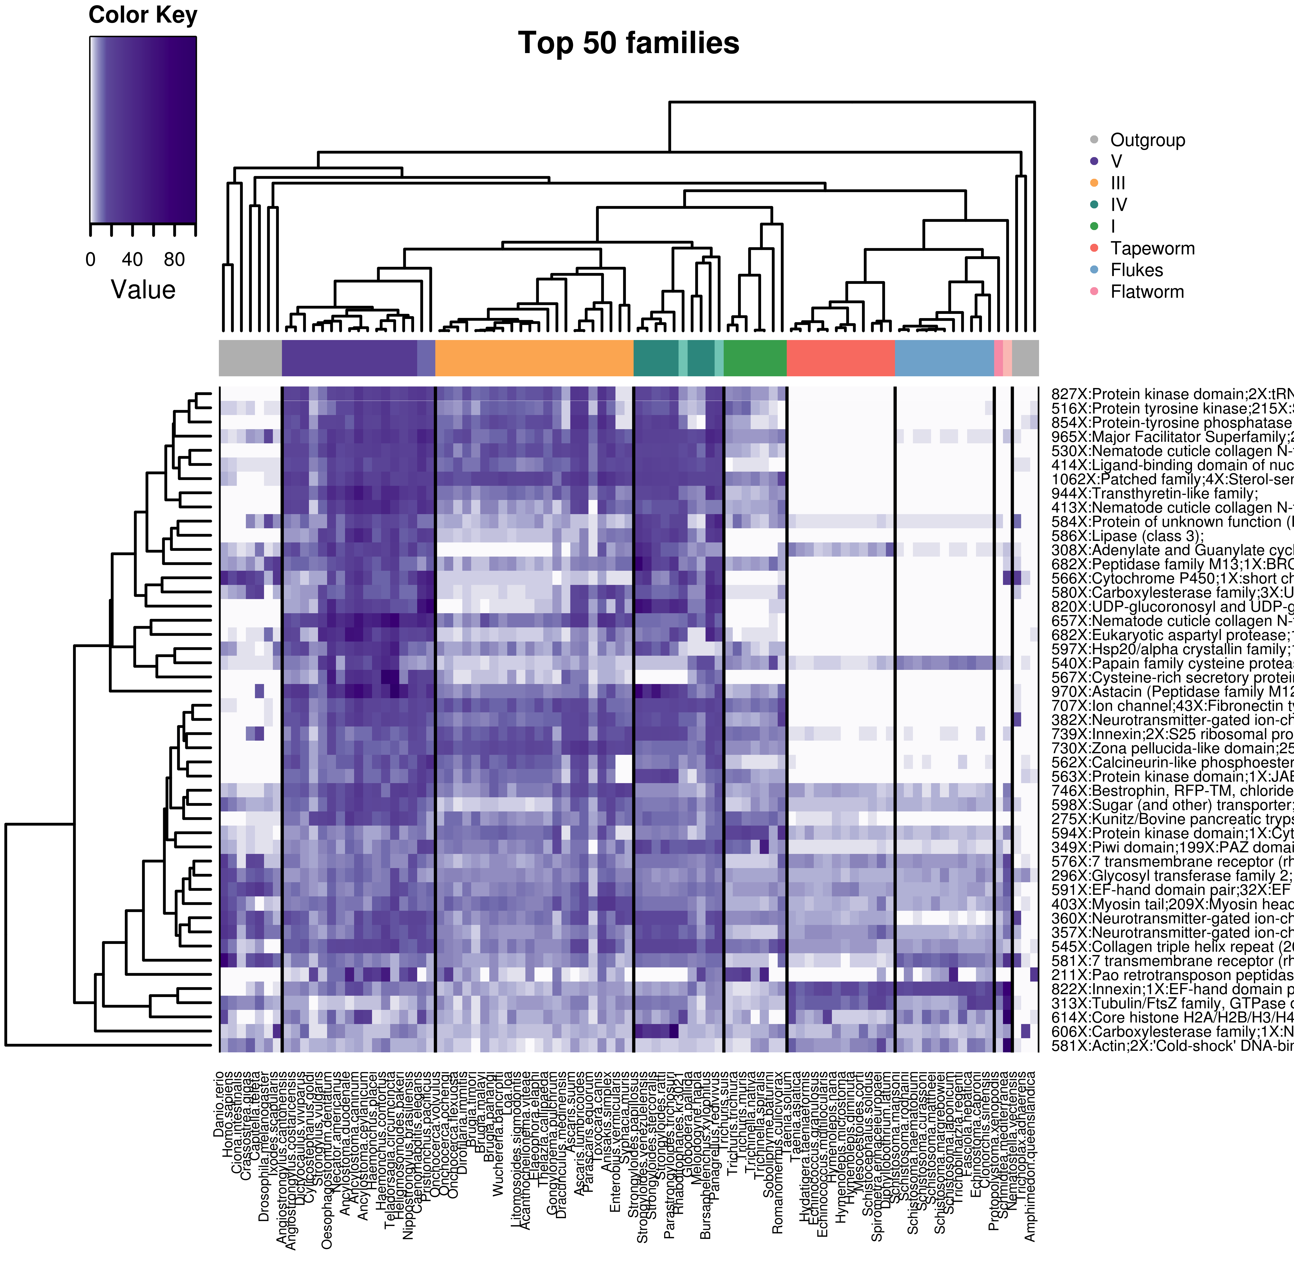
Top 50 families – all species
Column dendrogram -> species tree
Row dendrogram -> distfun = dist, hclustfun = hclust
Species coloring ->
dark colors = parasitic
lighter colors = free-living
Scale -> plain values
Filtering: families with > 100 genes
Notes:
Tubulin→ resistance against benzimidazole (BZ) drugs in the parasitic nematode Haemonchus contortus.
Papain→ Parasitic Papain-Like Cysteine Proteases: Their Role in Physiology and Pathology and Recent Developments in Inhibitor Design

Slide 26
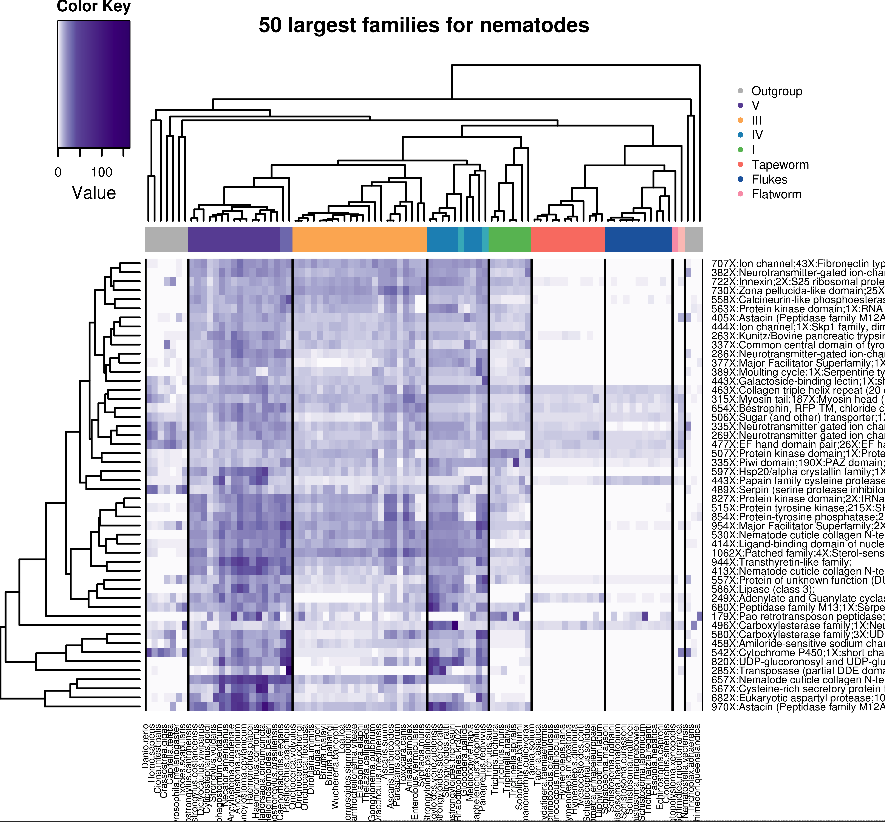
Top 50 families – all species
50 Largest families for nematodes
Running parser for only nematodes, ranking by family size but then plotting for all species
Column dendrogram -> species tree
Row dendrogram -> distfun = dist, hclustfun = hclust
Species coloring ->
dark colors = parasitic
lighter colors = free-living
Scale -> plain values
Not showing nematode tree because problems reading tree
Filtering: families with > 100 genes

Slide 27
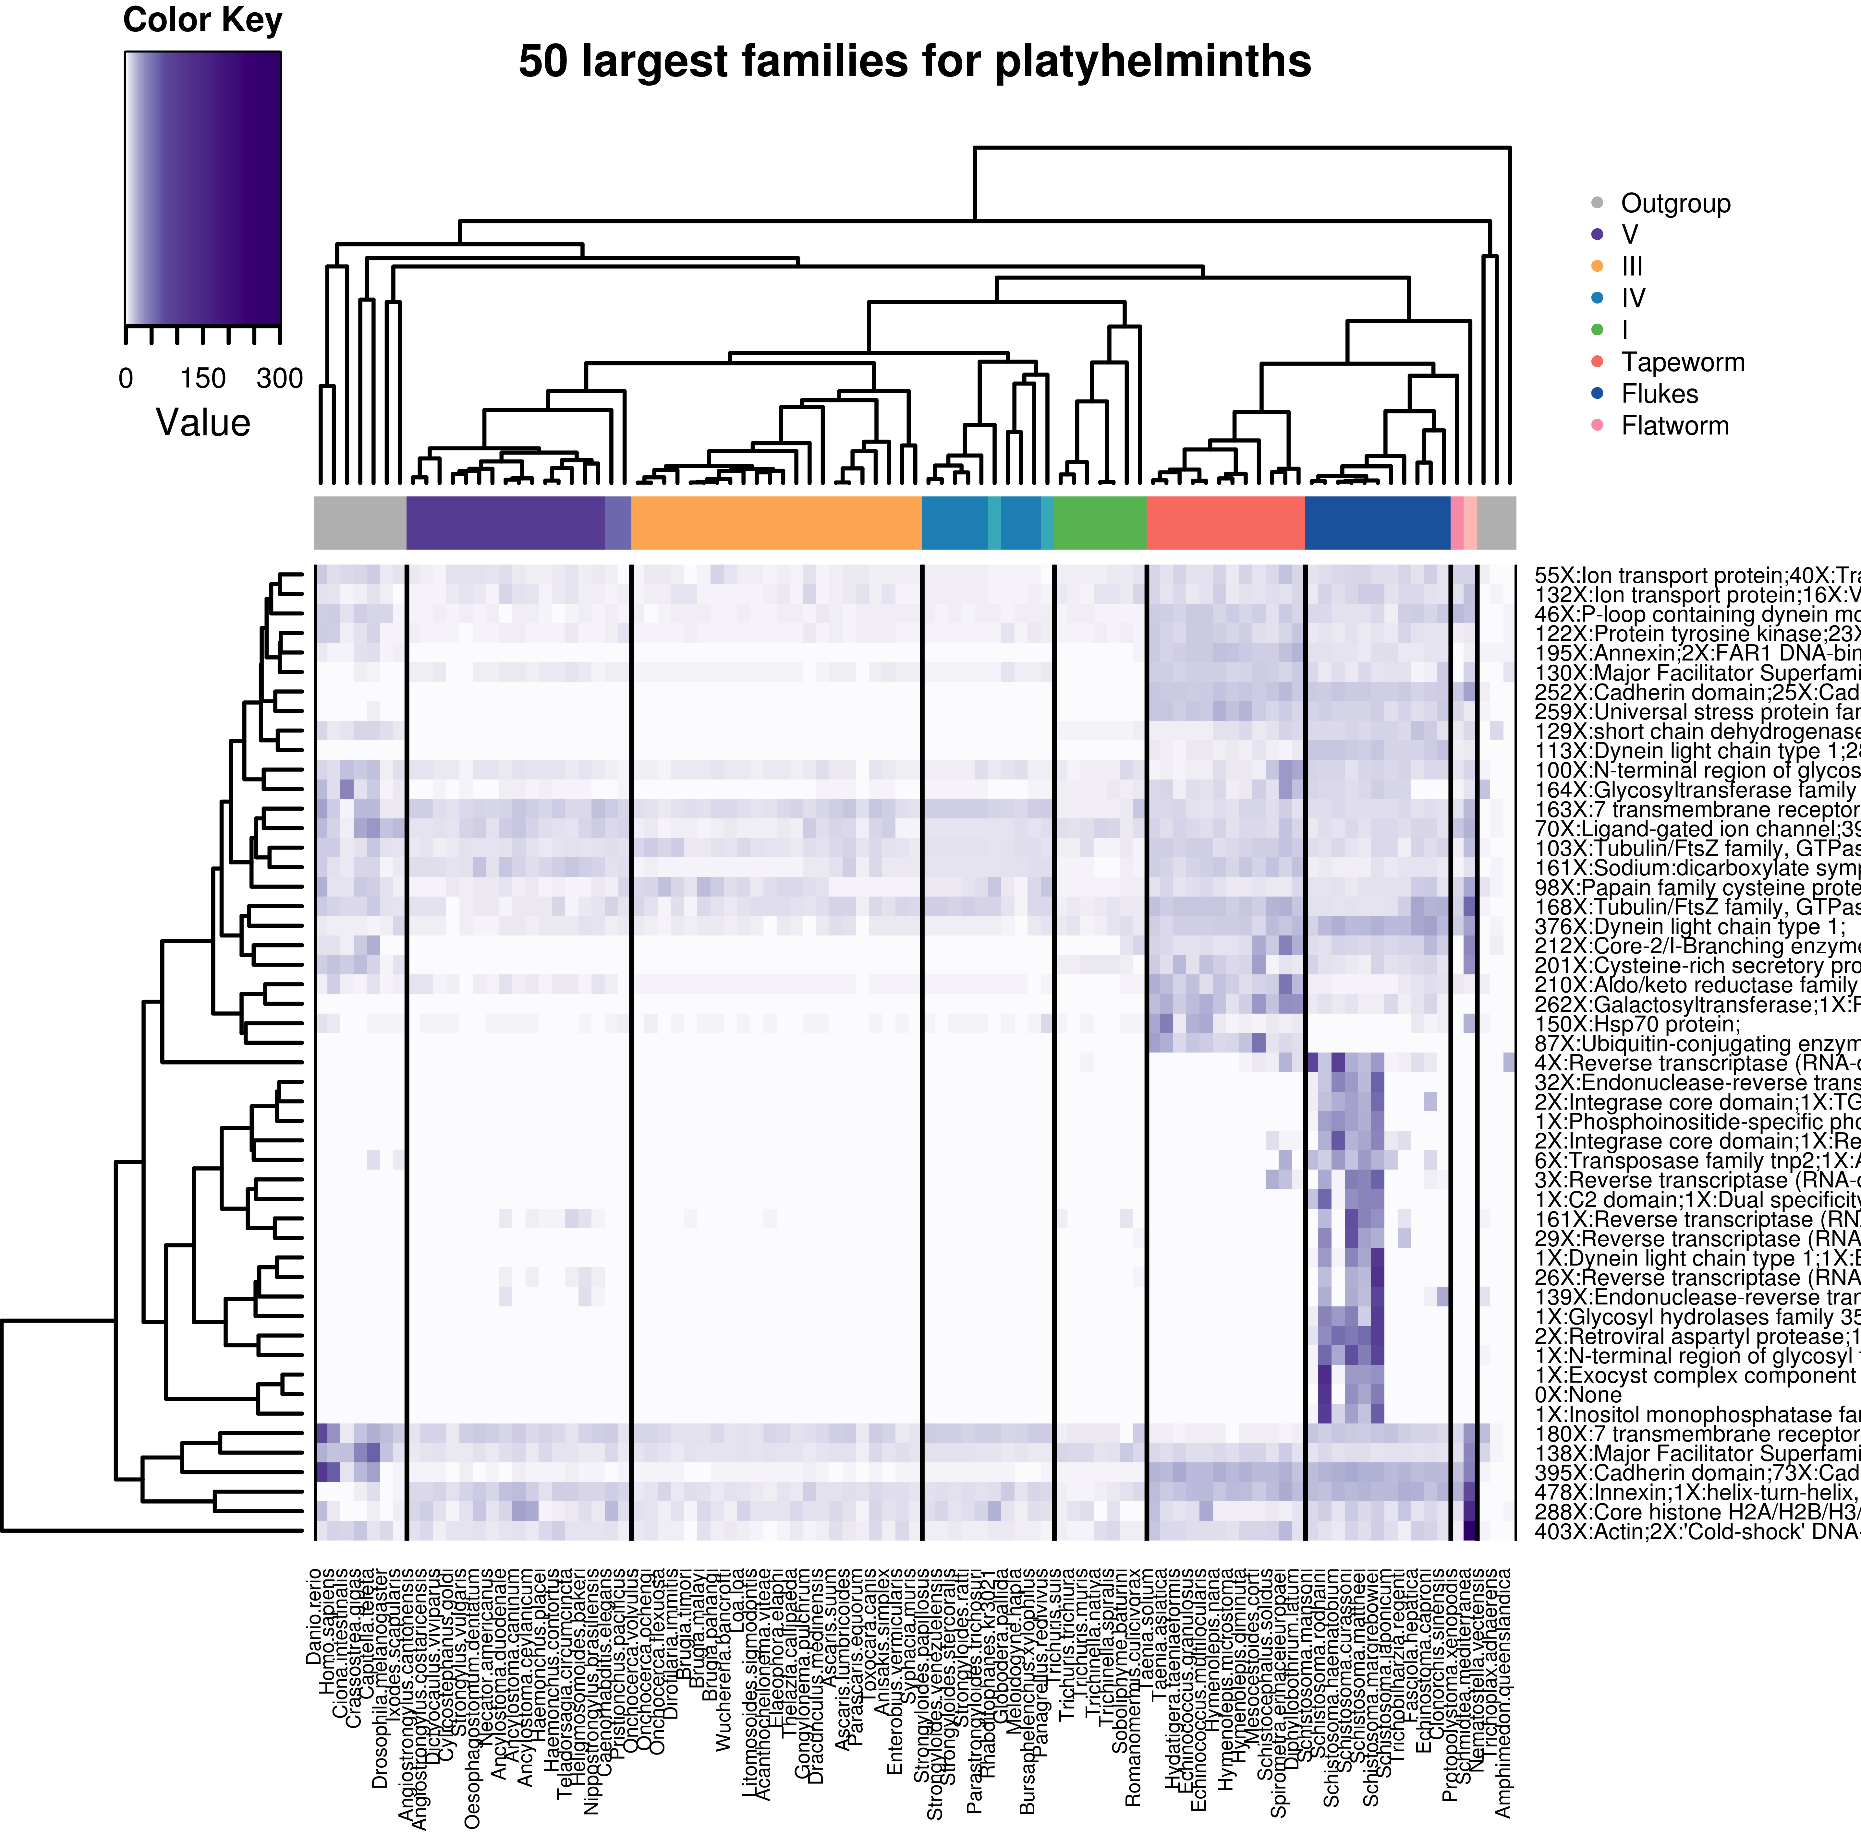
50 Largest families for platyhelminths.
Running parser for only platyhelminths, ranking by family size but then plotting for all species
Column dendrogram -> species tree
Row dendrogram -> distfun = dist, hclustfun = hclust
Species coloring ->
dark colors = parasitic
lighter colors = free-living
Scale -> plain values
Not showing platyhelmiths tree because problems reading tree
Filtering: families with > 100 genes

Slide 28
Top 20 sorted by variation coefficient – 33 species
Filtering: families with > 100 genes

Slide 29
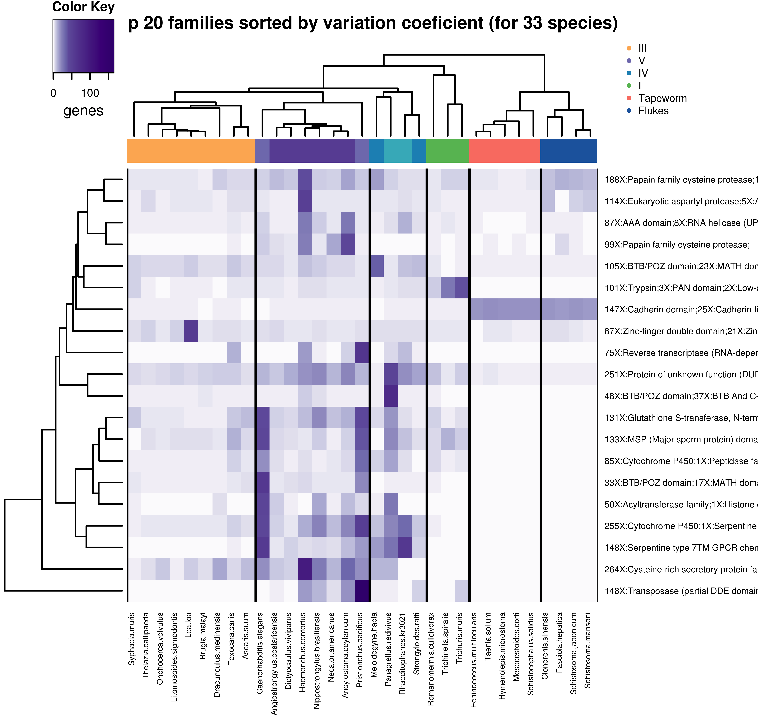
Top 20 sorted by Variation Coefficient – 33 species
Column dendrogram -> species tree
Row dendrogram -> distfun = dist, hclustfun = hclust
Species coloring ->
dark colors = parasitic
lighter colors = free-living
Scale -> plain values
No transposable element filtering yet
Note: used 33 species list here because otherwise 10 out of 20 families come from free-living species (mostly schmidtea)
Filtering: families with > 100 genes

Slide 30
Top 20 sorted by Signal Peptide % – all species
Filtering: families with > 100 genes

Slide 31
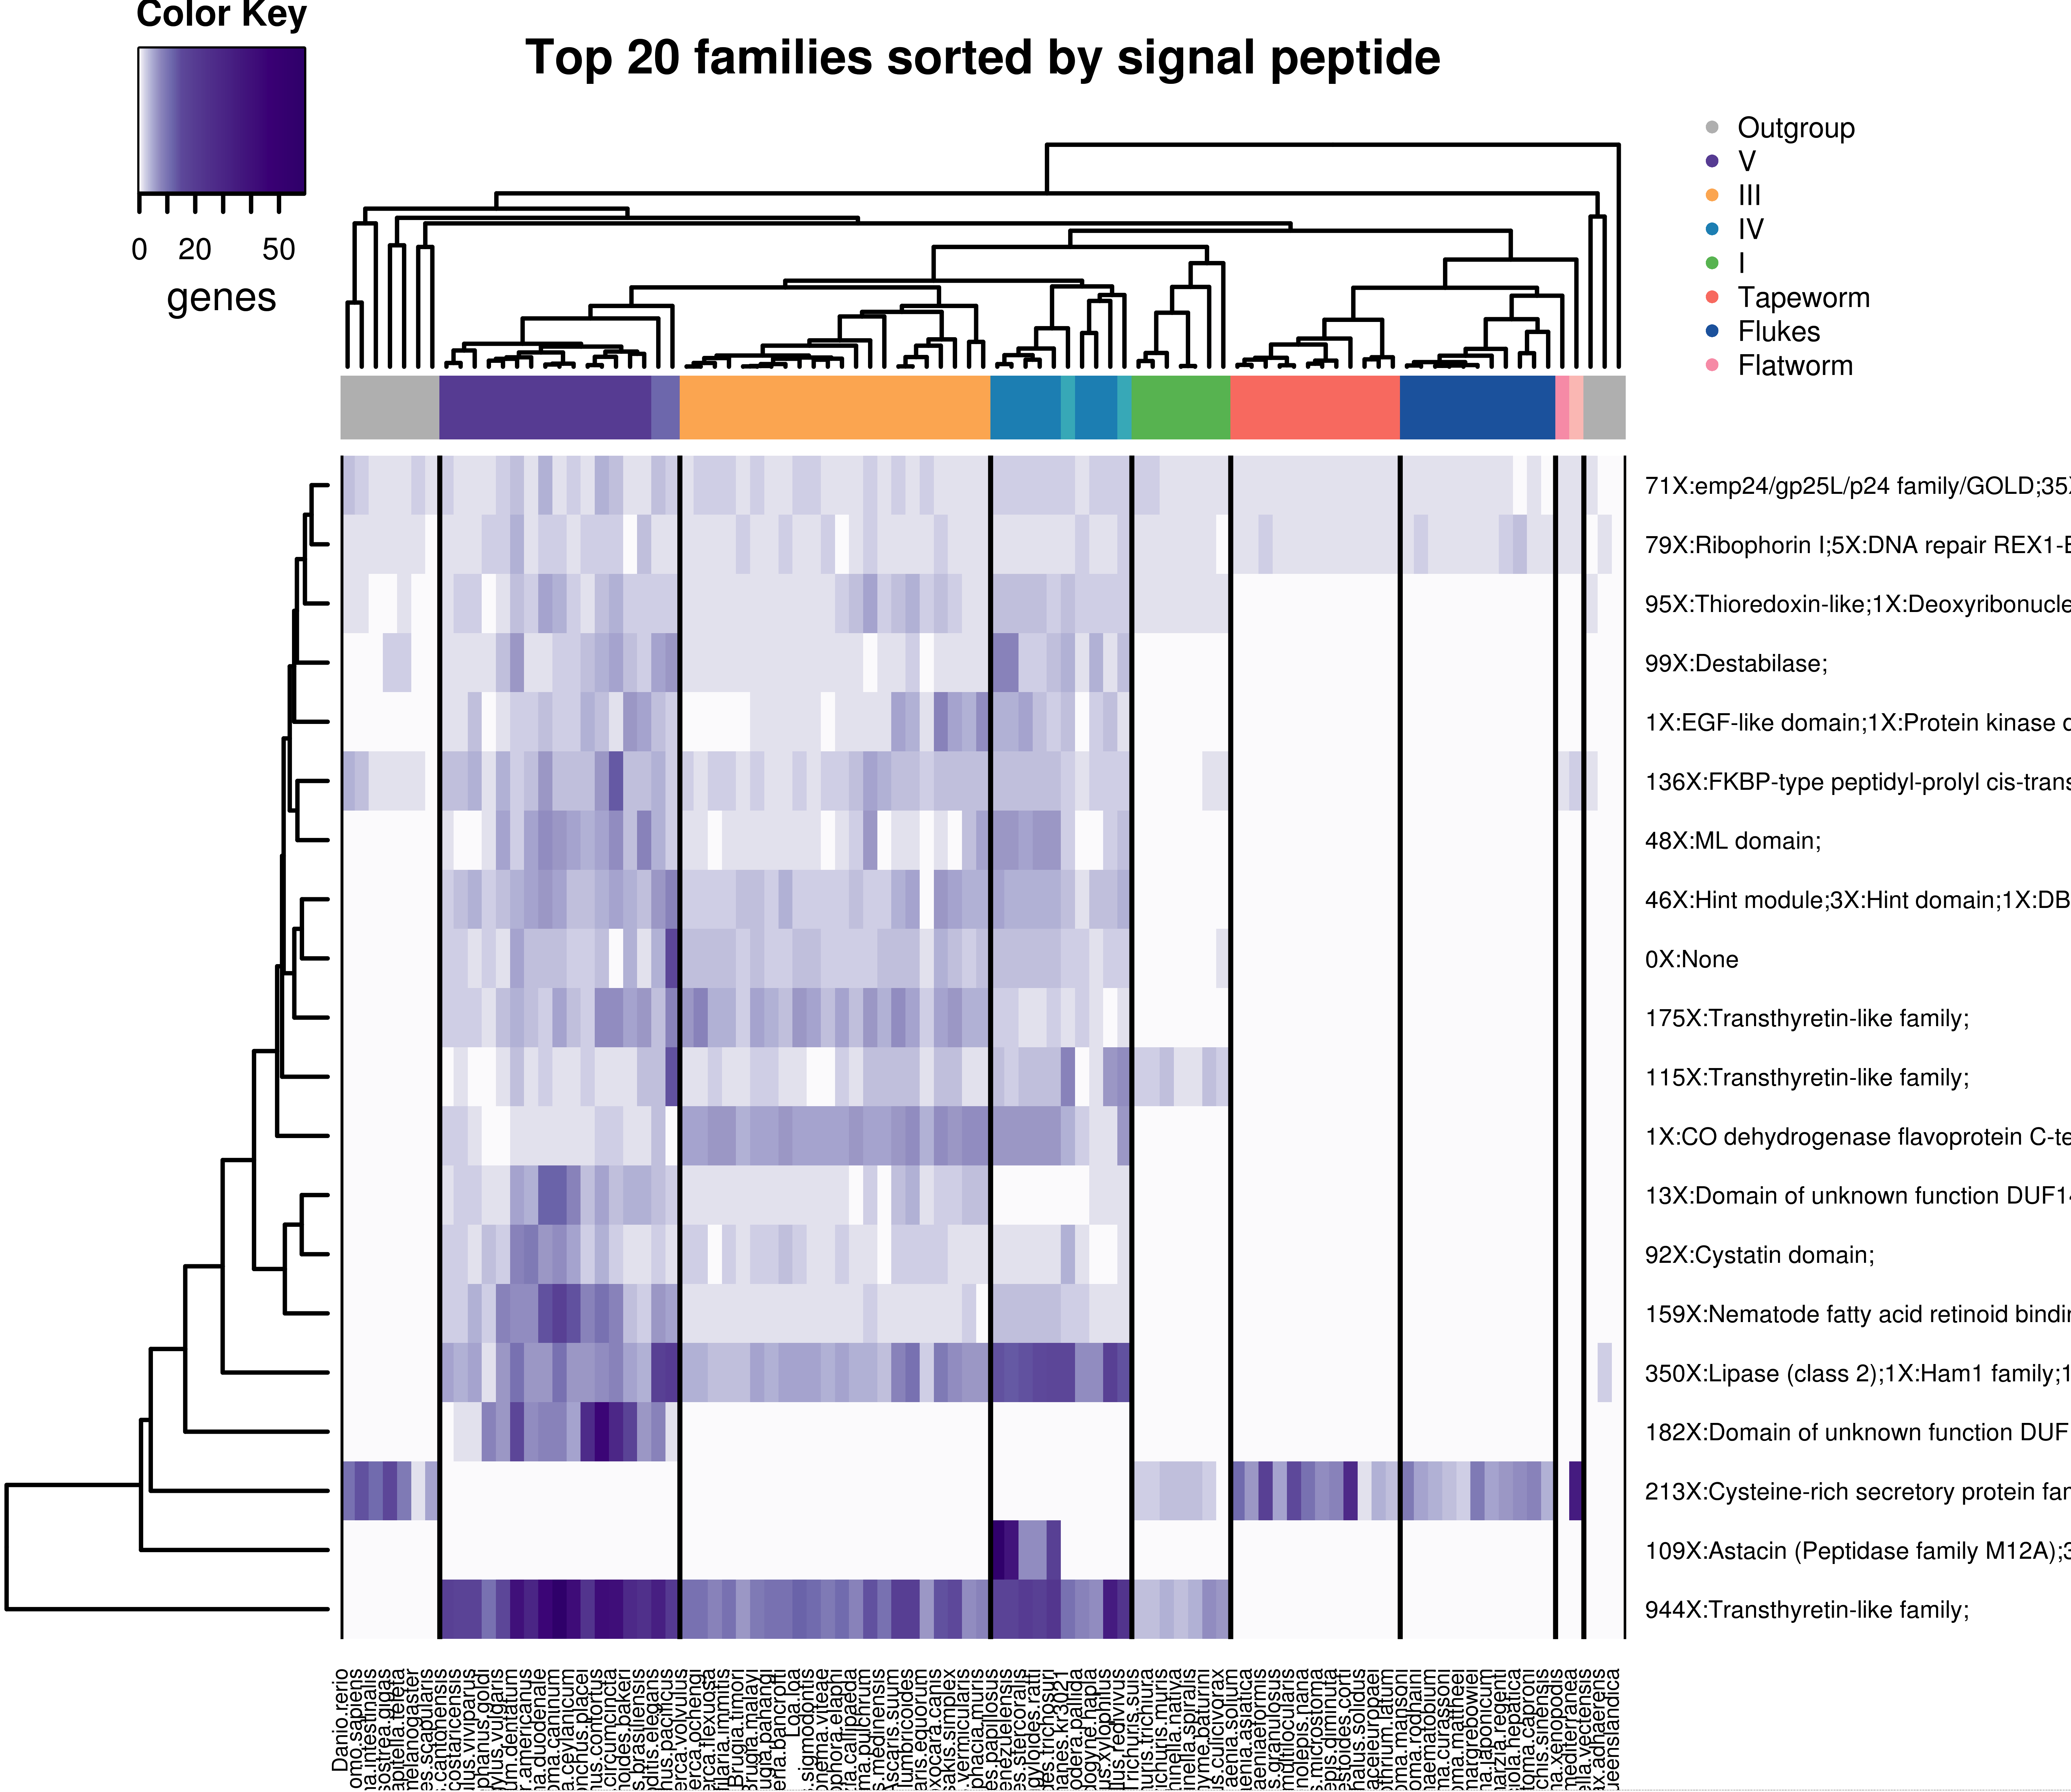
Top 20 sorted by Signal peptide % – all species
Column dendrogram -> species tree
Row dendrogram -> distfun = dist, hclustfun = hclust
Species coloring ->
dark colors = parasitic
lighter colors = free-living
Scale -> plain values
Filtering: families with > 100 genes

Slide 32
Top 20 sorted by Signal peptide % – all species GO term enrichment
BP
file | id | term | ann | sig | exp | p
clust1 | GO:0007030 | Golgi organization | 235 | 109 | 0.33 | < 1e-30
clust1 | GO:0006457 | protein folding | 4906 | 138 | 6.79 | < 1e-30
clust1 | GO:0009967 | positive regulation of signal transducti... | 2200 | 107 | 3.04 | < 1e-30
clust1 | GO:0006486 | protein glycosylation | 4029 | 99 | 5.58 | < 1e-30
clust1 | GO:0006810 | transport | 82534 | 191 | 114.21 | < 1e-30
clust1 | GO:0016539 | intein-mediated protein splicing | 153 | 41 | 0.21 | < 1e-30
clust1 | GO:0051649 | establishment of localization in cell | 19114 | 85 | 26.45 | < 1e-30
clust1 | GO:0006508 | proteolysis | 29783 | 158 | 41.21 | < 1e-30
clust1 | GO:0000003 | reproduction | 14833 | 84 | 20.53 | 2.60E-27
clust1 | GO:0045454 | cell redox homeostasis | 2599 | 20 | 3.6 | 1.40E-09
clust1 | GO:0008152 | metabolic process | 280194 | 446 | 387.72 | 1.40E-06
clust1 | GO:0007154 | cell communication | 62898 | 125 | 87.04 | 0.00012
MF
file | id | term | ann | sig | exp | p
clust1 | GO:0003796 | lysozyme activity | 143 | 99 | 0.28 | <1e-30
clust1 | GO:0008289 | lipid binding | 8913 | 264 | 17.73 | <1e-30
clust1 | GO:0004579 | dolichyl-diphosphooligosaccharide-protei... | 403 | 99 | 0.8 | <1e-30
clust1 | GO:0004869 | cysteine-type endopeptidase inhibitor ac... | 349 | 93 | 0.69 | <1e-30
clust1 | GO:0016787 | hydrolase activity | 107283 | 615 | 213.44 | <1e-30
clust1 | GO:0005215 | transporter activity | 45228 | 108 | 89.98 | <1e-30
clust1 | GO:0004222 | metalloendopeptidase activity | 7752 | 111 | 15.42 | <1e-30
clust1 | GO:0008233 | peptidase activity | 26406 | 163 | 52.53 | <1e-30
clust1 | GO:0004149 | dihydrolipoyllysine-residue succinyltran... | 65 | 2 | 0.13 | 0.0076
CC
file | id | term | ann | sig | exp | p
clust1 | GO:0005615 | extracellular space | 3830 | 1209 | 17.65 | <1e-30
clust1 | GO:0005576 | extracellular region | 11809 | 1310 | 54.43 | <1e-30
clust1 | GO:0005783 | endoplasmic reticulum | 6794 | 99 | 31.31 | <1e-30
Filtering: families with > 100 genes

Slide 33
Receptor-type protein-tyrosine phosphatase
Receptor-type protein-tyrosine phosphatase ζ (PTP-ζ) (19, 20), a cell surface receptor and a chondroitin sulfate (CS) proteoglycan, is highly abundant in the brain (21), primarily expressed on neural progenitors and glial cells (22–24), and binds to and signals through the actions of multiple ligands (25), including the growth factor pleiotrophin (PTN) (26, 27), the cell surface protein contactin (28), and the extracellular matrix (ECM) protein tenascin-R (TN-R) (29). The binding of some of these ligands involves the CS glycosaminoglycan (GAG) moiety of PTP-ζ (26, 30). Ligand binding to PTP-ζ leads to increased tyrosine phosphorylation of downstream targets, including β-catenin, β-adducin, Src family kinases (SFK), focal adhesion kinase (FAK), paxillin, and extracellular signal-regulated kinase-1/2 (Erk-1/2) (31–38). PTP-ζ is up-regulated in many human cancers, including glioblastomas, and regulates their proliferation and migration (39–41). http://www.ncbi.nlm.nih.gov/pmc/articles/PMC3724651/
Receptor-type protein tyrosine phosphatase β (RPTP-β) belongs to the family of RPTPs which have been implicated in cell-cell and cell-matrix interactions [28,29]. RPTP-β, encoded by the ptprb gene, is composed of an extracellular domain with cell adhesion molecule-like motif (multiple fibronectin type 3-like domains), a transmembrane domain, and a single intracellular protein tyrosine phosphatase domain [30,31]. http://www.ncbi.nlm.nih.gov/pmc/articles/PMC3514745/
Protein tyrosine phosphatases are a group of enzymes that remove phosphate groups from phosphorylated tyrosine residues on proteins. Protein tyrosine (pTyr) phosphorylation is a common post-translational modification that can create novel recognition motifs for protein interactions and cellular localization, affect protein stability, and regulate enzyme activity. As a consequence, maintaining an appropriate level of protein tyrosine phosphorylation is essential for many cellular functions. Tyrosine-specific protein phosphatases (PTPase; EC 3.1.3.48) catalyse the removal of a phosphate group attached to a tyrosine residue, using a cysteinyl-phosphate enzyme intermediate. These enzymes are key regulatory components in signal transduction pathways (such as the MAP kinase pathway) and cell cycle control, and are important in the control of cell growth, proliferation, differentiation and transformation.^{[1][2]}

