Slide 1
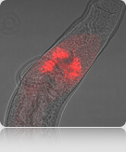
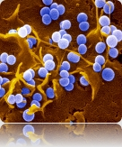
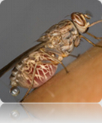
http://www.genedb.org

Slide 2
GeneDB
Database of genomes undergoing active annotation
Shows curated Plasmodium, Trypanosoma and Leishmania genomes
At the beginning of every month, embl files and GFF files of genomes that are being curated are provided on the FTP site
Genomes are regularly sent to EuPathDB

Slide 3
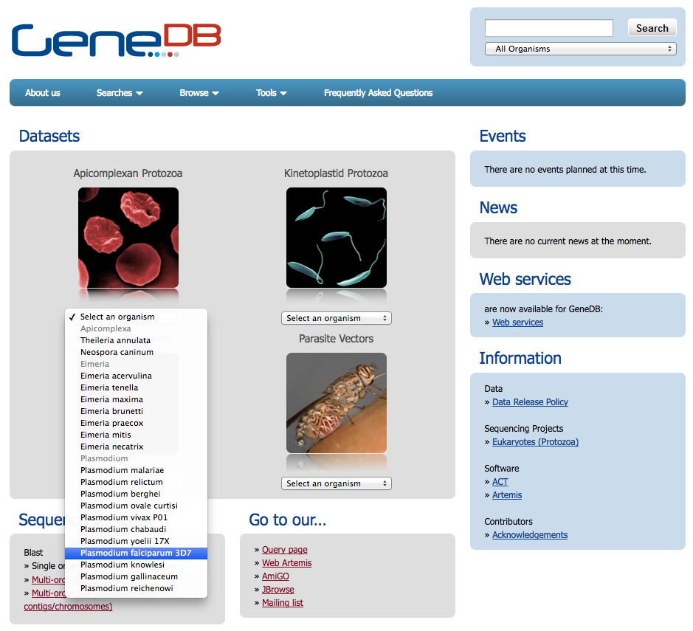
GeneDB

Slide 4
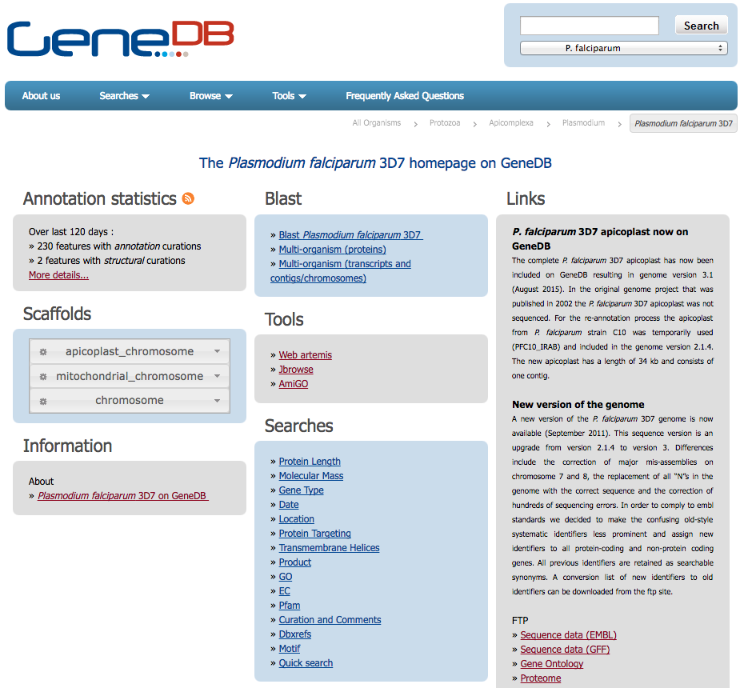
Monthly updates on the FTP site

Slide 5
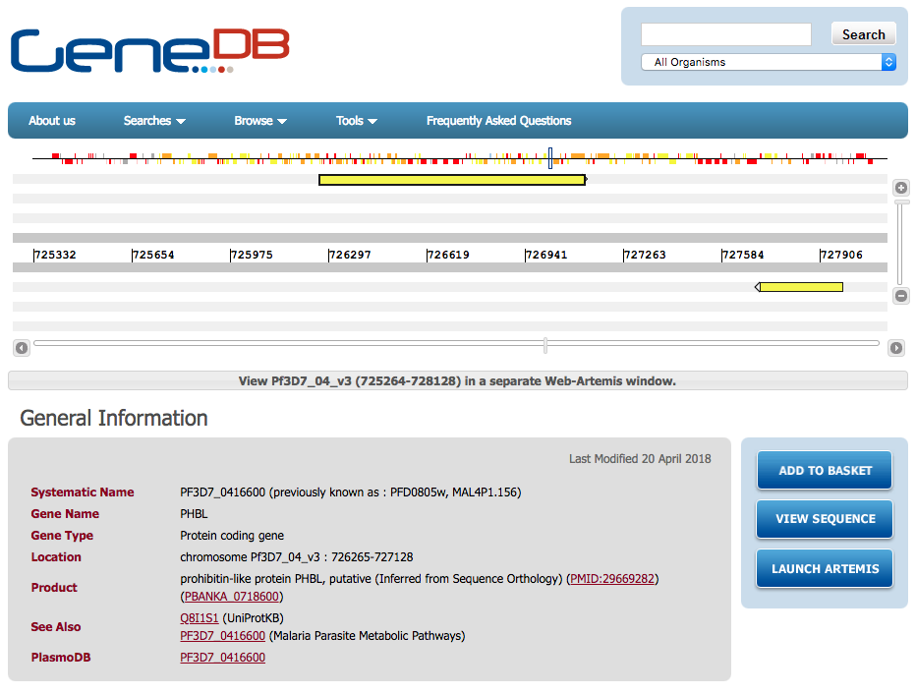
Gene record page

Slide 6
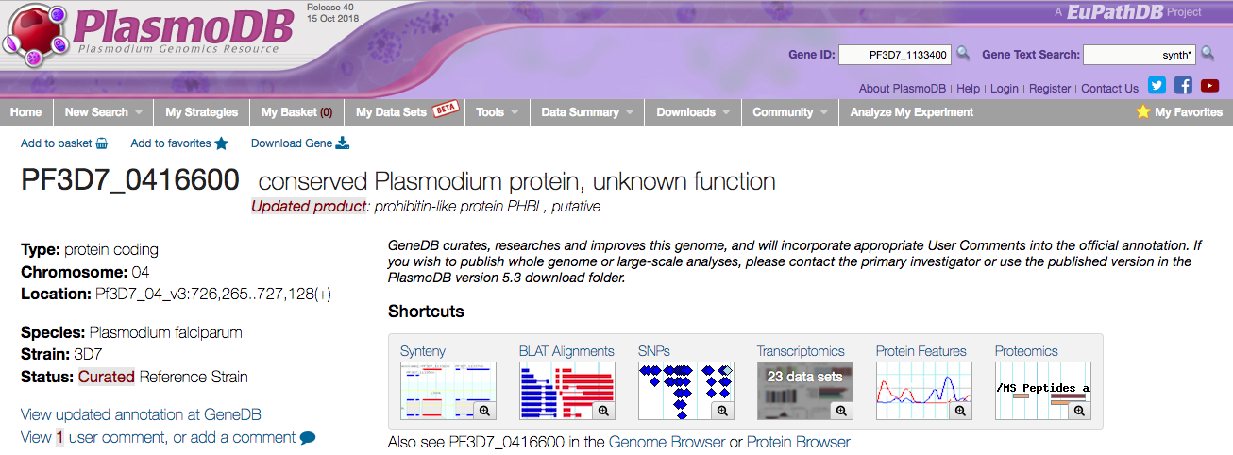
Links from PlasmoDB to GeneDB indicate a change in the genome

Slide 7
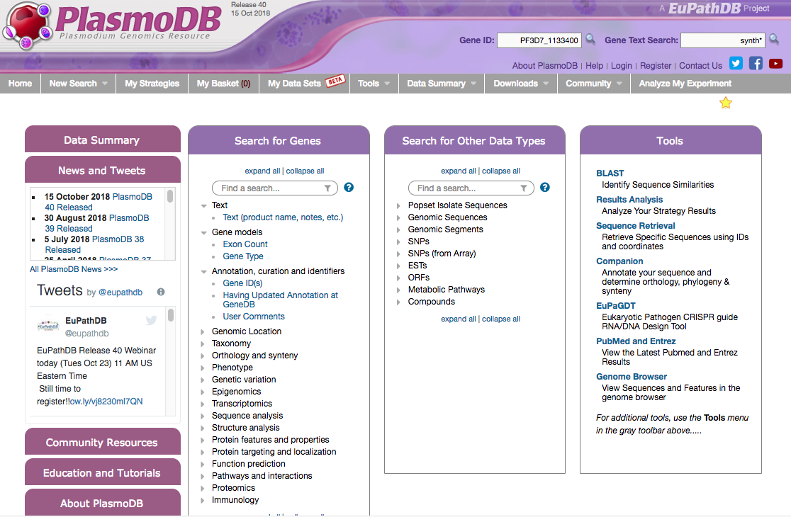
Identify genes based on updated annotation from GeneDB

Slide 8
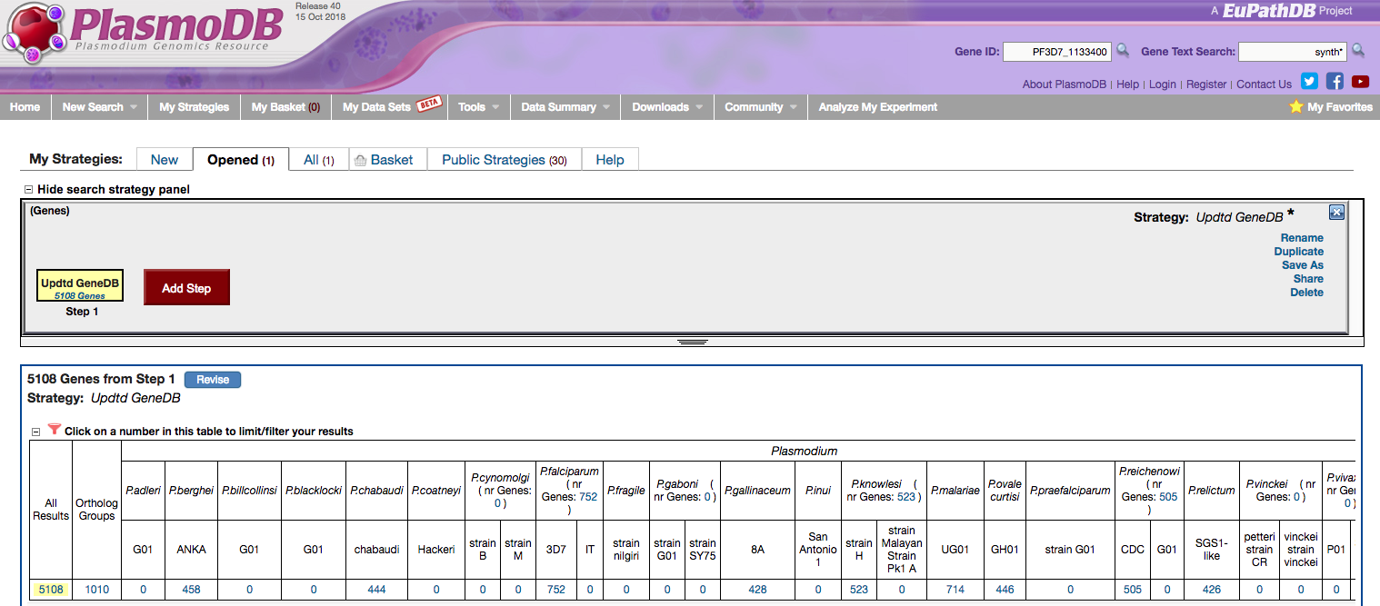
View updated annotation from GeneDB

Slide 10
Annotation statistics

Slide 11
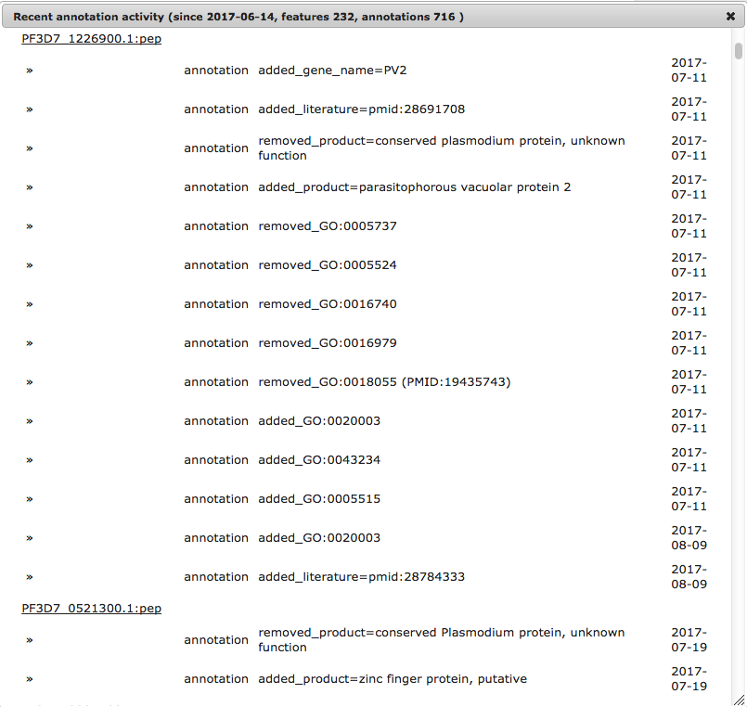
Annotation statistics

