Slide 1
References
References
Abbot, J. C. et al. (2005) Bioinformatics 21(18) 3665-3666.
WebACT – an online companion for the Artemis Comparison Tool
Berriman, M., and K. Rutherford (2003) Brief Bioinform 4 (2) 124-132.
Viewing and annotating sequence data with Artemis.
Carver T. J. et al. (2010) Bioinformatics (doi:10.1093/bioinformatics/btq010).
BamView: Viewing mapped read alignment data in the context of the reference sequence.
Carver T.J. et al. (2012) Bioinformatics 28 (4): 464-9.
Artemis: an integrated platform for visualization and analysis of high-throughput sequence-based experimental data.
Carver T.J. et al. (2012) Brief Bioinform (doi: 10.1093/bib/bbr073).
BamView: visualizing and interpretation of next-generation sequencing read alignments.
Carver T. J. et al. (2005) Bioinformatics 21: 3422-3.
ACT: the Artemis Comparison Tool.
Fidock, D.A. et al. (2000) Molecular Cell 6: 861-871.
Mutations in the P. falciparum digestive vacuole transmembrane protein PfCRT and evidence for their role in chloroquine resistance.
Logan-Klumpler, F.J. et al. (2012) Nucleic Acid Res 40; D98-108.
GeneDB--an annotation database for pathogens.
Otto T. D. et al. (2011) Nucleic Acid Res 39; e57.
RATT: Rapid Annotation Transfer Tool.
Rutherford et al. (2000) Bioinformatics 16 (10) 944-945.
Artemis: sequence visualization and annotation.
Sanchez, C. and Lanzer, M. (2000) Current Opinion on Infectious Diseases 13: 653-658. Changing ideas on chloroquine in Plasmodium falciparum.
Steinbiss, S. et al (2016) Nucleic Acid Res 44:W29-34. Companion: a web server for annotation and analysis of parasite genomes.

Slide 2
Appendices
Appendices

Slide 3
Appendices
Appendix I: Course Virtual Machine (VM) Quick Start Guide
Using a VM enables us to encapsulate the course data and software in such a way that you can still make use of them when you return to your own laboratory.
To use the VM on the USB stick provided, you will first need to download VirtualBox (http://www.virtualbox.org/). This software is required to run the VM on your machine, it is free and available for windows, MacOSX and linux,
For a detailed description of VirtualBox and the installation see the on-line manual (http://www.virtualbox.org/manual/).
Download and Install VirtualBox
Download VirtualBox for the type of workstation you are using (e.g. windows) from http://www.virtualbox.org/wiki/Downloads.
Double click on the executable file (windows). The installation welcome dialog opens and allows you to choose where to install VirtualBox to and which components to install. Depending on your Windows configuration, you may see warnings about "unsigned drivers" or similar. Please select "Continue" on these warnings; otherwise VirtualBox might not function correctly after installation.
Launch the VirtualBox software from the desktop shortcut or from the program menu.
Setting up the VM
VirtualBox needs to be pointed at the VDI (This is the file that is on the memory stick used during the course) file as follows:
Insert the USB memory stick provided. This contains a Virtual Disk Image (VDI) file.
Create a new virtual machine by selecting ‘New’ from the options at the top.
Then fill the boxes in as shown:
In the first window enter:
Name: Artemis
Operating System: Linux
Version: Ubuntu

Slide 4
Appendices
- Click ‘Continue’
- In the next window keep the memory default setting (512 MB)
Click ‘Continue’.
In the next window select ‘Use existing hard disk’ and from the folder icon on the right hand side navigate to the memory USB stick and select the VDI file located on the memory stick.

Slide 5
Appendices
- Click ‘Continue’
- There will now be an ‘Artemis’ (powered off) button in the left hand side of VirtualBox.

Slide 6
Appendices
Double click on this new Artemis course power button to start the VM. The VM is designed to look for a shared folder between the operating system you are running it on and the VM operating system. So when the VM is first started after a few seconds you will see the screen below and you should type ‘s’ to skip this part.
It will then log you into the Ubuntu desktop.
Setting up a Shared Folder
This allows you to share a folder between the VM and your workstation. This means you can put files that you want to share between the operating systems in this folder.
Create a directory to share called ‘VMshare’ on your machine. With the VM shutdown select the ‘Artemis’ button in VirtualBox and click ‘Settings’ in the top menu bar. Go to ‘Shared Folders’ and select the ‘+’ button on the right. In the ‘Folder Path’ select ‘Other’ and navigate to and select the ‘VMshare’ folder that you have created. Then click on ‘OK’. When the ‘Artemis’ VM is next started it will show the contents of this folder in the /home/wt/host directory in Ubuntu.

Slide 7
Appendices
Appendix II: Artemis minimum hardware and software requirements.
Artemis and ACT will, in general, work well on any standard modern machine and with most common operating systems. It is currently used on many different varieties of UNIX and Linux systems as well as Apple Macintosh and Microsoft Windows systems.
Note that the ability to run external programs (such as BLAST and FASTA) from within Artemis and ACT is available only on UNIX and Linux systems.
Minimum memory requirements for people working on whole genomes are approximately 128 megabytes for Artemis and 128 megabytes per genome for ACT. Analysis of cosmid sized sequences can comfortably be achieved with less memory.
Appendix III: ACT comparison files
ACT supports three different comparison file formats:
1) BLAST version 2.2.2 output: The blastall command must be run with
the -m 8 flag which generates one line of information per HSP.
2) MegaBLAST output: ACT can also read the output of MegaBLAST,
which is part of the NCBI blast distribution.
3) MSPcrunch output: MSPcrunch is program for UNIX and GNU/Linux
systems which can post-process BLAST version 1 output into an
easier to read format. ACT can only read MSPcrunch output with
the -d flag.
Here is an example of an ACT readable comparison file generated by MSPcrunch -d.
1399 97.00 940 2539 sequence1.dna 1 1596 AF140550.seq
1033 93.00 9041 10501 sequence1.dna 9420 10880 AF140550.seq
828 95.00 6823 7890 sequence1.dna 7211 8276 AF140550.seq
773 94.00 2837 3841 sequence1.dna 2338 3342 AF140550.seq
The columns have the following meanings (in order): score, percent
identity, match start in the query sequence, match end in the query
sequence, query sequence name, subject sequence start, subject sequence
end, subject sequence name.
The columns should be separated by single spaces.

Slide 8
Appendices
Appendix IV: Feature Keys and Qualifiers – a brief explanation of what they are and a sample of the one’s we use.
1 – Feature Keys: They describe features with DNA coordinates and once marked, they all appear in the Artemis main window. The ones we use are:
\CDS: Marks the extent of the coding sequence.
\misc_feature: Miscellaneous feature in the DNA
\rRNA: Ribosomal RNA
\repeat_region
\tRNA: Transfer RNA
2 – Qualifiers: They describe features with protein coordinates. Once marked they appear in the lower part of the Artemis window. They describe the gene whose coordinates appear in the ‘location’ part of the editing window. The ones we commonly use for annotation at the Sanger Institute are:
\colour: Also used in-house in order to differentiate between different types of genes and other features.
\gene: Descriptive gene a name, eg. ilvE, argA, VAR etc.
\label: Allows you to label a gene/feature in the main view panel.
\note: This qualifier allows for the inclusion of free text. This could be a description of the evidence supporting the functional prediction or other notable features/information which cannot be described using other qualifiers.
\product: The assigned possible function for the protein goes here.
\pseudo: Matches in different frames to consecutive segments of the same protein in the databases can be linked or joined as one and edited in one window. They are marked as pseudogenes. They are normally not functional and are considered to have been mutated.
\locus_tag : Systematic gene number, eg SAS1670, Sty2412 etc.
The list of keys and qualifiers accepted by EMBL in sequence/annotation submission files are listed at the following web page:
http://www.ebi.ac.uk/ena/WebFeat/

Slide 9
Appendices
Appendix V: Schematic of workshop files and directories
Key:
Directories and subdirectories
Module_1_Artemis
Module_ 2_Comparative_genomics
Module_3_Mapping
Module_4_RNA-Seq
Home directory
(position at login)

Slide 10
Appendices
Appendix VI: Useful Web addresses
Major Public Sequence Repositories
DNA Data Bank of Japan (DDBJ) http://www.ddbj.nig.ac.jp
EMBL Nucleotide Sequence Database http://www.ebi.ac.uk/ena/
Genomes at the EBI http://www.ebi.ac.uk/genomes
GenBank http://www.ncbi.nlm.nih.gov/genbank
Genome Databases Resources
GeneDB http://www.genedb.org
Eupathdb http://eupathdb.org/
Protein Motif Databases
InterPro https://www.ebi.ac.uk/interpro/
Prosite http://prosite.expasy.org/
Pfam http://pfam.xfam.org/
PRINTS http://www.bioinf.manchester.ac.uk/dbbrowser/PRINTS/
SMART http://smart.embl-heidelberg.de
Protein feature prediction tools
TMHMM Transmembrane helices prediction http://www.cbs.dtu.dk/services/TMHMM/
SignalP Prediction Server http://www.cbs.dtu.dk/services/SignalP/
PSORT protein prediction http://psort.hgc.jp/form.html
Metabolic Pathways and Cellular Regulation
ENZYME http://enzyme.expasy.org/
Kyoto Encyclopedia of Genes and Genomes (KEGG) http://www.genome.jp/kegg/
MetaCyc http://metacyc.org/
Miscellaneous sites
NCBI BLAST website http://blast.ncbi.nlm.nih.gov/Blast.cgi
EBI FASTA website http://www.ebi.ac.uk/Tools/sss/fasta/
tRNAscan-SE Search Server http://trna.ucsc.edu/tRNAscan-SE/
Rfam http://rfam.xfam.org/
Codon usage database http://www.kazusa.or.jp/codon/
GO Gene Ontology Consortium http://geneontology.org/
Artemis homepage http://www.sanger.ac.uk/science/tools/artemis
ACT homepage http://www.sanger.ac.uk/science/tools/artemis-comparison-tool-act
Artemis/ACT download http://sanger-pathogens.github.io/Artemis/Artemis/
WebACT http://www.webact.org/WebACT/home
Double ACT http://www.hpa-bioinfotools.org.uk/pise/double_actv2.html
String http://string.embl.de
EMBOSS http://www.ebi.ac.uk/Tools/emboss/

Slide 11
Appendices
Appendix VII: List of colour codes
2 (red) - gene product is based on experimental evidence
6 (dark pink) - unlikely hypothetical protein
7 (yellow) - gene product is based on orthology
8 (light green) - hypothetical protein, unknown function
10 (orange) - conserved hypothetical
13 (light grey) - pseudogenes
Appendix VIII: List of degenerate nucleotide value/IUB Base Codes.
R = A or G
S = G or C
B = C, G or T
Y = C or T
W = A or T
D = A, G or T
K = G or T
N = A, C, G or T
H = A, C or T
M = A or C
V = A, C or G

Slide 12
Appendices
Appendix VIIII Splice site information
Gene No. Exon Intron Exon Size (bp)
41-3 1 GAA|GTACACA..CCTTCTTTTTCCATATTTAG|CAA 152
2 AAT|GTTAAAA...TTTTTTTTTTTAAACTTAG|CCG 208
3 GAG|GTAAGAA...ATTCATTATATATTTATAG|GGA 86
4 TCG|GTATGGA...TTTTGAAATACTTCCTCAG|TTA 152
5 ACT|GTAATAT..TTTTTTTTTTTATTTCCTAG|ATG 112
6 CAG|GTAAATA..ATAATGACATTTTGATACAG|ATT 120
7 AAT|GTACATT..TTATTTTTATTTATTTATAG|AAA 81
8 TAG|GTATTTG..ATATTTTTTACTTATGATAG|TTA 96
RhopH3 1 AGG|GTAATAT..TTTATTTTATTTTTTTTTTA|TTT 150
2 GGA|GTAAGAG..TTTTTATTATTTTATTGTAG|TCC 442
3 GGA|GTAAGAG..TTTTTATTATTTTATTGTAG|TCC 199
4 CAG|GTAYGCT..TTTAATTTTTTTTTCCTTCA|TCA 160
5 AAA|GTAAGAA..TATTTTTTTACAATTTTTAG|TTC 206
6 AAG|GTAAAAG..TTTTTTTTTTTTTGTTTCAG|TTT 142
RNA pol III 1 CAG|GTACATA..TTTTTTTTTTTTTTTTTTAG|GTG 158
2 CAA|GTAATTA..TATATTTTATTTTTTCTTAG|GTT 113
3 TAC|GTTAGTT..TTTTTTTTTTTTTTTTTTAG|TGG 169
4 ATT|GTAAGTT..TATTTTTTTTTTTTTTTTAG|TGA 112
SERA 1 TGT|GTAAGAA..TTGTCATTATTTTTTTTTAG|GTG 158
2 AAA|GTATAAA..TTTATTTATTTTTTTTTTAG|ATA 175
3 CAG|GTAAATA..TTTTAATTTTTTTGTTTTAG|AAA 129
SERP H 1 CTG|GTTTGTC..CATATATTTCTTTATTTTAG|ATA 345
2 AGA|GTAAAAA..TTTCTTATATTTTCTTTTAG|GTG 92
3 CTG|GTTTGTC..CATATATTTCTTTATTTTAG|ATA 116
Ag15 1 ATG|GTAAGAG..TATTTTTGATACCTTTATAG|AGT 214
2 AAA|GTAATTA..CAATCATATTAACACAAAAG|ATG 280
PfGPx 1 GAG|GTATACA..TTATTATTCCCTTGCTTTAG|ATC 208
2 TCG|GTTAGTA..TATTTATCATTTTTTTCCAG|ATG 168
Calmodulin 1 GAA|GTAAATC..TTTTTTATTTTTCTCATTAG|CTA 480
PfPK1 1 TAG|GTGTGTT..TCATTACATTTTTACCTTAG|GAT 101
MESA 1 TTA|GTAAGTT..CGTAATATATTTTTTTTTAG|GAT 122
Aldolase 1 ATG|GTAAGAA..TATTTTTATATTTTTTTTAG|GCT 452
KAHRP 1 AAC|GTAAGTT..TTATTTTTTTTTTCATATAG|TGC 430
GBPH2 1 TTG|GTATGCC..TTTGTATTATTTAATTTTAG|AAT 157
GBP 1 TTG|GTATG....TGTGTATTGTTTATTTTTAG|AAT 179
FIRA 1 TGT|GTAAGGA..TTTTTATATTTTTTCTTTAG|CGA 175
GARP 1 AAG|GTAACAA..TATATGTATTTTTTTTTTAG|TGC 214
Donor motif
Acceptor motif
The splice acceptor and donor sequences for several P. falciparum genes: adapted from Coppel and Black(1998). In "Malaria:Parasite Biology, Pathogenesis and Protection", I.W. Sherman (ed.); ASM Press; Washington DC; pp185-202

Slide 13
Appendix: Basic Unix
BASIC UNIX
Introduction
Unix is the standard operating system on most large computer systems in scientific research, in the same way that Microsoft Windows is the dominant operating system on desktop PCs.
Unix and MS Windows both perform the important job of managing the computer's hardware (screen, keyboard, mouse, hard disks, network connections, etc) on your behalf. They also provide you with tools to manage your files and to run application software.
They both offer a graphical user interface. On Unix systems, this is called the X Window System, or just X.
Unix is a powerful, robust and stable operating system which allows dozens of people to run programs on the same computer at the same time. This is why it is the preferred operating system for large-scale scientific computing. It runs on all kinds of machines, from desktop PCs to supercomputers.
Aims
The aim of this module is to introduce UNIX and cover some of the basics that will allow you to run some of the programs used in this workshop. Several of the programs that you are going to use during the workshop, plus many others that are useful for bioinformatics analyses, are run in UNIX. This module is only designed to provide a very brief introduction to some of the features and useful commands of UNIX.
During this module we will also obtain a genome sequence that will be used in the next module, and examine the basic structure of an EMBL entry.

Slide 14
Appendix: Basic Unix
Why use UNIX?
UNIX is a well established, very widespread operating system.
Command line driven, with a huge number of often terse, but powerful commands
In contrast to Windows, it is designed to allow many users to run their programs simultaneously on the same computer
Designed to work in computer networks - for example, most of the Internet is UNIX based
It is used on many of the powerful computers at bioinformatics centres and also on many workstations
UNIX is not a monolithic entity. There are numerous different UNIX operating systems. Some of them are freely distributed such as Linux which was originally created to provide a free UNIX on personal PCs. This operating system is now so popular that it has been ported to many different system architectures.

Slide 15
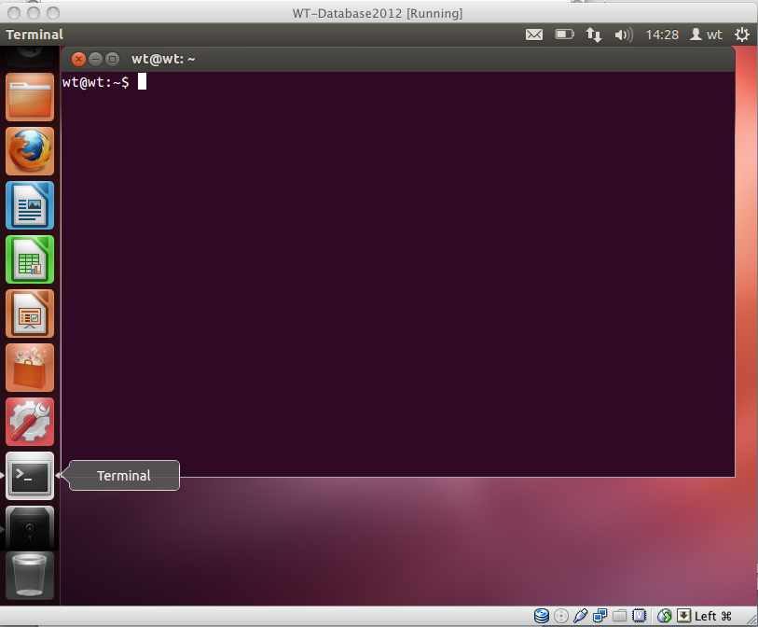
Appendix: Basic Unix
Getting started
.
In this workshop, we will be using desktop PCs which run Linux, a version of UNIX which was specially designed for PCs.
We will use a terminal window to type in our UNIX command line. This is similar to the "Command Prompt" window on MS Windows systems, which allows the user to type DOS commands to manage files.
You should see a window labelled "Terminal" which will be empty except for a ’$' character at the top left. The '$' character is the UNIX prompt, similar to "C:\" in DOS. Note: the prompt will often be different on different UNIX computers, for example it may be displayed as a ‘%’ character.
UNIX prompt
You can type commands directly into the terminal at the ‘%' prompt.
A list of useful commands can be found on the next page.
Many of them are two- or three-letter abbreviations. The earliest UNIX systems (circa 1970) only had slow Teletype terminals, so it was faster to type 'rm' to remove a file than 'delete' or 'erase'. This terseness is a feature of UNIX which still survives.
To get a terminal window click on the
terminal icon

Slide 16
Appendix: Basic Unix
The command line
All UNIX programs may be run by typing commands at the UNIX prompt $. The command line tells the computer what to do.
You may subtly alter these commands by specifying certain options when typing in the command line.
Command line Arguments
Typing any of the commands listed above at the UNIX prompt with the appropriate variables such as files names or directories will result in the tasks being performed on pressing the enter key.
Additional arguments or flags can be added to the commands to affect the way the command works. For example:
The cal command prints a calendar for a month or a year
If you type in just cal with no month or year, you get the calendar for the current month
If you type cal and a year you get the calendar for that year
$ cal 2000 [enter]
Additional arguments for the commands are not covered here, but if you want to find out what arguments are available, or want to find out more about a UNIX command, type man followed by the UNIX command
$ man cal [enter]

Slide 17
Appendix: Basic Unix
Files and Directories
Directories are the UNIX equivalent of folders on a PC or Mac. They are organised in a hierarchy, so directories can have sub-directories and so on. Directories are very useful for organising your work and keeping your account tidy - for example, if you have more than one project, you can organise the files for each one into different directories to keep them separate. You can think of directories as rooms in a house. You can only be in one room (directory) at a time. When you are in a room you can see everything in that room easily. To see things in other rooms, you have to go to the appropriate door and crane your head around. UNIX works in a similar manner, moving from directory to directory to access files. The location or directory that you are in is referred to as the current working directory.
Directory structure example
/
/usr
/bin
/nfs
/var
/home
/local
/fred
/bin
/lib
/man
/data
/rna
/pfam
/dna
/protein
/cosmids
Therefore if there is a file called genome.seq in the dna directory its location or full pathname can be expressed as /nfs/dna/genome.seq.
For the actual directory structure you will be using during the workshop, see Appendix IV.

Slide 18
Appendix: Basic Unix
General Points
UNIX is pretty straightforward, but there are some general points to remember that will make your life easier:
UNIX is case sensitive - typing "ls" is not the same as typing "LS".
You need to put a space between a command and its argument - for example, "more myfile" will show you the contents of the file called myfile; "moremyfile" will just give you an error!
UNIX is not psychic! If you mis-spell the name of a command or the name of a file, it will not understand you.
Many of the commands are only a few letters long; this can be confusing until you start to think logically about why those letters were chosen - ls for list, rm for remove and so on.
Often when you have problems with UNIX, it is due to a spelling mistake, or perhaps you have omitted a space.
If you want to know more about UNIX and its commands there are plenty of resources available that provide a more comprehensive guide:- (e.g. http://unixhelp.ed.ac.uk or http://unix.t-a-y-l-o-r.com/ ).
In what follows, we shall use the following typographical conventions:
Characters written in bold typewriter font are commands to be typed into the computer as they stand.
Characters written in italic typewriter font indicate non-specific file or directory names.
Words inserted within square brackets [Ctrl] indicate keys to be pressed.
So, for example,
$ ls anydirectory [Enter]
means "at the UNIX prompt $, type ls followed by the name of some directory, then press the key marked Enter"
Don't forget to press the [Enter] key: commands are not sent to the computer until this is done.

Slide 19
Appendix: Basic Unix
Some useful UNIX commands
Command | What it does
ls | Lists the contents of the current directory
mkdir | Makes a new directory
mv | Moves or renames a file
cp | Copies a file
rm | Removes a file
cat | Concatenates files
more | Displays the contents of a file one page at a time
head | Displays the first ten lines of a file
tail | Displays the last ten lines of a file
cd | Changes current working directory
pwd find grep wc | Prints working directory Finds files matching an expression Searches a file for patterns Counts the lines, words, characters, and bytes in a file
kill | Stops a process
jobs | Lists the processes that are running

Slide 20
Appendix: Basic Unix
Exercise
The following exercise introduces a few useful UNIX commands and provides examples of how they can be used.
Many people panic when they are confronted with an UNIX prompt! Don’t! The exercise is designed to be step-by-step, so all the commands you need are provided in the text. If you get lost ask a demonstrator. If you are a person skilled at UNIX, be patient it is only a short exercise.
Finding where you are and what you’ve got
pwd Print the working directory
As seen previously directories are arranged in a hierarchical structure. To determine where you are in the hierarchy you can use the pwd command to display the name of the current working directory. The current working directory may be thought of as the directory you are in, i.e. your current position in the file-system tree
To find out where you are type
pwd [enter]
You will see that you are in your home directory. We need to move into the UNIX directory
UNIX is case sensitive, PWD is not the same as pwd
cd Change current working directory
The cd command will change the current working directory to another, in other words allow you to move up or down in the directory hierarchy. First of all we are going to move into the UNIX directory below. To do this type:
cd UNIX [enter]
Now use the pwd command to check your location in the directory hierarchy.
ls List the contents of a directory
To find out what are the contents of the current directory type
ls [enter]
The ls command lists the contents of your current directory, this includes files and directories
You should see that there are 4 files called:
AL513382.embl, MAL13P1.dna, MAL13P1.tab, Malaria.fasta

Slide 21
Appendix: Basic Unix
Changing and moving what you’ve got
cp Copy a file
cp file1 file2 is the the command which makes a copy of file1 in the current working directory and calls it file2
What you are going to do is make a copy of AL513382.embl. This file contains the genome of Salmonella typhi strain CT18 in EMBL format. The new file will be called S_typhi.embl
cp AL513382.embl S_typhi.embl [enter]
If you use the ls command to check the contents of the current directory you will see that there are now two files, AL513382.embl and S_typhi.embl.
rm Delete a file
This command removes a file permanently so take care!
You are now going to remove the old version of S. typhi genome file, AL513382.embl
rm AL513382.embl [enter]
The file will be removed. Use the ls command to check the contents of the current directory to see that AL513382.embl has been removed.
UNIX as a general rule does exactly what you ask, and does not ask for confirmation. Unfortunately there is no "recycle bin" on the command line to recover the file from, so you have to be careful.
cd Change current working directory
As before the cd command will change the current working directory to another, in other words allow you to move up or down in the directory hierarchy. First of all we are going to move into the directory above, type:
cd .. [enter]
Now use the pwd command to check your location in the directory hierarchy.

Slide 22
Appendix: Basic Unix
Next, we are going to move into the Module_1_Artemis directory.
To change to the Module_1_Artemis directory type:
cd Module_1_Artemis [enter]
use the ls command to check the contents of the directory
mv Move a file
To move a file from one place to another use the mv command. This moves the file rather than copies it, therefore you end up with only one file rather than two.
When using the command the path or pathname is used to tell UNIX where to find the file. You refer to files in other directories by using the list of hierarchical names separated by slashes. For example, the file bases in the directory genome has the path genome/bases
If no path is specified UNIX assumes that the file is in the current working directory.
What you are going to do is move the file S_typhi.embl from the UNIX directory, to the current working directory
mv ../UNIX/S_typhi.embl . [enter]
Use the ls command to check the contents of the current directory to see that S_typhi.embl has been moved.
../UNIX/S_typhi.embl specifies that S_typhi.embl is in the UNIX directory. If the file was in the directory above, the path would change to: ../S_typhi.embl
. specifies the current working directory
.. specifies the directory above the current working direcory
The command can also be used to rename a file in the current working directory. Previously we used the cp command, but mv provides an alternative without the need to delete the original file. Therefore we could have used:
mv AL513382.embl S_typhi.embl [enter]

Slide 23
Appendix: Basic Unix
Viewing what you’ve got
more Display file contents
This command displays the contents of a specified file one screen at a time.
You are now going to look at the contents of S_typhi.embl.
more S_typhi.embl [enter]
The contents of S_typhi.embl will be displayed one screen at a time, to view the next screen press the space bar. The percentage of the file that has been viewed so far will be displayed at the bottom of the screen. As S_typhi.embl is a large file this will take a while, therefore you may want to escape or exit from his command. To do this press the control and c keys simultaneously, this kills the more command, and returns you to the UNIX prompt. more can also scroll backwards if you hit the b key. Another useful feature is the slash key, /, to search for an expression in the file.
head Display the first ten lines of a file
tail Display the last ten lines of a file
Sometimes you may just want to view the text at the beginning or the end of a file, without having to display all of the file. The head and tail commands can be used to do this.
You are now going to look at the beginning of S_typhi.embl.
head S_typhi.embl [enter]
To look at the end of S_typhi.embl type:
tail S_typhi.embl [enter]
The amount of the file that is displayed can be increased by adding extra arguments. To increase the number of lines viewed from 10 to 100 add the –100 argument to the command. For example to view the last 100 lines of S_typhi.embl type:
tail -100 S_typhi.embl [enter]
Do this for both head and tail commands. What type of information is at the beginning and end of the EMBL format file?

Slide 24
Appendix: Basic Unix
cat Join files together
Having looked at the beginning and end of the S_typhi.embl file you should notice that in EMBL format files the annotation comes first, then the DNA sequence at the end.
If you had two separate files containing the annotation and the DNA sequence, both in EMBL format, it is possible to concatenate or join the two together to make a single file like the S_typhi.embl file you have just looked at. The UNIX command cat can be used to join two or more files into a single file. The order in which the files are joined is determined by the order in which they appear in the command line.
For example, we have two separate files, MAL13P1.dna and MAL13P1.tab, that contain the DNA and annotation, respectively, from the P. falciparum genome.
By typing the command line:
cat MAL13P1.tab MAL13P1.dna > MAL13P1.embl [enter]
MAL13P1.tab and MAL13P1.dna will be joined together and written to a file called MAL13P1.embl
The > symbol in the command line directs the output of the cat program to the designated file MAL13P1.embl

Slide 25
Appendix: Basic Unix
wc Counts the lines, words or characters
By typing the command line:
ls | wc -l [enter]
The above command uses wc to count the number of files that are listed by ls.
The | symbol in the command line connects the two commands into a single operation for simplicity. You can connect as many commands as you want:
$ ls | grep “.embl” | wc -l
grep Searches a file for patterns
grep is a powerful tool to search for patterns in a file.
In the examples below, we are going to use the file called Malaria.fasta that contains the set of P. falciparum chromosomes in FASTA format. A FASTA file has the following format:
>Sequence Header
CTAAACCTAAACCTAAACCCTGAACCCTAA…
…
Therefore if we want to get the sequence headers, we can extract the lines that match the > symbol:
grep ‘>’ Malaria.fasta [enter]
By typing the command line:
grep -c ‘>’ Malaria.fasta [enter]
The > symbol is placed in quotes as this stops the shell from interpreting the > as an instruction for where to put the output.
The -c option prints only a count of matching lines. Therefore in this example we will display the number of sequence entries that this file contains.

Slide 26
Appendix: Basic Unix
find Finds files matching an expression
The find command is similar to ls but in many ways it is more powerful. It can be used to recursively search the directory tree for a specified path name, seeking files that match a given Boolean expression (a test which returns true or false)
find . -name “*.embl”
This command will return the files which name has the .embl suffix.
find . -type d
This command will return all the subdirectories contained in the current directory.
These is just two basic examples but it is possible to search in many other ways:
-mtime search files by modifying date
-atime search files by last access date
-size search files by file size
-user search files by user they belong to
You need to be careful with quoting when using wildcards.
The wildcard * symbol represents a string of any character and of any length.

Slide 27
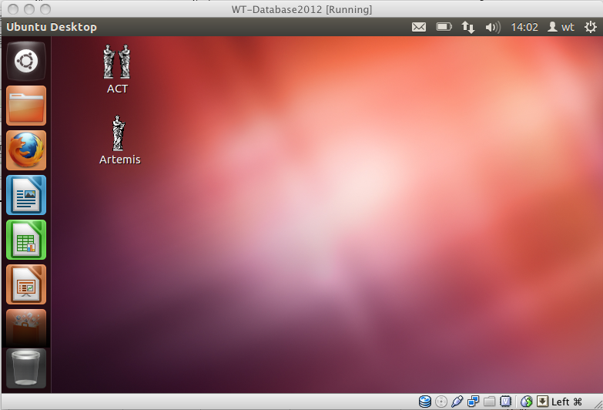
Appendix: Basic Unix
Obtaining and transferring information
The first step in exploiting genome sequences is obtaining your genome sequence. As time goes by there are more and more genome sequences available, from an ever increasing number of locations. Typically a complete genome sequence project is quite large, and therefore the files containing the data are going to be quite unwieldy. One of the simplest ways in which such information can be obtained is using ftp or ‘file transfer protocol’. This a method of transferring information from a remote machine to the computer you are working on.
The ftp command can be used in UNIX to connect to a remote machine specified in the command line. Once a connection is established it is possible to both send (upload) and receive (download) data. However as we are limited for time we will not use this method, and instead use a more user-friendly method.
Using ftp on the internet
In addition to UNIX, ftp is also available on most Macs and PCs and allows you to transfer files readily between different computers worldwide. It is worth learning how to use ftp; most machines will have a graphical ftp interface and this makes file transfer very easy. Unfortunately there are a large number of alternatives and we can't show them all to you. Instead, we'll use ftp to download information to the current working directory on the computer you are working using the Firefox web browser. You are now going to an ftp web page where you are going to download the DNA sequence for P. falciparum chromosome 3.
Open up Firefox from the icon on tool bar at the top of the screen.

Slide 28
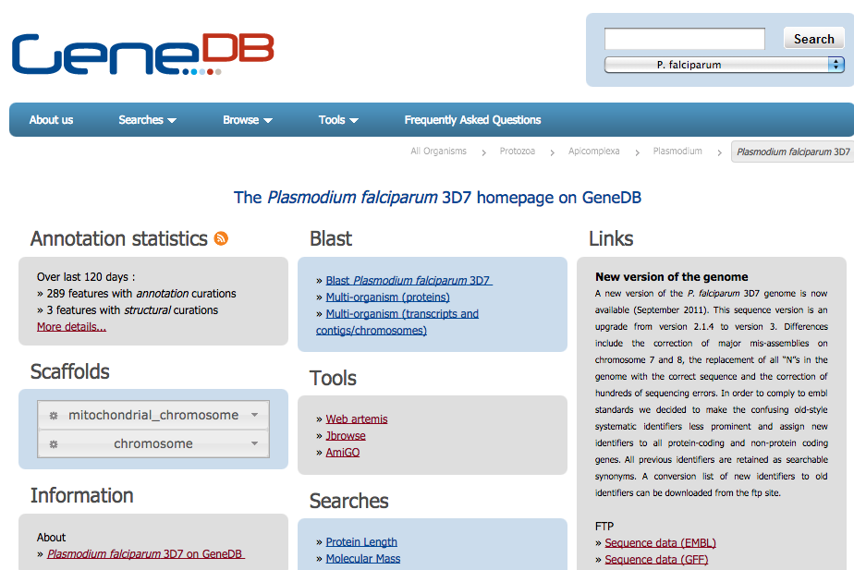
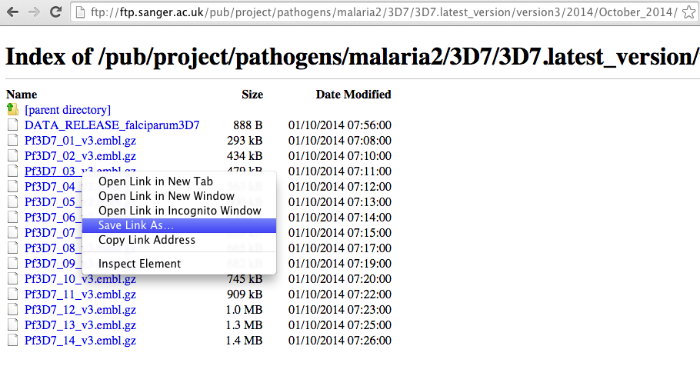
Appendix: Basic Unix
In the location box type in the address http://www.genedb.org/Homepage/Pfalciparum and press return. The page below should appear.
Click on the ftp access link
Right click on Pf3D7_03_v3.embl.gz and choose ‘Save Link As’.

Slide 29
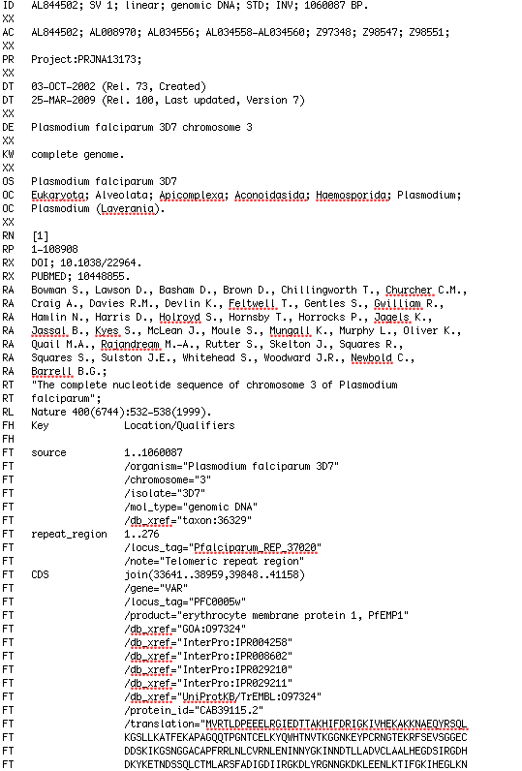
Appendices
Database Entries
The P. falciparum chr3 embl file can be obtained from the EMBL database at the European Bioinformatics Institute (http://www.ebi.ac.uk/) and is presented in a specific format with a series of defined qualifiers and keys (see below and Appendix IV) to help identify the different components of an entry.
Below is an example of a small EMBL entry with the different features of the entry highlighted
EMBL Header
Qualifier
Key
Annotation
Two-character line code indicates the type of information contained in the line
Sequence
In addition to the EMBL database, there are the mirror databases, Genbank (NCBI) and DDBJ (National Institute of Genetics, Japan), which contain the same sequence entries, but have slight differences in the way in which the information is presented. The next two pages contain the text of the complete entries for same sequence from the EMBL and GenBank databases, compare the two entries and identify the differences.

Slide 30
Appendix: Basic Unix
EMBL Entry
ID ECRSMA standard; DNA; PRO; 500 BP.
XX
AC L40173;
XX
SV L40173.1
XX
DT 10-AUG-1995 (Rel. 44, Created)
DT 04-MAR-2000 (Rel. 63, Last updated, Version 4)
XX
DE Erwinia carotovora repressor (rsmA) gene, complete cds.
XX
KW repressor; rsmA gene.
XX
OS Pectobacterium carotovorum
OC Bacteria; Proteobacteria; Gammaproteobacteria; Enterobacteriaceae;
OC Pectobacterium.
XX
RN [1]
RP 1-500
RA Cui Y., Chatterjee A., Liu Y., Dumenyo C.K., Chatterjee A.K.;
RT "Identification of a global repressor gene, rsmA, of Erwinia carotovora
RT subsp. carotovora that controls extracellular enzymes,
RT N-(3-oxohexanoyl)-L-homoserine lactone, and pathogenicity in soft-rotting
RT Erwinia spp";
RL J. Bacteriol. 177(17):0-0(1995).
XX
DR GOA; Q47620; Q47620.
DR SWISS-PROT; Q47620; CSRA_ERWCA.
XX
FH Key Location/Qualifiers
FH
FT source 1..500
FT /db_xref="taxon:554"
FT /organism="Pectobacterium carotovorum"
FT /strain="71"
FT /sub_species="carotovora"
FT /gene="rsmA"
FT CDS 246..431
FT /codon_start=1
FT /db_xref="GOA:Q47620"
FT /db_xref="SWISS-PROT:Q47620"
FT /note="putative"
FT /transl_table=11
FT /gene="rsmA"
FT /function="global repressor"
FT /protein_id="AAA74502.1"
FT /translation="MLILTRRVGETLIIGDEVTVTVLGVKGNQVRIGVNAPKEVSVHRE
FT EIYQRIQAEKSQPTSY"
XX
SQ Sequence 500 BP; 140 A; 101 C; 120 G; 139 T; 0 other;
ggatccggca agcaggatag aaagtgtgtt accttcagat attctgaagc tttacatgct 60
cagttctgtt gttgtgataa caaaagcaca agctactgat atcgactaaa ctaacaagta 120
gtgacaaacc ggagtgtgat ggtgtggtta taccatcgtc taggtttacg ttttcacagc 180
acatgatgga taatggcggg gagacagaga gacccgactc tttataatct ttcaaggagc 240
aaagaatgct tattttgact cgtcgagttg gcgaaaccct catcatcggc gatgaggtaa 300
cggttaccgt attaggagtg aaaggcaacc aggtgcgtat tggtgttaat gcacctaaag 360
aggtttctgt ccaccgtgaa gagatctatc agcgtattca ggccgaaaaa tctcaaccaa 420
cgtcatattg attgacaatg cgtctcgtgt tcgcgggacg caattgttat ttccggtttt 480
tcccccacac atttatcgat 500
//

Slide 31
Appendix: Basic Unix
GenBank Entry
LOCUS ERWRSMA 500 bp DNA linear BCT 19-AUG-1995
DEFINITION Erwinia carotovora repressor (rsmA) gene, complete cds.
ACCESSION L40173
VERSION L40173.1 GI:927031
KEYWORDS repressor; rsmA gene.
SOURCE Pectobacterium carotovorum
ORGANISM Pectobacterium carotovorum
Bacteria; Proteobacteria; Gammaproteobacteria; Enterobacteriaceae;
Pectobacterium.
REFERENCE 1 (bases 1 to 500)
AUTHORS Cui,Y., Chatterjee,A., Liu,Y., Dumenyo,C.K. and Chatterjee,A.K.
TITLE Identification of a global repressor gene, rsmA, of Erwinia
carotovora subsp. carotovora that controls extracellular enzymes,
N-(3-oxohexanoyl)-L-homoserine lactone, and pathogenicity in
soft-rotting Erwinia spp
JOURNAL J. Bacteriol. 177(17) (1995) In press
COMMENT Original source text: Erwinia carotovora (strain 71, sub_species
carotovora) DNA.
FEATURES Location/Qualifiers
source 1..500
/organism="Pectobacterium carotovorum"
/strain="71"
/sub_species="carotovora"
/db_xref="taxon:554"
gene 107..431
/gene="rsmA"
-10_signal 107..112
/gene="rsmA"
RBS 235..239
/gene="rsmA"
CDS 246..431
/gene="rsmA"
/function="global repressor"
/note="putative"
/codon_start=1
/transl_table=11
/protein_id="AAA74502.1"
/db_xref="GI:927032"
/translation="MLILTRRVGETLIIGDEVTVTVLGVKGNQVRIGVNAPKEVSVHR
EEIYQRIQAEKSQPTSY"
BASE COUNT 140 a 101 c 120 g 139 t
ORIGIN
1 ggatccggca agcaggatag aaagtgtgtt accttcagat attctgaagc tttacatgct
61 cagttctgtt gttgtgataa caaaagcaca agctactgat atcgactaaa ctaacaagta
121 gtgacaaacc ggagtgtgat ggtgtggtta taccatcgtc taggtttacg ttttcacagc
181 acatgatgga taatggcggg gagacagaga gacccgactc tttataatct ttcaaggagc
241 aaagaatgct tattttgact cgtcgagttg gcgaaaccct catcatcggc gatgaggtaa
301 cggttaccgt attaggagtg aaaggcaacc aggtgcgtat tggtgttaat gcacctaaag
361 aggtttctgt ccaccgtgaa gagatctatc agcgtattca ggccgaaaaa tctcaaccaa
421 cgtcatattg attgacaatg cgtctcgtgt tcgcgggacg caattgttat ttccggtttt
481 tcccccacac atttatcgat
//

Slide 32
Appendix: Basic Unix
The two entries shown above contain the same biological information but differ in the format and presentation of this information. One of the most obvious difference is in the header region of the file that gives the background information to the submitted sequence. Another clear difference is that the EMBL entry has an additional two letter line code on the left hand margin.
EMBL entries are structured so as to be usable by human readers as well as by computer programs. The explanations, descriptions, classifications and other comments are in ordinary English for readability. At the same time, the structure is systematic enough to allow computer programs to easily read, identify, and manipulate the various types of data included.
Each line begins with a two letter line code, which indicates the type of information contained in the line. The currently used line types, along with their respective line codes, are listed below.
ID - identification (begins each entry; 1 per entry)
AC - accession number (>=1 per entry)
SV - new sequence identifier (>=1 per entry)
DT - date (2 per entry)
DE - description (>=1 per entry)
KW - keyword (>=1 per entry)
OS - organism species (>=1 per entry)
OC - organism classification (>=1 per entry)
OG - organelle (0 or 1 per entry)
RN - reference number (>=1 per entry)
RC - reference comment (>=0 per entry)
RP - reference positions (>=1 per entry)
RX - reference cross-reference (>=0 per entry)
RA - reference author(s) (>=1 per entry)
RT - reference title (>=1 per entry)
RL - reference location (>=1 per entry)
DR - database cross-reference (>=0 per entry)
FH - feature table header (0 or 2 per entry)
FT - feature table data (>=0 per entry)
CC - comments or notes (>=0 per entry)
XX - spacer line (many per entry)
SQ - sequence header (1 per entry)
bb - (blanks) sequence data (>=1 per entry)
// - termination line (ends each entry; 1 per entry)

