Slide 1
MaDAS
a collaborative tool for sequence annotation.

Slide 2
Current annotation model

Slide 3
Limitations of current model
Prediction methods are unable to generate high quality data in many of the cases.
Biologists, with high confidence data, are unable to contribute in a effective way to the process of sequence annotation.
Information is provided by only a few groups, compared with the number of people that use this information.

Slide 4
Collaborative model for sequence annotation

Slide 5
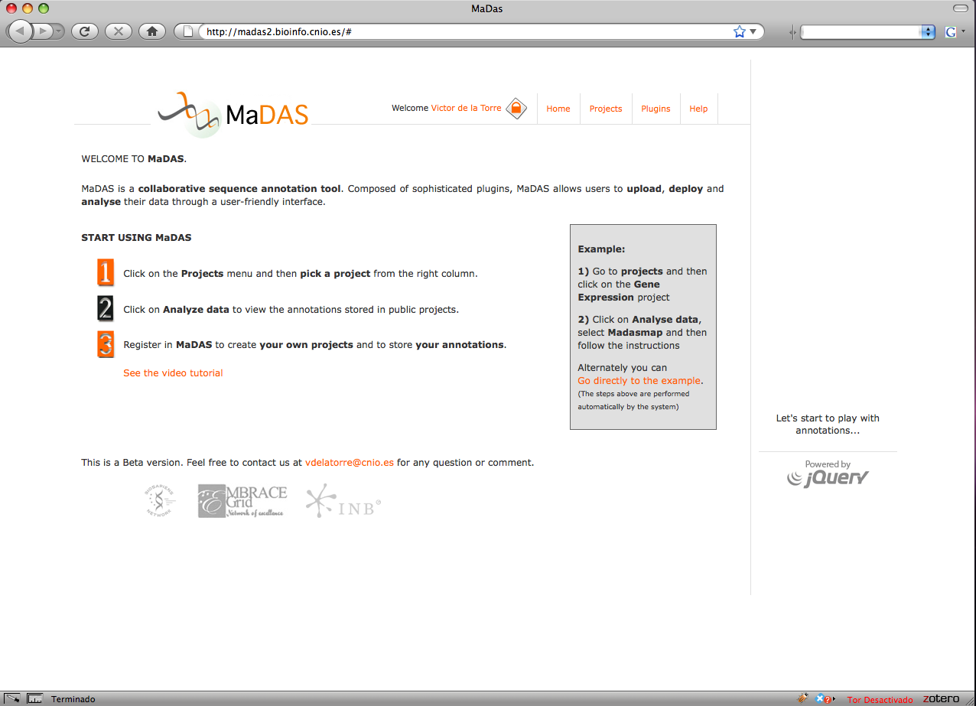
What could a collaborative application look like?

Slide 6
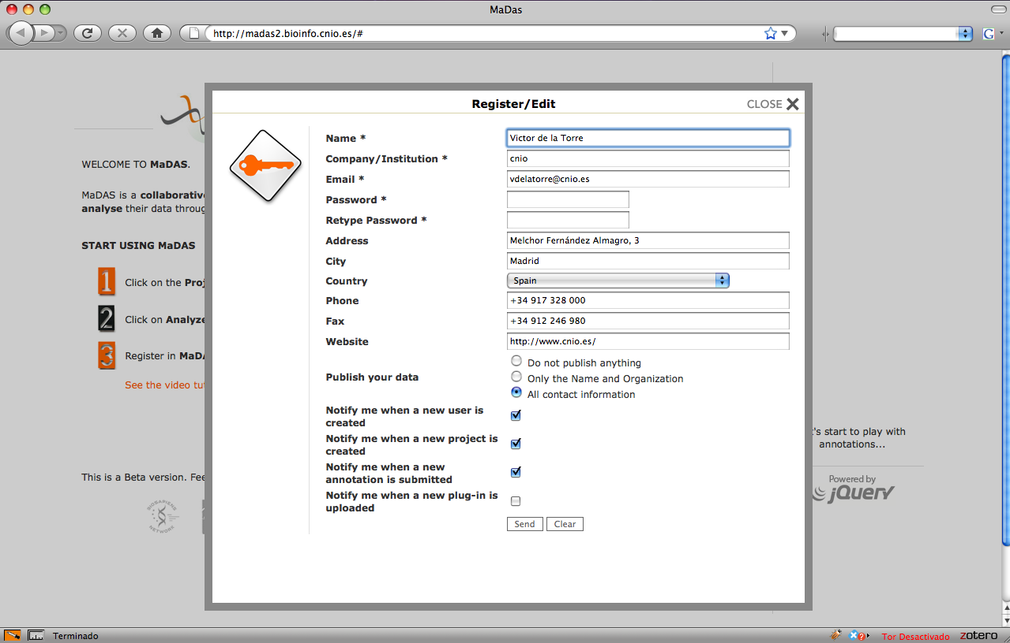
Provide a user comunity
Users have a profile information that can be used to exchange knowledge

Slide 7
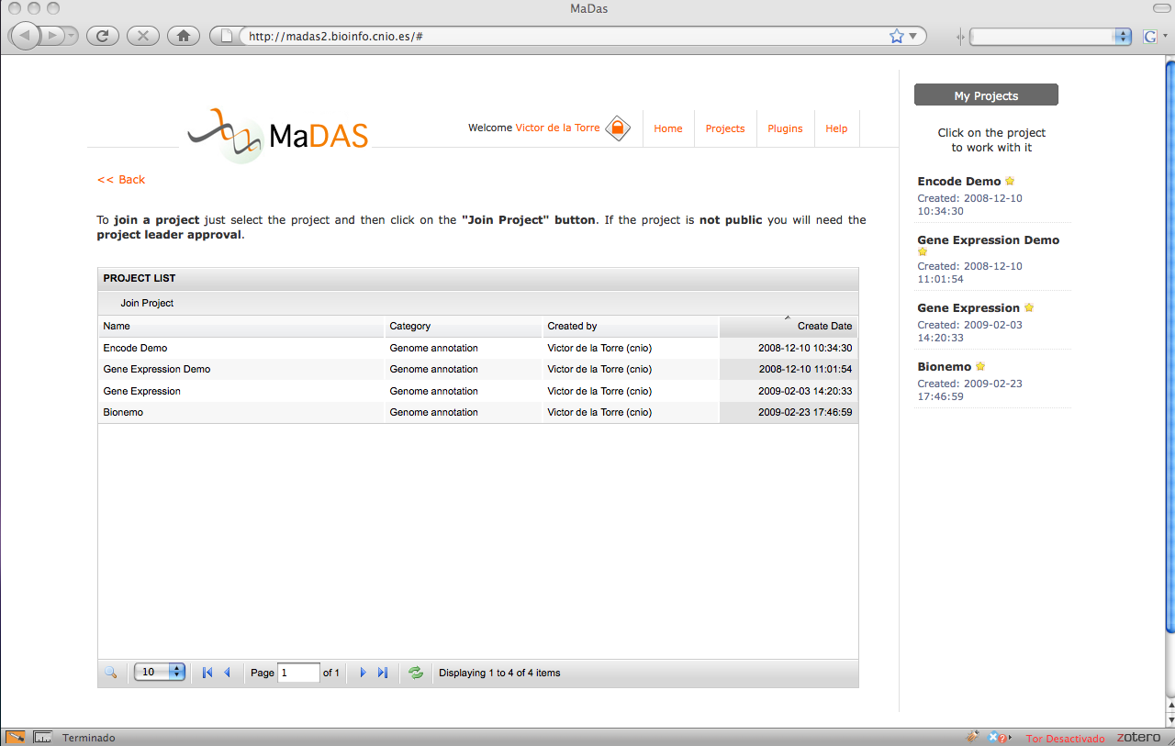
Project workspace
Researchers can build their own projects. A project is the fundamental unit in the research field.

Slide 8
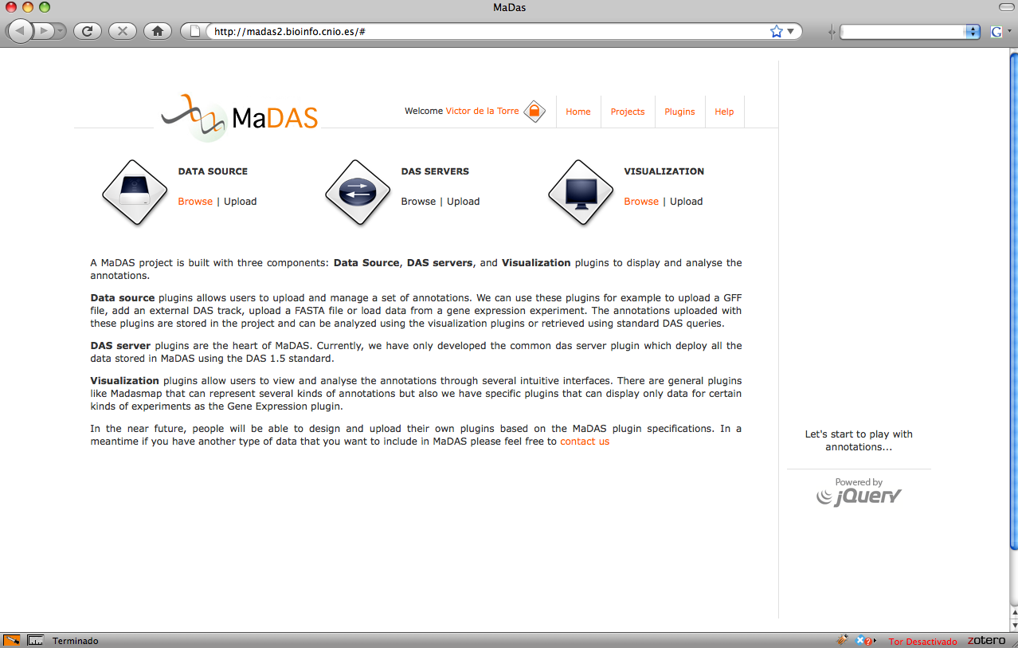
Plug-in system
Integration with external bioinformatic resources is possible through several plug-ins.

Slide 9
Data source plug-ins.

Slide 10
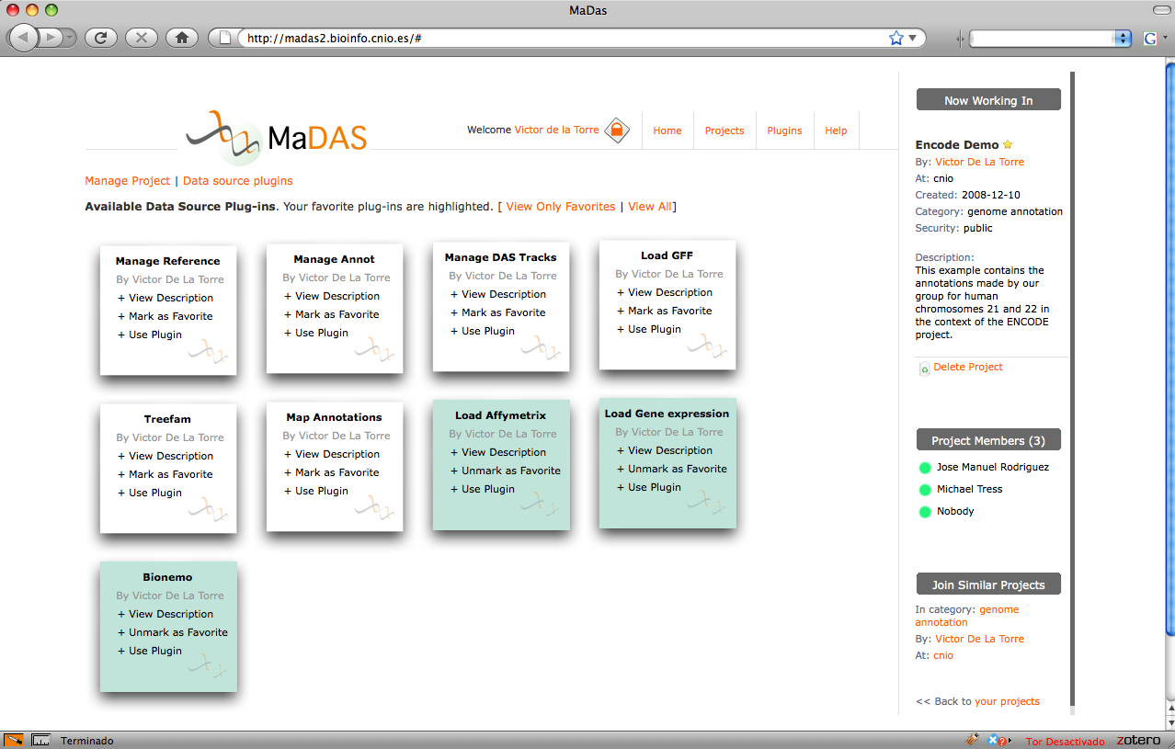
Data source plug-ins
Researchers can upload their data or get it from different repositories.

Slide 11
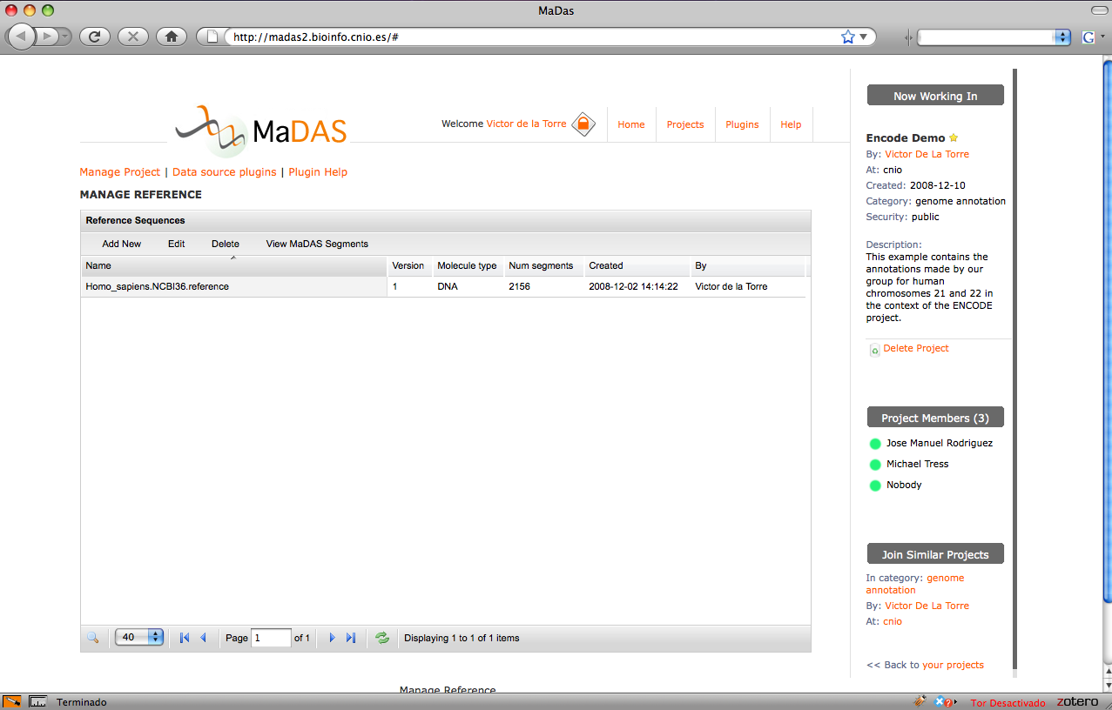
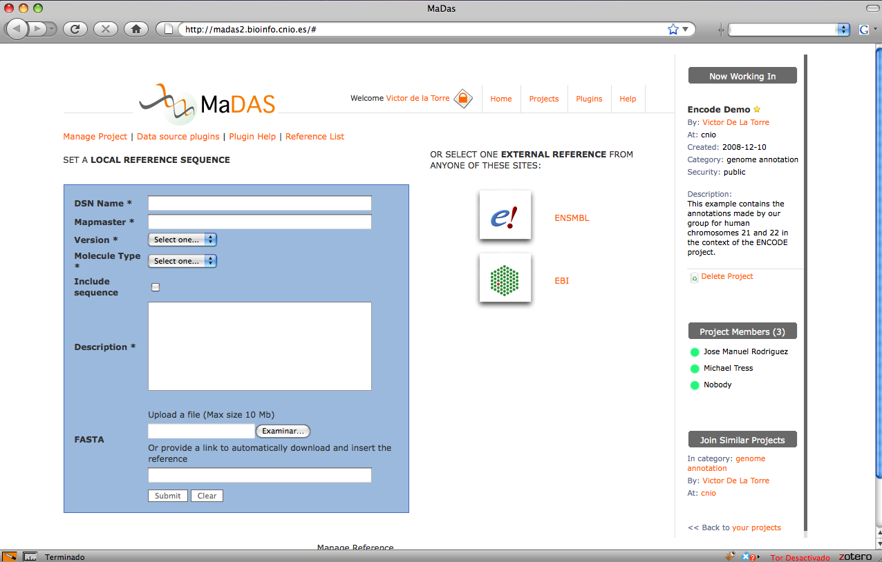
General data source plug-ins
Users can set their sequence reference from Ensembl, Uniprot or provide a new one.

Slide 12
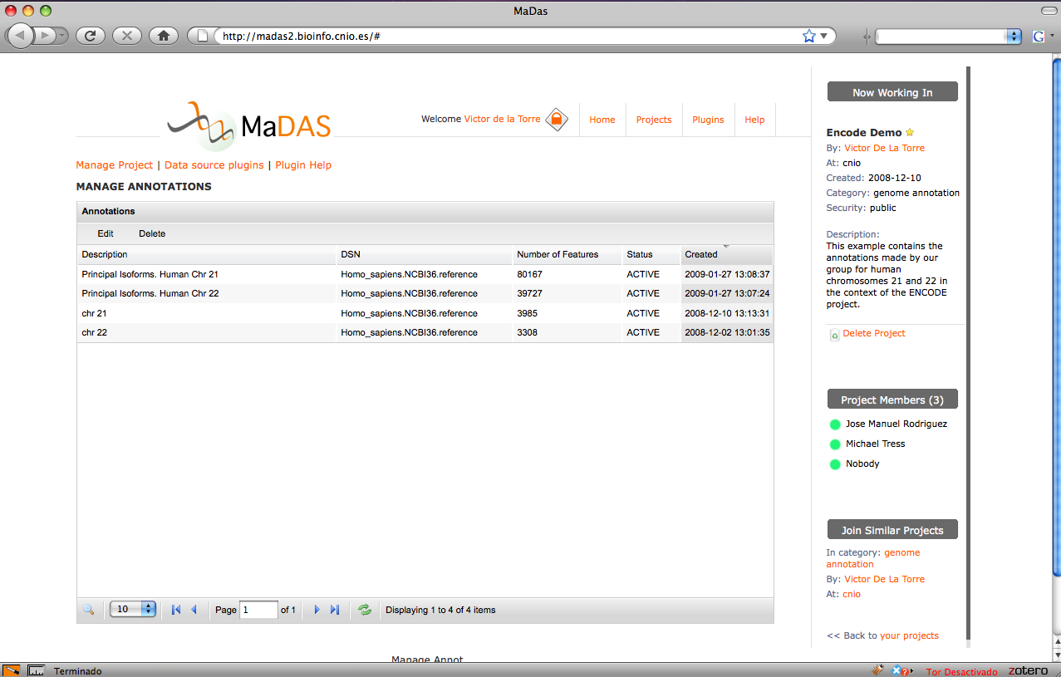
General data source plug-ins
Researchers have full control over their annotations

Slide 13
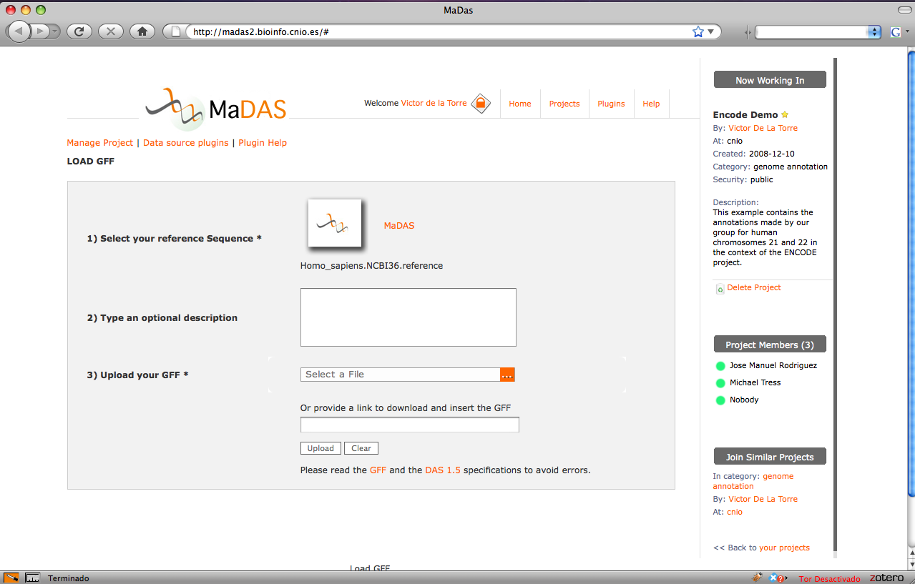
General data source plug-ins
Load GFF files

Slide 14
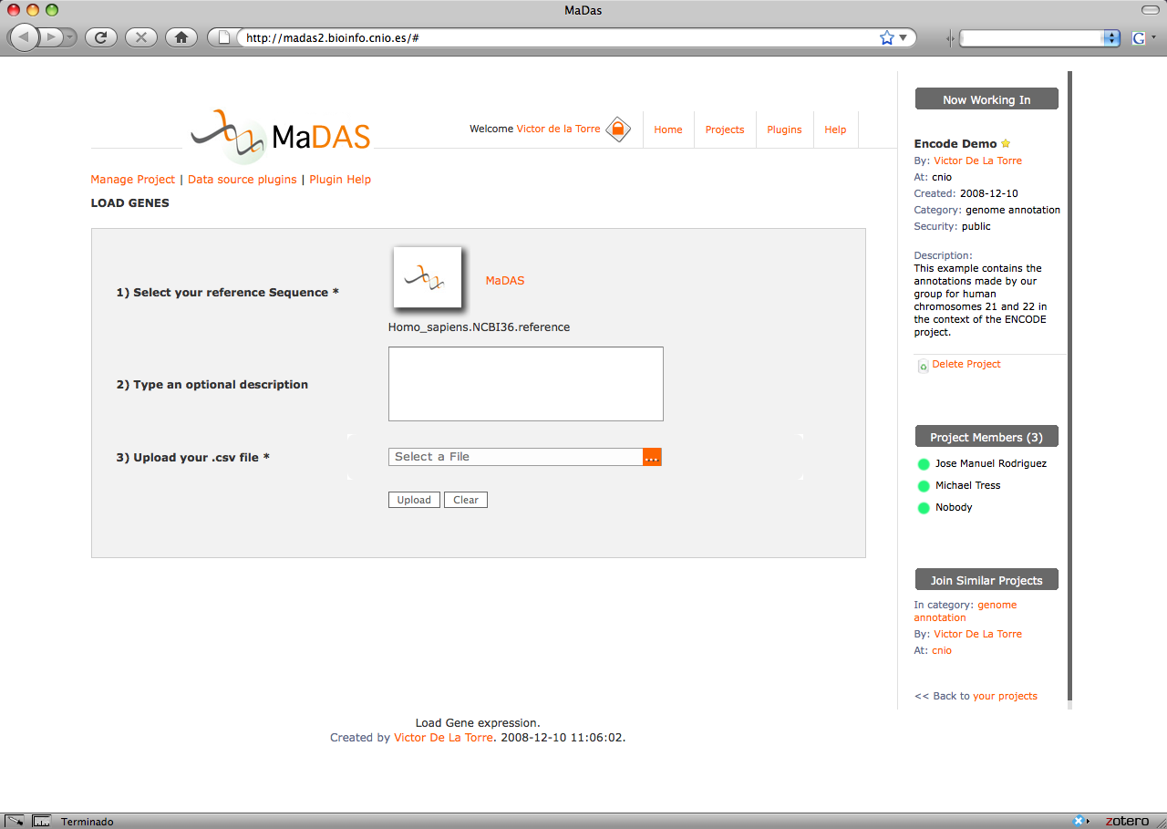
Specific data source plug-ins
Load information from a gene expression experiment.

Slide 15
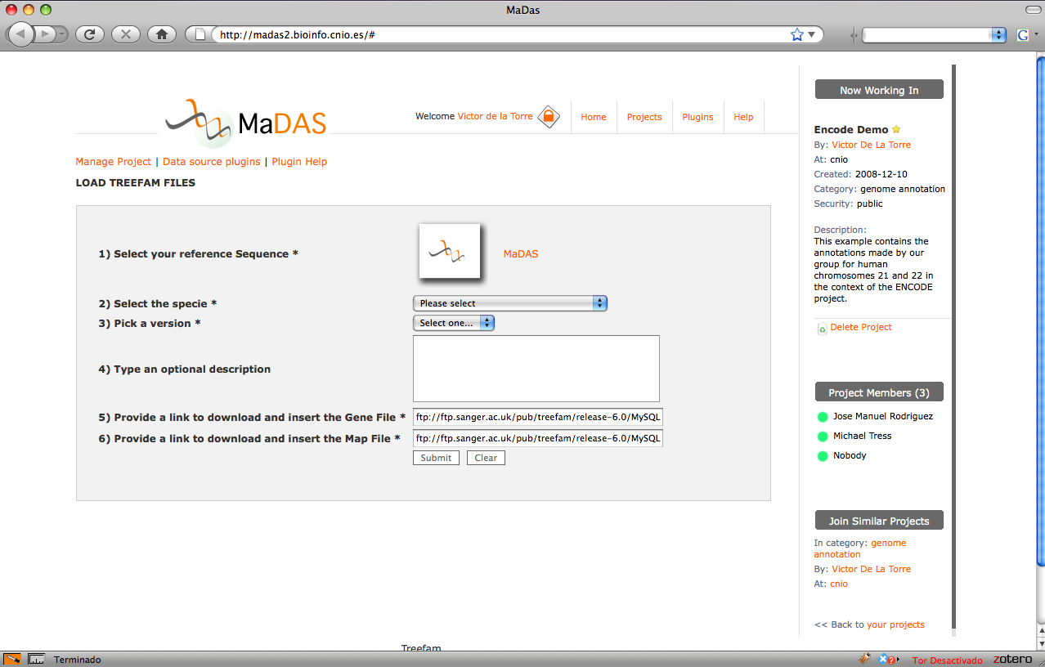
Specific data source plug-ins
Load information from specific databases like Treefam

Slide 16
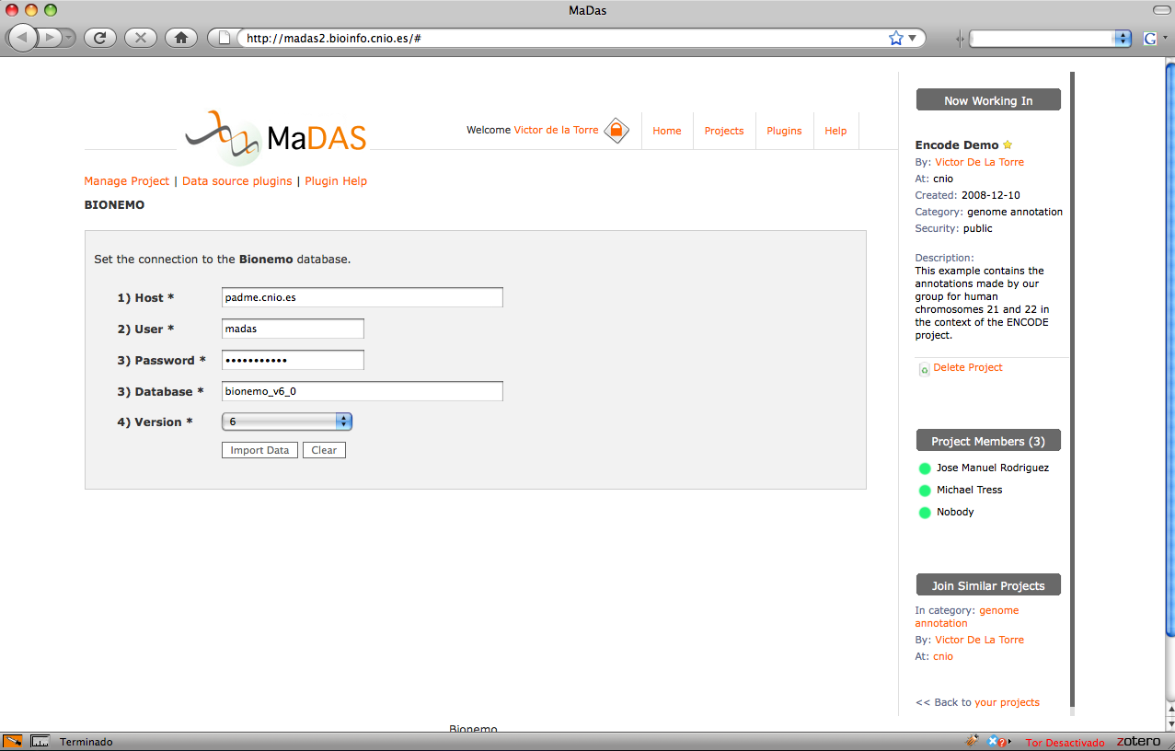
Specific data source plug-ins
Connect to a Postgres SQL server and import the annotations.

Slide 17
Visualization plug-ins.

Slide 18
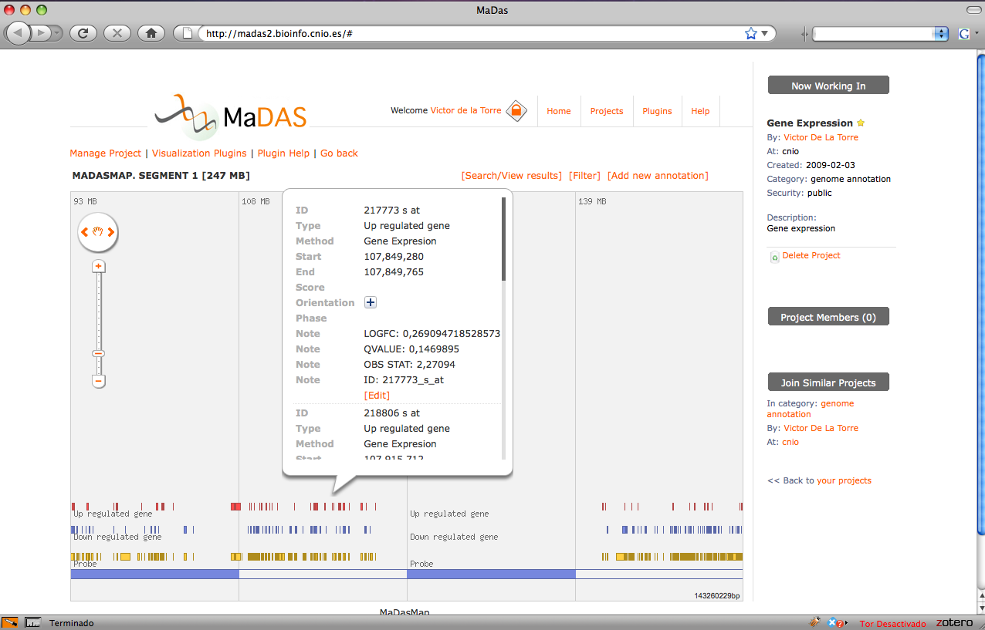
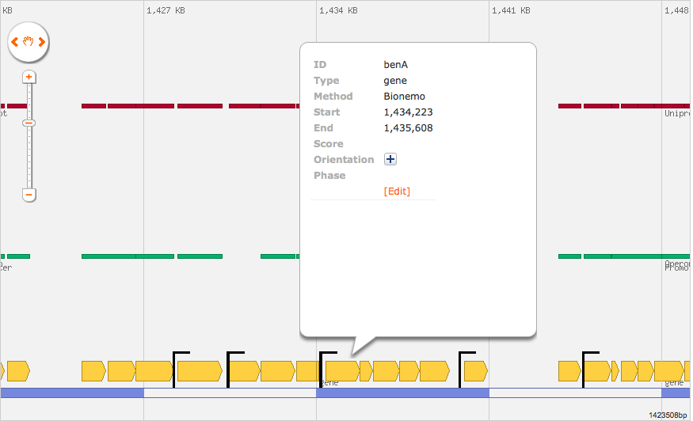
Visualization plug-ins. Madasmap
Google maps like representation of genome or protein annotations

Slide 19
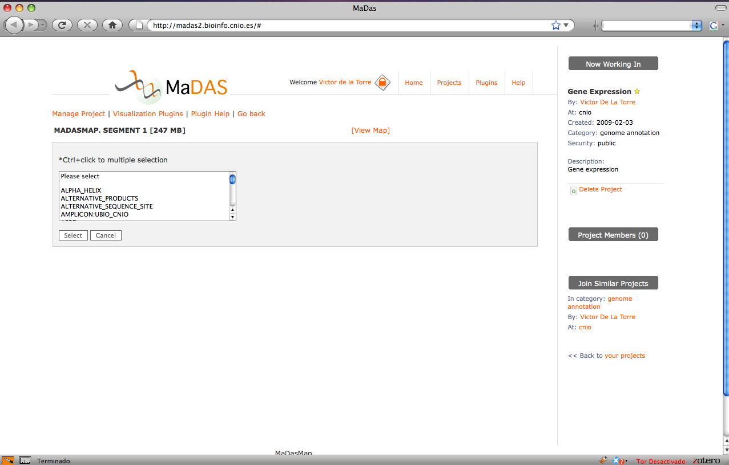
Visualization plug-ins
Users can filter their annotations

Slide 20
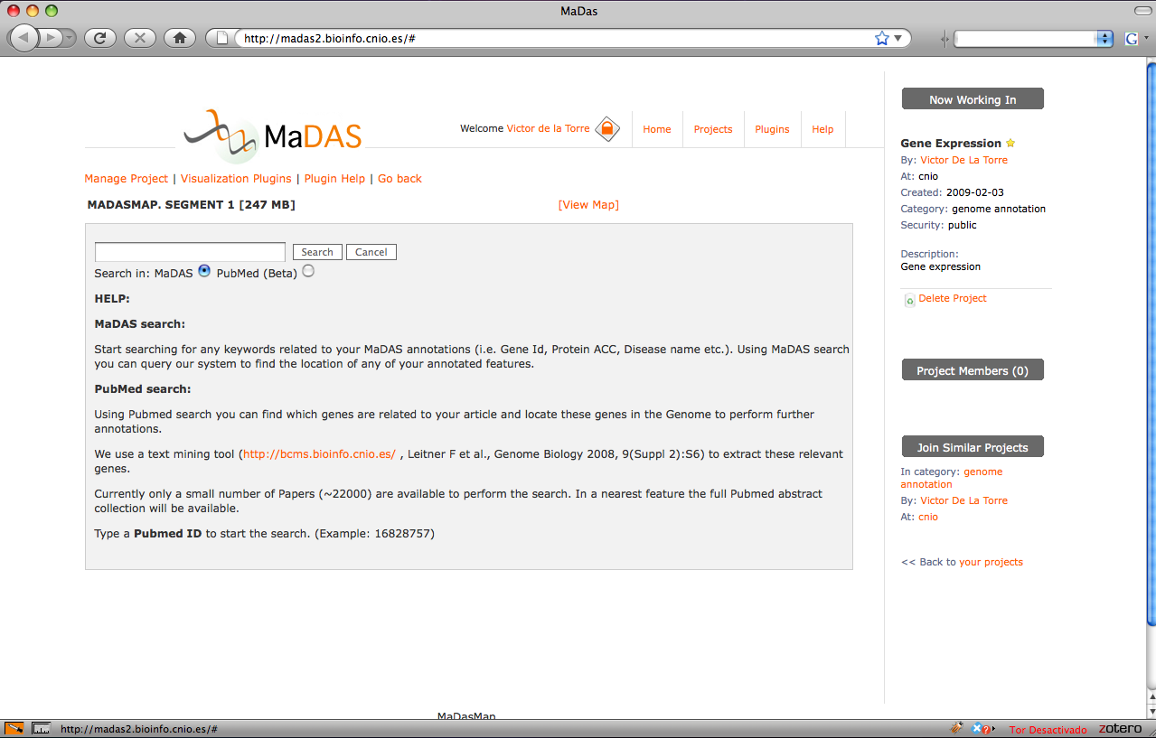
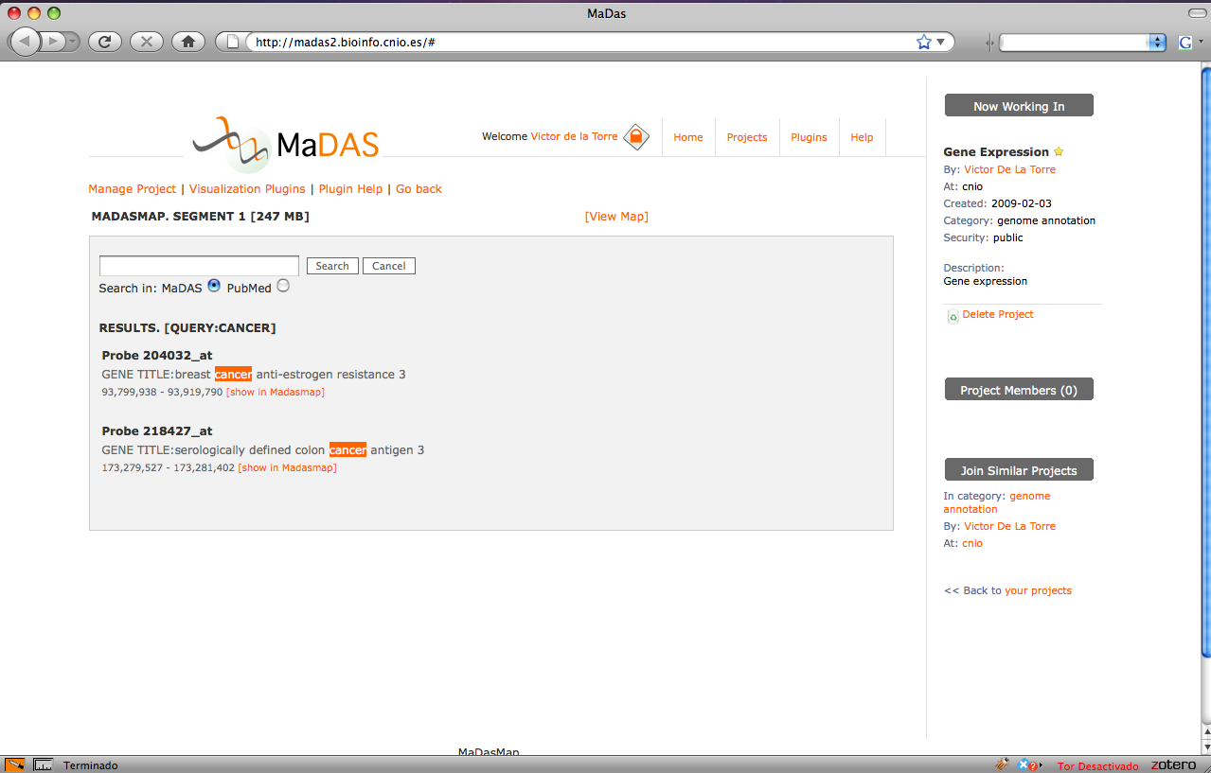
Visualization plug-ins
Internal and Pubmed searches. In Pubmed search, a text mining tool
(Biocreative Metaserver) is used to automatically extract genes from the articles.

Slide 21
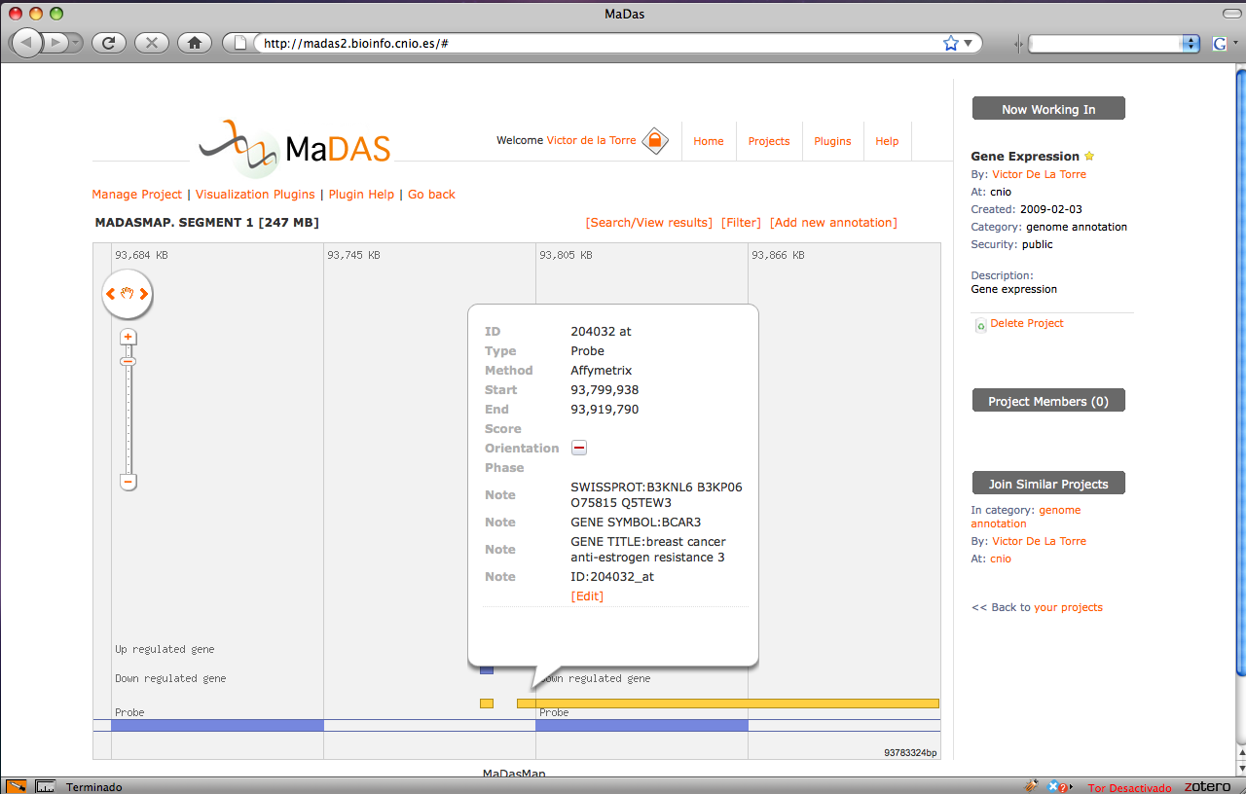
Search results
The query results are mapped to the sequence and displayed in the map.

Slide 22
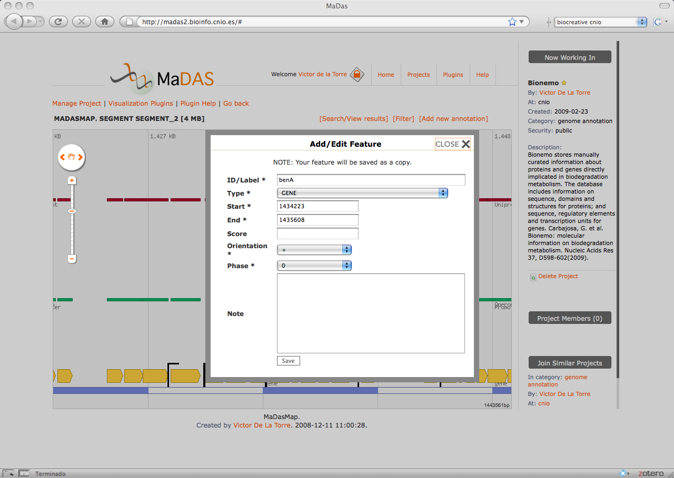
Manual annotations
Users can manually add or edit their annotations

Slide 23
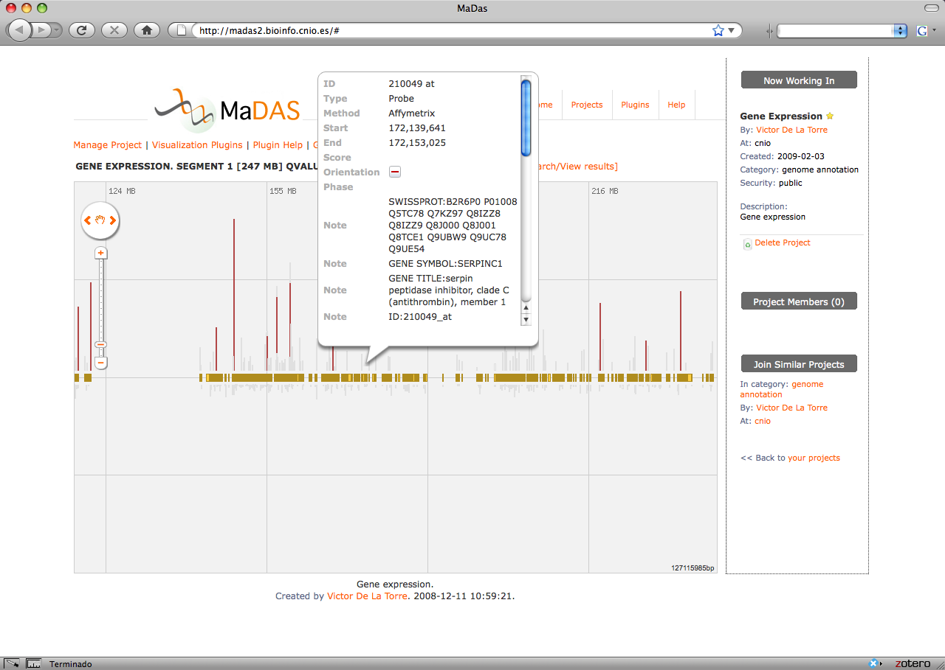
Other plug-in for gene expression
Visualization of a Up/down regulated genes for a given
q-value.
The search and edit capability also work with this plug-in.

Slide 24
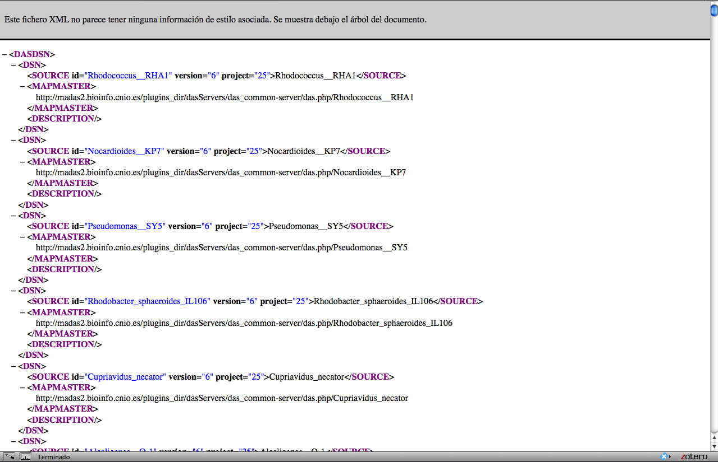
The central plug-in. DAS server
All the information stored in MaDAS is available trough DAS.

Slide 25
Other applications used by MaDAS
Metaserver:
Leitner F et al. Introducing meta-services for biomedical information extraction. Genome Biology 2008, 9(Suppl 2):S6
Bionemo:
Carbajosa, G. et al. Bionemo: molecular information on biodegradation metabolism. Nucleic Acids Res 37, D598-602(2009).

Slide 26
Thanks!
URL: http://madas2.bioinfo.cnio.es
Contact: vdelatorre@cnio.es

