Slide 1
Trellis DAS/2 Server Framework
Gregg Helt

Slide 2
DAS/2 Overview
Same goal and overall strategy as DAS1
  HTTP transport, URL queries, XML responses
  RESTful approach to Web Services
Tries to address many issues with DAS1
Enhancements
  Alternative Data Formats (potentially much more efficient)
  URIs for all assemblies, sequences, features, feature types
  Feature Hierarchies
  Enhanced use of HTTP (caching, authentication, etc.)
  Enhanced use of XML (arbitrary XML, xml:base, etc.)
  Writeback
Current Implementations
  Servers
    Genometry (Java, in-memory object database)
    BioPackages (Perl, GMOD-Chado database)
  Clients: IGB -- Integrated Genome Browser (Java WebStart)
  Validator: Dasypus (Python)
  Trellis Framework
Current deployments
  Public
    Affymetrix
    TransVar (UNC Charlotte)
    Huntsman Cancer Institute (U.Utah)
    Trellis Cloud Deployments
  Private

Slide 3
Trellis DAS/2 Framework
Abstract DAS/2 data model
Basic Server implementation of data model
Translation from DAS HTTP requests to data model (URL → API)
Translation from data models to DAS HTTP responses (API → XML)
Basic DAS/2 servlet
  Add data source plugin(s) for fully functional DAS/2 server
Open source
  http://code.google.com/p/genomancer/
Test deployments on Amazon EC2 cloud

Slide 4
Trellis DAS/2 Server
Trellis Framework Servlet
Data Source
Capabilities Plugin
DAS/2 Client
Model to Data Source Query
DAS/2 Data Model
URL/HTTP Request
to Model
Data Source to Model Response
Model to
XML/HTTP Response

Slide 5
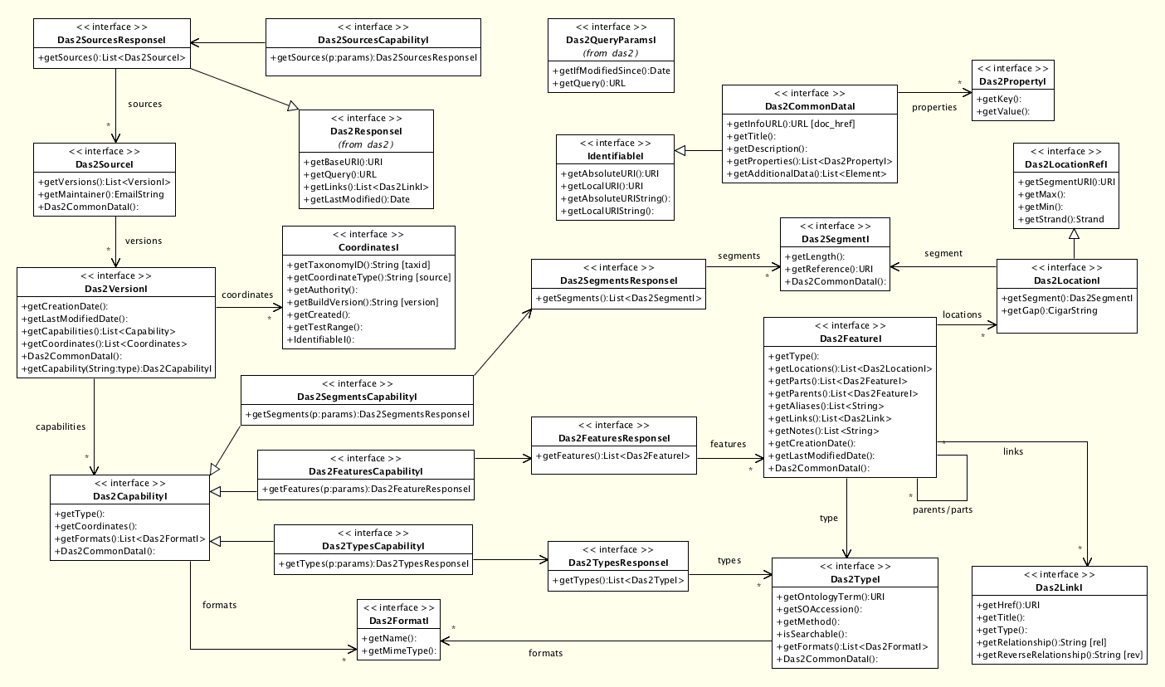
Trellis DAS2 Data Model

Slide 6
Ivy DAS1→DAS2 Proxy
Trellis Framework Servlet
Ivy DAS1→DAS2 Plugin
DAS/1 Server
DAS1 Client
DAS/2 Client
DAS1 HTTP request
DAS1 Data Model
DAS2 to DAS1 query model
DAS2 Data Model
DAS1 HTTP response
DAS1 to DAS2 response model

Slide 7
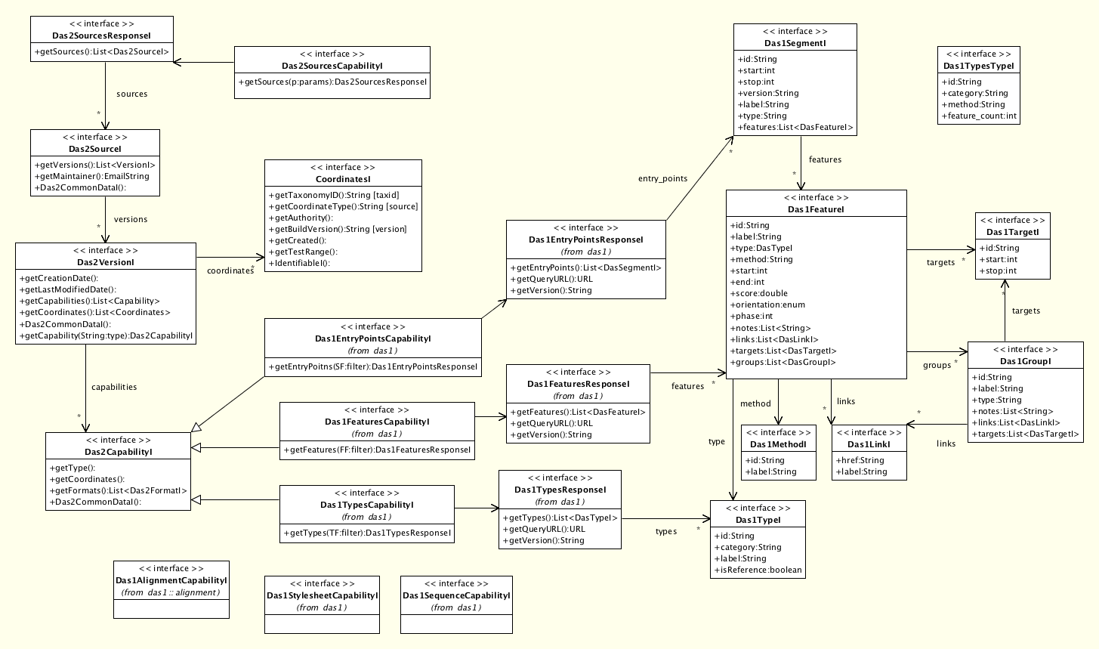
Ivy DAS1 Data Model

Slide 8
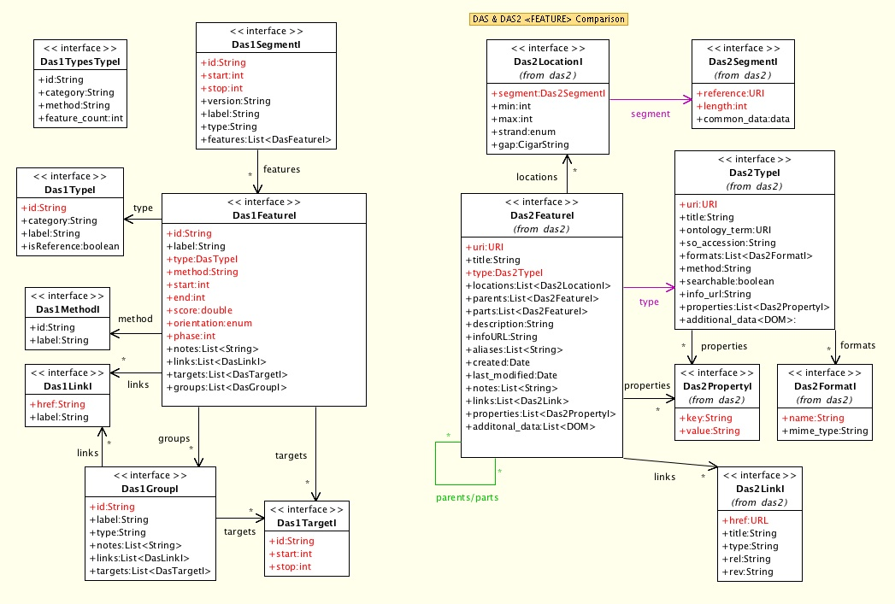
DAS1 / DAS2 Feature Comparison

Slide 9
Ivy DAS1→DAS2 Proxy
Test deployment on the Amazon EC2 cloud
  Proxying for DAS1 Sanger Registry
  http://www.genomancer.org/das2/das1_proxy/sources
Supported DAS 1.53/1.6 queries:
  sources
  segments
  types
  features
Queries not yet supported
  dsn
  dna
  1.53e extensions
    Alignments
    Etc.

Slide 10
Vine DAS2→DAS2 Proxy
Trellis Framework Servlet
Ivy DAS1→DAS2 Plugin
DAS/2 Server
DAS/2 Client
DAS2 Client
DAS2 Data Model
DAS2 HTTP request
DAS2 HTTP
response

Slide 11
Poka: DAS2 UCSC
Genome Database Server
Test deployment on the Amazon EC2 cloud
  http://www.genomancer.org:9095/das2/ucsc/genome/sources
Current release: alpha
    Supports roughly half of UCSC annotation tracks
    Latest human genome:
      1724 total tracks in hg18 genome database
      Poka can serve up 878 as DAS2 types/features
Next release: beta
  Adds support for wiggle/wib tracks

Slide 12
Demo

Slide 13
Trellis Enhancements
Caching
Caching Injection
Sources Capability Injection
Format Injection
  Tranformational DAS Proxy

Slide 14
Sources Capability Injection

Slide 15
Caching Injection

Slide 16
Source/Type Transformations

Slide 17
Format Injection
Trellis supports format plugins
Add format plugin to Trellis, then server can support alternative format even though data source plugin does not
Current: bed
Soon: gff, psl, bps, bgn, bar, wiggle
BigWig?

Slide 18
Format Injection
Trellis Framework Servlet
URL/HTTP Request
to Model
Data Source
Capabilities Plugin
DAS/2 Client
Model to DASXML
HTTP Response
Model to Data Source Query
DAS/2 Data Model
Model to JSON
HTTP Response
Data Source to Model Response
Model to BED
HTTP Response
Model to ProtoBuf
HTTP Response

