Slide 1
Illumina Processing
Steven Leonard (srl@sanger.ac.uk)
David Jackson’s NPG group part of Sequencing Informatics
How we start with images and end up with sequence data
Intensities
Corrections
Quality issues
Notes:
*

Slide 2
MiSeq to HiSeqX
MiSeq (yield 540M - 8.5GB)
Flow cell made on the instrument
Non-patterned flowcell
Small fast, 1 lane, 4 hrs - 2 days, 36 - 600 cycles
HiSeqX (yield 1TB)
New hardware, optics etc.
Patterned flowcell
8 lanes, 2-3 days for 300 (150+150) cycle run

Slide 3
MiSeq to HiSeqX
HiSeq 4000 (yield 50 GB - 750 GB)
Patterned flowcell
8 lanes, 1-3 days for 50-300 cycle run
More variability in read length (e.g. 28+98) than HiSeqX

Slide 4
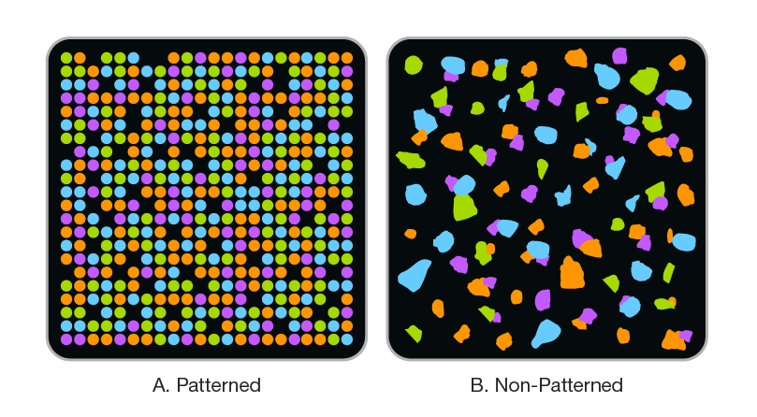
Patterned Flowcell
Illumina - hiseq x percent pf technical note

Slide 5
iSeq 100 and NovaSeq
iSeq 100 (yield 144MB to 1.2 GB - smaller than MiSeq)
Small fast, 1 lane 17.5 hrs for a 300 cycle run
1 channel chemistry
NovaSeq (yield 3 TB - 3x HiSeqX)
4 lanes, 44 hrs for a 300 cycle run
2 channel chemistry
Both use patterned flowcells made on the instrument

Slide 6
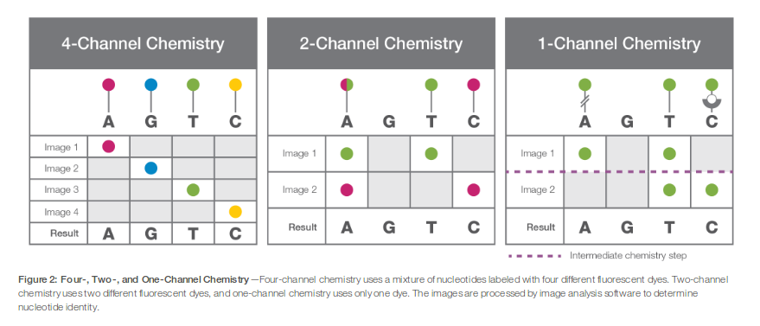
1, 2 or 4 channel chemistry
Source: Illumina tech note “Illumina CMOS Chip and One-Channel SBS Chemistry”

Slide 7
Flowcell – one channel (lane)
top
HiSeq(X)
4/2 cameras
2 surfaces
2 or 3 swathes
Continuous scan
2x3x16 tiles
2x2x14 tiles
2x2x24 tiles
2048*10048 pixels
MiSeq
2 cameras
1 or 2 surfaces
1 swath
4 discrete images
1x1x2 tiles
1x1x14 tiles
2x1x14 tiles
2x1x19 tiles
2944x2866 pixels
Bottom
Notes:
*

Slide 8
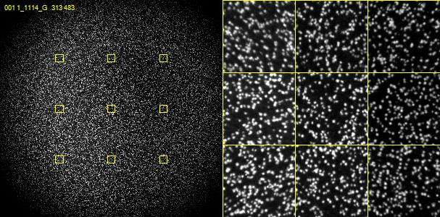
Images - MiSeq

Slide 9
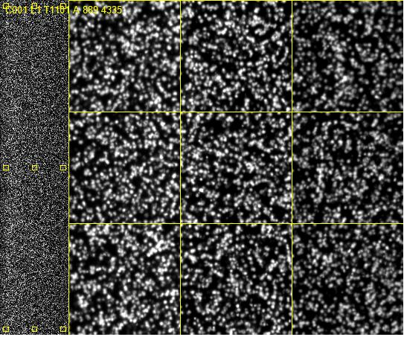
Images - HiSeq

Slide 10
On instrument processing
HCS or MCS
Generates raw images
RTA
Images converted to intensities
Correct raw intensities
Call bases and assign quality values
Basecall (.bcl) files produced for each cycle
We transfer these to staging areas
Can be transferred to BaseSpace for offline processing.
Notes:
*

Slide 11
Image processing and corrections
Template generation (Not HiSeqX)
Image registration
Between cycles, due to stage positioning inaccuracies
Between channels, due to optical path differences
Dye crosstalk correction
Overlap between dye emission spectra causes (e.g.) C bases to appear in A channel images
Phasing correction
Inefficiencies in chemistry cause a subset of molecules to
lead/lag the rest of the cluster, increasingly over time
Notes:
*

Slide 12
Template generation
Looks at first few cycles
HiSeq 4 cycles, MiSeq 4 (v2) or 7 (v3) cycles
4xN images from all channels
Identifies clusters in ALL images
Chooses ‘best’ cycle, cycle with most A/C clusters
Registers all images to best A/C
Generate a set of intensities for each potential cluster
Filters low quality clusters and duplicates
Creates a locations file X/Y locations
Reported cluster density
Notes:
*

Slide 13
Why? - Cluster Mapping
By detecting clusters from multiple cycles there is a better chance of resolving overlapping clusters
Neighbouring clusters are less likely to have the same base for multiple cycles (first four used for template generation)
Low complexity and unbalanced samples can have difficulties at this step

Slide 14
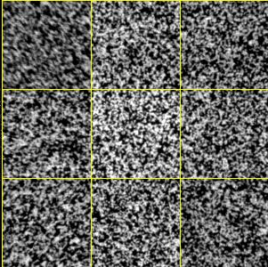
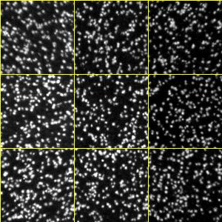
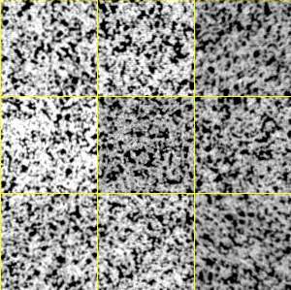
High density/Low complexity
high density tile (1500K / mm²)
normal (800K / mm²)
Low complexity T (1000K / mm²)

Slide 15
Image registration
The stage/camera moves between cycles
For each cycle, tile and channel
Calc a X/Y offset for a region in each corner
From 4 sets of offsets calcs a
X/Y offset
X/Y stretch
X/Y Skew/Rotation
If ANY channel fails
The tile ‘drops out’ basecalls ALL N, qualities 0
Notes:
*

Slide 16
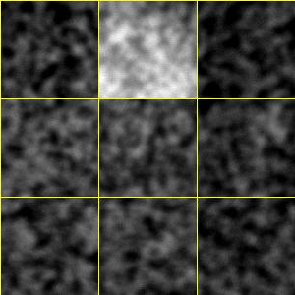
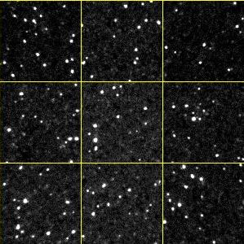
Image focus/Low complexity
Focus (500 K/mm²)
Normal (800 K/mm²)
Low complexity A (1000 K/mm²)

Slide 17
Cross-talk
Overlap between dye emission spectra causes (e.g.) A bases to appear in C channel images
Calculate the cross-talk between each pair of channels - matrix
HiSeq - template cycles i.e. first 4 cycles
MiSeq - first 11 cycles (low complexity)
Apply inverse of this matrix to correct cross-talk
Notes:
*

Slide 18
Matrix Calculations
Matrix corrects for cross-talk between the channels and normalizes the observed intensity differences
T
G
A C G T
A 0.65 0.14 0.01 0.02
C 0.81 1.04 0.02 0.03
G 0.02 0.02 1.18 0.04
T 0.03 0.03 1.10 1.56

Slide 19
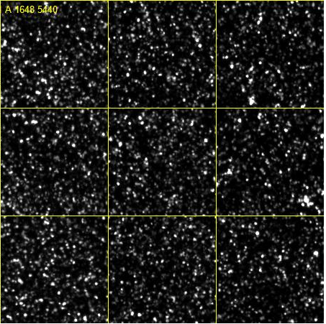
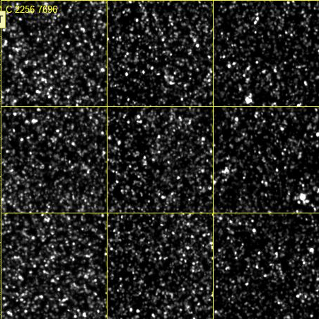
Cross-talk
Notes:
*

Slide 20
Cluster finding, image registration, crosstalk correction
Cluster finding
High Density reduce density
Low complexity Spike 50% phix (HiSeq)
Registration
High Density reduce density
Low complexity Spike in 5% phix
Crosstalk correction
Low complexity Spike in 20-50% phix (HiSeq)

Slide 21
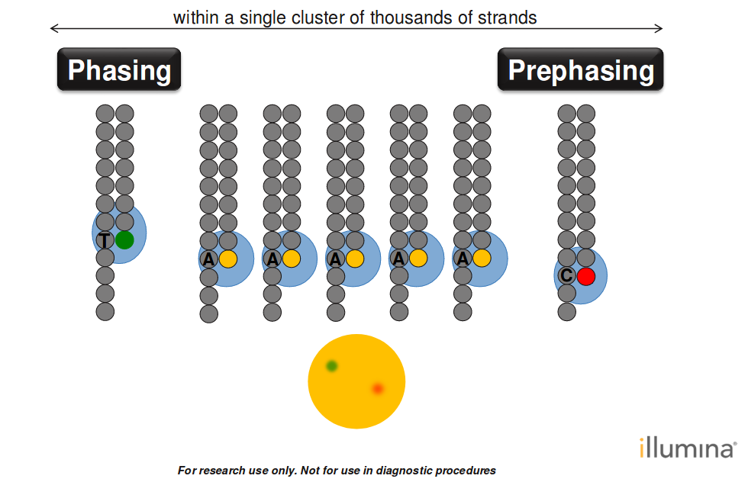
(Pre)Phasing Correction
Notes:
*

Slide 22
Phasing Correction
Phasing is cumulative
Can affect a significant fraction of the cluster for long reads
Estimate
For each base look for clusters where the previous/next base is different to the called base. Calculate the average relative intensity in the previous/next base in the channel corresponding to the called base
Dynamic
Phasing is estimated and corrected dynamically

Slide 23
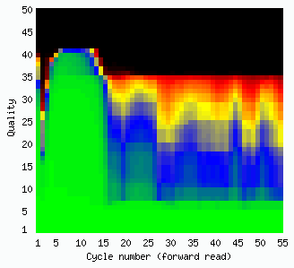
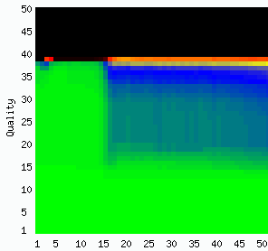
Phasing Correction
HiSeq
MiSeq

Slide 24
Base calling and quality scoring
Tiles are basecalled independently
Base calling is easy: Pick the base corresponding to the
highest corrected intensity for each cluster
Quality scoring: Calculate the probability that a given base in a read has been called incorrectly
BCL file 1 byte per base
2 bits for basecall [ACGT]
6 bits for quality score (0..63)
quality 0 ⇔ Basecall N
Notes:
*

Slide 25
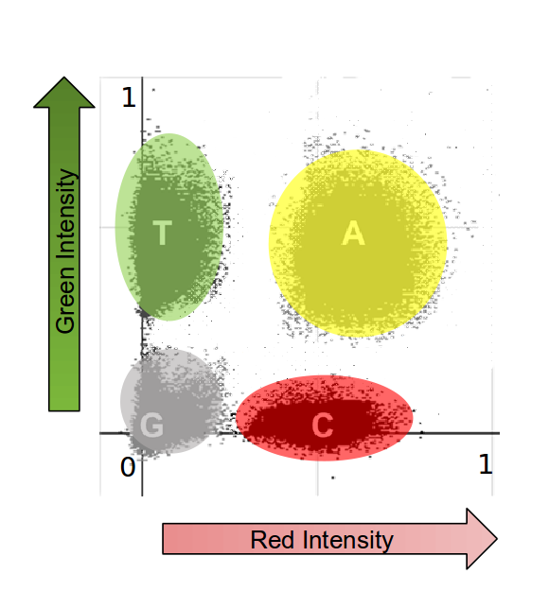
NovaSeq - Basecalling and Quality Scoring
One CBCL file per surface containing 468 tiles
1/2 byte per base
2 bits for basecall [ACGT]
4 quality scores so 2 bits per base
No call (0)
low(11)
medium(25)
high(37).

Slide 26
Quality scores
Representation of probability of base called incorrectly
Phred scaled -10.0*log₁₀(prob. error)
10 1/10 chance of an error
20 1/100
30 1/1000
40 1/10000
Readable form ascii character: Q+33 (!=0…b=64)
Notes:
*

Slide 27
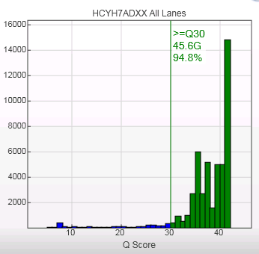
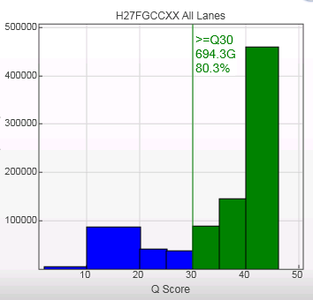
Reduced set of quality scores
Notes:
*

Slide 28
Quality score computation
Quality scores are computed by a 6-dimensional table lookup using features derived from the data:
Motif (6-mer) Are we in a difficult sequencing context ?
Motif accumulation Have we been in a difficult sequencing context ?
Endiness Where are we in the read ?
Shifted Purity, G adjusted Modified purity
Online Overlap Are the local intensities ‘Noisy’ ?
Penultimate Chastity 25 Value used for purity filtering
“Canned” calibration table is used Different tables for HiSeq and MiSeq
Notes:
*

Slide 29
“Purity” filtering (PF)
Base caller assumes cluster is homogeneous
may produce errors if it is mixed
PF attempts to remove mixed clusters.
Definition: Chastity = I_{MAX} / (I_{MAX}+I_{NEXT}) > 0.6
Reads which fail the Chastity check more than once in the first 25 cycles are discarded
bcl files contain ALL reads there is a separate filter file
~5% of reads discarded on a MiSeq, depending on density of lane, 20-30% on a patterned flowcell
Can be (much) lower if you overload the flowcell i.e. if the density is too high
Notes:
*

Slide 30
Low complexity - PF rate too high

Slide 31
Phasing vs purity filtering
Different phenomena:
Mixed clusters are problematic from the start
Phasing is a gradual process
Different response:
PF discards entire reads
Phasing degrades individual base quality
Phasing has minimal effect in first 25 cycles examined by PF
Notes:
*

Slide 32
Spiked phix
PhiX sample “spiked in” to every lane at ~0.5%
Known sequence
Controls used for error rate estimation
Computed on instrument in near-realtime
Spatial distribution of errors
Notes:
*

Slide 33
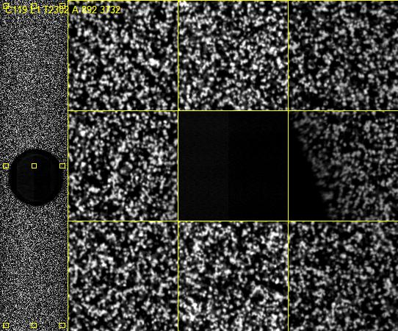
Bubbles

Slide 34
Spatial filter
Bubble detection
Spatially correlated.
Attributed to bubbles in reagent flow inhibiting chemistry in
small region of tile.
Affects all molecules of a cluster.
coverage - PF filtering
Indels, errors, low quality
Notes:
*

Slide 35
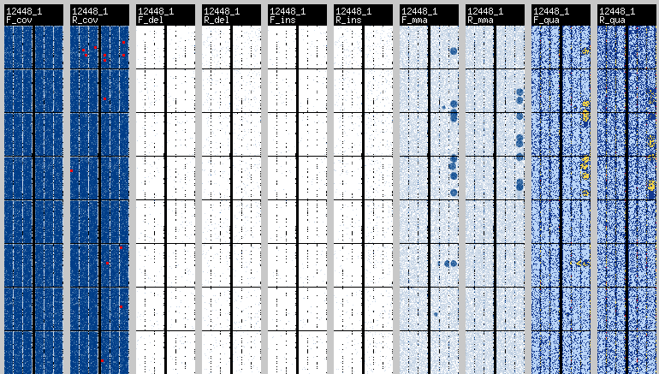
Spatial filter - images
Notes:
*

Slide 36
Multiplexed samples
Ligate a different “bar-code” tag to each sample
Pool samples
Sequence read-1, tag, read-2, separately primed
Choose tag set carefully
want variation in each cycle of the index read
prevent focus/registration problems
aids decoding
Notes:
*

Slide 37
Take-home message
There’s a lot of software between flowcell and sequence file
New versions of software are released frequently
Every run is different
At Sanger, every run gets QC checked by a human
Track your configuration!
Notes:
*

Slide 39
What next ?
QC checks
Alignment to reference
De novo assembly
SNP-finding
Application-specific steps (ChIP-Seq, RNAseq,...)
Archival (packaging, reduce quality values, lossy compression)
You’ll need a pipeline to automate all this!
Notes:
*

Slide 40
BaseSpace
Illumina-sponsored, cloud-hosted repository for storage and processing of data products from Illumina instruments
.bcl files loaded from instrument direct to the cloud
Complete analysis platform and repository
Enables web-based data management and analysis
Provides tools for collaboration and sharing
“App store” support for third-party tools
Notes:
*

Slide 41
Packaging
Fastq
Sequence + quality
SAM / BAM (samtools/htslib - Github, )
Sequence + quality + alignment + tags
Headers contain instrument and analysis information
CRAM (htslib)
Reference-based compression, optionally binned Q-scores
Notes:
*

Slide 42
Some numbers (input tiff files)
8 * 96 * 100 * 2 * 4 * 2048 * 10048 * 2 = 25.12 TB HiSeq - 2000
2 * 64 * 100 * 2 * 4 * 2048 * 10048 * 2 = 4.21 TB HiSeq - 2500
1 * 28 * 150 * 2 * 4 * 2994 * 2866 * 2 = 0.57 TB MiSeq
Bytes/Pixel
Y Pixels
X Pixels
Bases
Reads
Cycles
Tiles/Lane
Lanes/Flowcell
Notes:
*

Slide 43
Some numbers (output bases)
8 * 96 * 100 * 2 * 3000000 * 0.90 = 414 GBases HiSeq - 2000
2 * 64 * 100 * 2 * 3000000 * 0.90 = 70 GBases HiSeq - 2500
1 * 28 * 150 * 2 * 700000 * 0.90 = 3.6 Gbases MiSeq
PF
Clusters/Tile
Reads
Cycles
Tiles/Lane
Lanes/Flowcell
Notes:
*

Slide 44
Throughput and timings
HiSeq 2000
60 minutes / cycle = 24 cycles / day
2.30 Gbases / cycle = 55 Gbases / day
HiSeq 2500 (rapid run)
8 minutes / cycle = 180 cycles / day
385 Mbases / cycle = 70 Gbases / day
MiSeq
5 minutes / cycle = 288 cycles / day
19.2 Mbases / cycle = 5.53 Gbases / day
Notes:
*

Slide 45
On instrument processing
HiSeq
MiSeq
HCS
MCS
Images
Images
Raw Intensities
Raw Intensities
RTA
RTA
Processed Intensities
Processed Intensities
BaseCalls
BaseCalls

Slide 46
Cluster finding, image registration, crosstalk correction
A
C
G
T
1
2
3
4
5
6
7
7
7
Notes:
*

Slide 47
Low complexity e.g. TraDis (Transposon Directed Insertion Site Sequencing)
A
C
G
T
1
2
3
4
5
6
7
Notes:
*

Slide 48
Correlation matrix
 | signal A | signal C | signal G | signal T
base A | 1.03 | 0.09 | 0.0 | 0.0
base C | 1.24 | 1.03 | 0.0 | 0.0
base G | 0.0 | 0.0 | 1.03 | 0.02
base T | 0.0 | 0.0 | 0.52 | 1.03

Slide 49
Milestone cycles
Template generation after 4 cycles
Nine hour processing halt on HiSeq
Crosstalk parameter estimated on 2nd cycle in each read
HiSeq calculate a new matrix for each read, 2nd cycle
MiSeq uses read 1 matrix for ALL reads
Phasing/Prephasing
HiSeq calculated over first 11 cycles
MiSeq dynamic correction, reported value is average over 25 cycles
Purity filtering after 25 cycles
BCL files contains ALL reads
Filter file contains a flag indicating which read pass filter
Notes:
*

