Slide 1
Illumina Processing
Steven Leonard (srl@sanger.ac.uk)
David Jackson’s NPG group part of Sequencing Informatics
How we start with images and end up with sequence data
Intensities
Corrections
Quality issues
Notes:
*

Slide 2
MiSeq to HiSeqX
MiSeq
Flow cell made on the instrument
Small fast, 1 lanes 1-2 days for a 600 cycle run
HiSeq 2000
Flow cells made elsewhere (cBot)
8 lanes, ~8-9 days for a 200 cycle run V3 chemistry
8 lanes, ~3-4 days for a 250 cycle run V4 chemistry
2 flowcells, independent runs

Slide 3
MiSeq to HiSeqX
HiSeq 2500 (rapid runs)
Upgraded 2000
Flow cell made on the instrument
2 lanes, 1-2 days for 200 cycle run
HiSeqX
New hardware, optics etc.
Patterned flowcell
density ~ 50% more usable data HiSeq 2000
8 lanes, 2-3 days for 300 cycle run

Slide 4
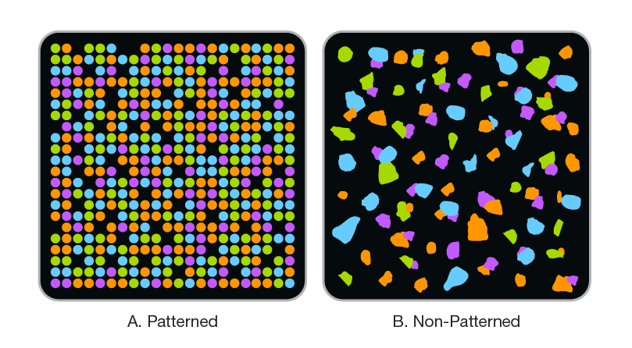
Patterned Flowcell
Illumina - hiseq x percent pf technical note

Slide 5
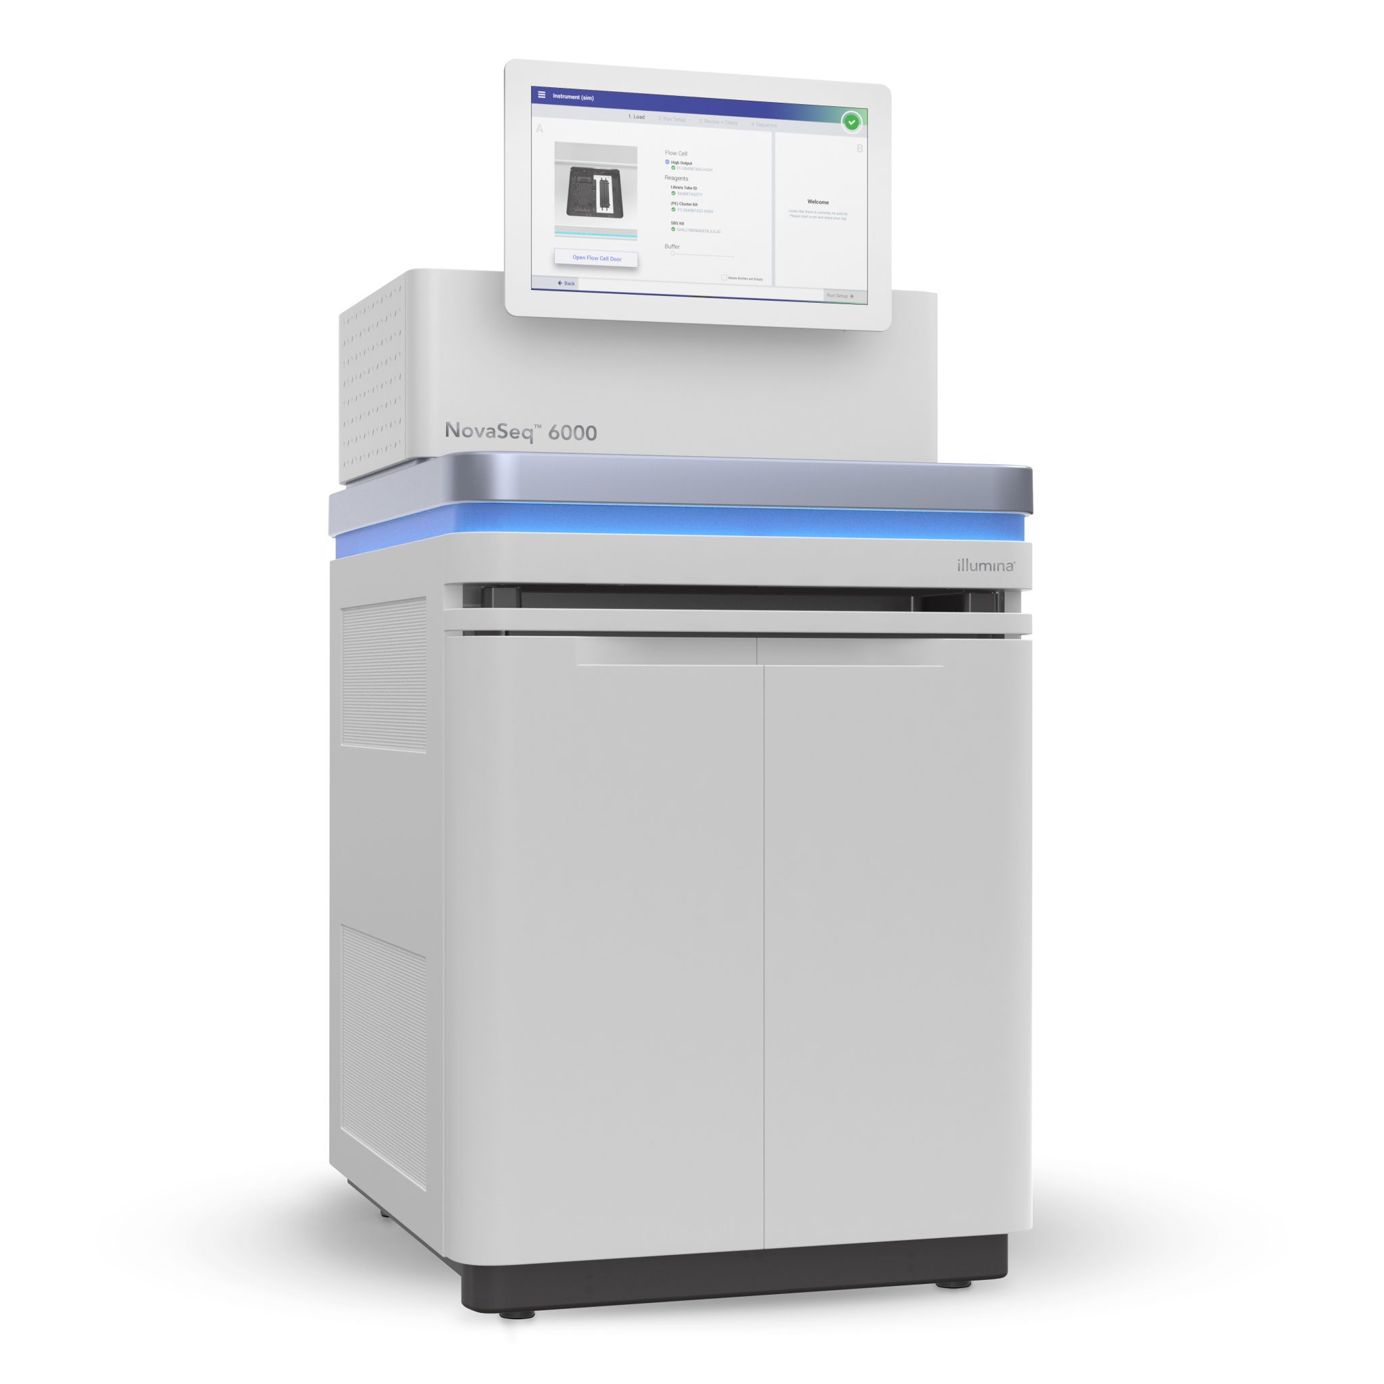
HiSeqX to NovaSeq
Pattern Flowcell
8 lanes but the same library in every lane
Multiple Modes, depending on data volume and speed
Best data volume, 3x more data per lane than a HiSeqX

Slide 6
Flowcell – one channel (lane)
top
HiSeq(X)
4/2 cameras
2 surfaces
2 or 3 swathes
Continuous scan
2x3x16 tiles
2x2x14 tiles
2x2x24 tiles
2048*10048 pixels
MiSeq
2 cameras
1 or 2 surfaces
1 swath
4 discrete images
1x1x2 tiles
1x1x14 tiles
2x1x14 tiles
2x1x19 tiles
2944x2866 pixels
Bottom
Notes:
*

Slide 7
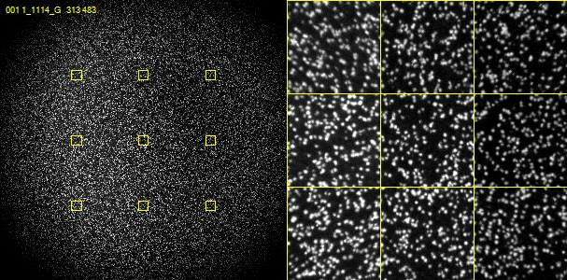
Images - MiSeq

Slide 8
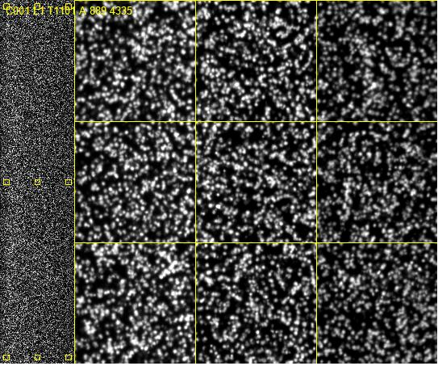
Images - HiSeq

Slide 9
On instrument processing
HCS or MCS
Generates raw images
RTA
Images converted to intensities
Correct raw intensities
Call bases and assign quality values
Basecall (.bcl) files produced for each cycle
We transfer these to staging areas
Can be transferred to BaseSpace for offline processing.
Notes:
*

Slide 10
Image processing and corrections
Template generation (Not HiSeqX)
Image registration
Between cycles, due to stage positioning inaccuracies
Between channels, due to optical path differences
Dye crosstalk correction
Overlap between dye emission spectra causes (e.g.) C bases to appear in A channel images
Phasing correction
Inefficiencies in chemistry cause a subset of molecules to
lead/lag the rest of the cluster, increasingly over time
Notes:
*

Slide 11
Template generation
Looks at first few cycles
HiSeq 4 cycles, MiSeq 4 (v2) or 7 (v3) cycles
4xN images from all channels
Identifies clusters in ALL images
Chooses ‘best’ cycle, cycle with most A/C clusters
Registers all images to best A/C
Generate a set of intensities for each potential cluster
Filters low quality clusters and duplicates
Creates a locations file X/Y locations
Reported cluster density
Notes:
*

Slide 12
Why? - Cluster Mapping
By detecting clusters from multiple cycles there is a better chance of resolving overlapping clusters
Neighbouring clusters are less likely to have the same base for multiple cycles (first four used for template generation)
Low complexity and unbalanced samples can have difficulties at this step

Slide 13
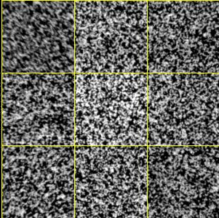
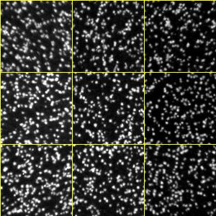
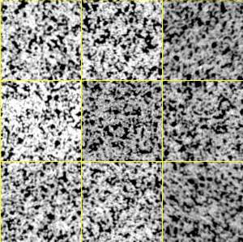
High density/Low complexity
high density tile (1500K / mm²)
normal (800K / mm²)
Low complexity T (1000K / mm²)

Slide 14
Image registration
The stage/camera moves between cycles
For each cycle, tile and channel
Calc a X/Y offset for a region in each corner
From 4 sets of offsets calcs a
X/Y offset
X/Y stretch
X/Y Skew/Rotation
If ANY channel fails
The tile ‘drops out’ basecalls ALL N, qualities 0
Notes:
*

Slide 15
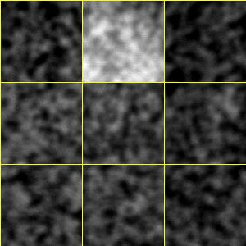
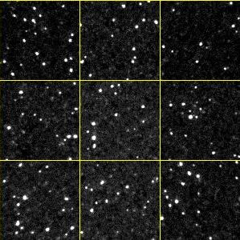
Image focus/Low complexity
Focus (500 K/mm²)
Normal (800 K/mm²)
Low complexity A (1000 K/mm²)

Slide 16
Cross-talk
Overlap between dye emission spectra causes (e.g.) A bases to appear in C channel images
Calculate the cross-talk between each pair of channels - matrix
HiSeq - template cycles i.e. first 4 cycles
MiSeq - first 11 cycles (low complexity)
Apply inverse of this matrix to correct cross-talk
Notes:
*

Slide 17
Matrix Calculations
Matrix corrects for cross-talk between the channels and normalizes the observed intensity differences
T
G
A C G T
A 0.65 0.14 0.01 0.02
C 0.81 1.04 0.02 0.03
G 0.02 0.02 1.18 0.04
T 0.03 0.03 1.10 1.56

Slide 18
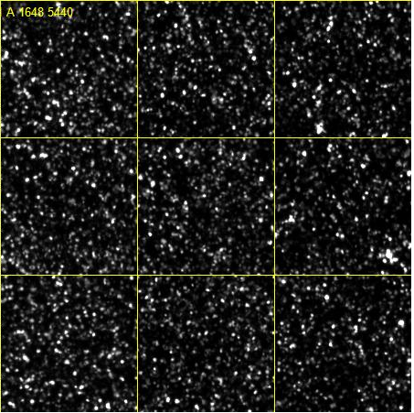
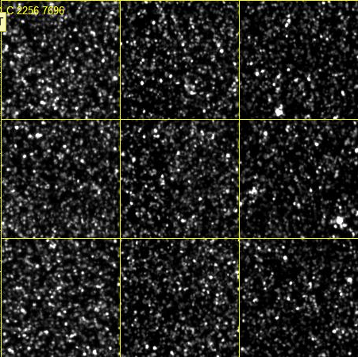
Cross-talk
Notes:
*

Slide 19
Cluster finding, image registration, crosstalk correction
Cluster finding
High Density reduce density
Low complexity Spike 50% phix (HiSeq)
Registration
High Density reduce density
Low complexity Spike in 5% phix
Crosstalk correction
Low complexity Spike in 20-50% phix (HiSeq)

Slide 20
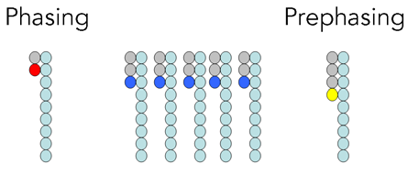
Phasing Correction
Source: Illumina Sequence Analysis Software User Guide
Notes:
*

Slide 21
Phasing Correction
Phasing is cumulative
Can affect a significant fraction of the cluster for long reads
Estimate
For each base look for clusters where the previous/next base is different to the called base. Calculate the average relative intensity in the previous/next base in the channel corresponding to the called base
Dynamic
Phasing is estimated and corrected dynamically

Slide 22
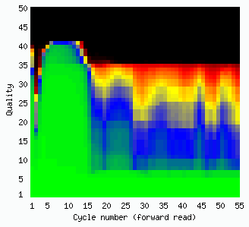
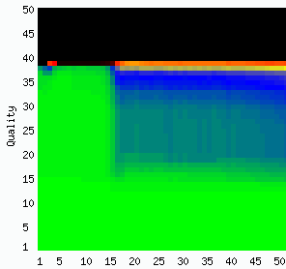
Phasing Correction
HiSeq
MiSeq

Slide 23
Base calling and quality scoring
Tiles are basecalled independently
Base calling is easy: Pick the base corresponding to the
highest corrected intensity for each cluster
Quality scoring: Calculate the probability that a given base in a read has been called incorrectly
BCL file 1 byte per base
2 bits for basecall [ACGT]
6 bits for quality score (0..63)
quality 0 ⇔ Basecall N
Notes:
*

Slide 24
Quality scores
Representation of probability of base called incorrectly
Phred scaled -10.0*log₁₀(prob. error)
10 1/10 chance of an error
20 1/100
30 1/1000
40 1/10000
Readable form ascii character: Q+33 (!=0…b=64)
Notes:
*

Slide 25
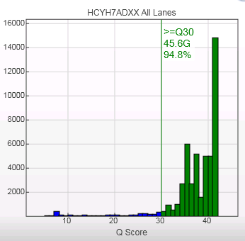
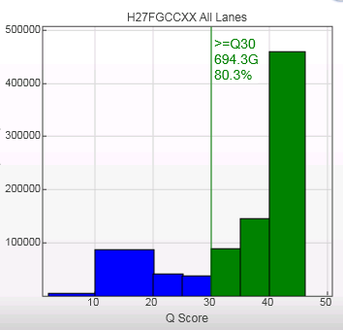
Reduced set of quality scores
Notes:
*

Slide 26
Quality score computation
Quality scores are computed as a 6-dimensional table
lookup driven by features derived from the data:
Motif Are we in a difficult sequencing context ?
Motif accumulation Have we been in a difficult sequencing context ?
Endiness Where are we in the read ?
Shifted Purity, G adjusted Modified purity
Online Overlap Are the local intensities ‘Noisy’ ?
Penultimate Chastity 25 Value used for purity filtering
“Canned” calibration table is used Different tables for HiSeq and MiSeq
Notes:
*

Slide 27
“Purity” filtering (PF)
Base caller assumes cluster is homogeneous
may produce errors if it is mixed
PF attempts to remove mixed clusters.
Definition: Chastity = IMAX / (IMAX+INEXT) > 0.6
Reads which fail the Chastity check more than
once in the first 25 cycles are discarded
bcl files contain ALL reads there is a separate filter file
~5% of reads discarded, depending on density of lane
Can be (much) lower if density too high
Can be too high if low complexity in first 25 cycles
Notes:
*

Slide 28
Low complexity - PF rate too high

Slide 29
Phasing vs purity filtering
Different phenomena:
Mixed clusters are problematic from the start
Phasing is a gradual process
Different response:
PF discards entire reads
Phasing degrades individual base quality
Phasing has minimal effect in first 25 cycles examined by PF
Notes:
*

Slide 30
Spiked phix
PhiX sample “spiked in” to every lane at ~0.5%
Known sequence
Controls used for error rate estimation
Computed on instrument in near-realtime
Notes:
*

Slide 31
Multiplexed samples
Ligate a different “bar-code” tag to each sample
Pool samples
Sequence read-1, tag, read-2, separately primed
Choose tag set carefully
want variation in each cycle of the index read
prevent focus/registration problems
aids decoding
Notes:
*

Slide 32
Take-home message
There’s a lot of software between flowcell and sequence file
New versions of software are released frequently
Every run is different
At Sanger, every run gets QC checked by a human
Track your configuration!
Notes:
*

