Slide 1
Scaff10x – A Relational Matrix Based Algorithm for Genome Scaffolding using 10x Data
Zemin Ning
The Wellcome Trust Sanger Institute
UK

Slide 2
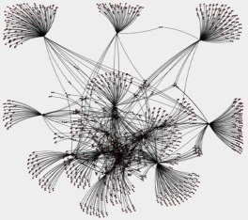
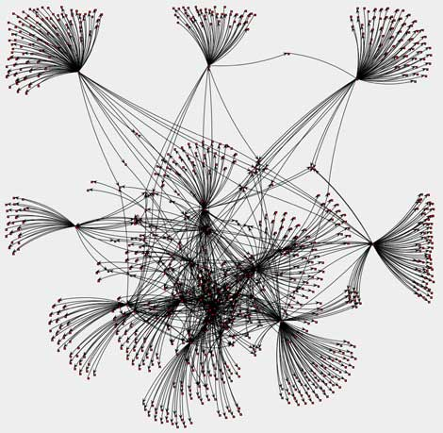
Strategy of Genome Scaffolding
Contigs connected by shared barcodes
Break connections by increasing shared barcodes
Assembly Scaffolds
Contig Order & Orientation

Slide 3
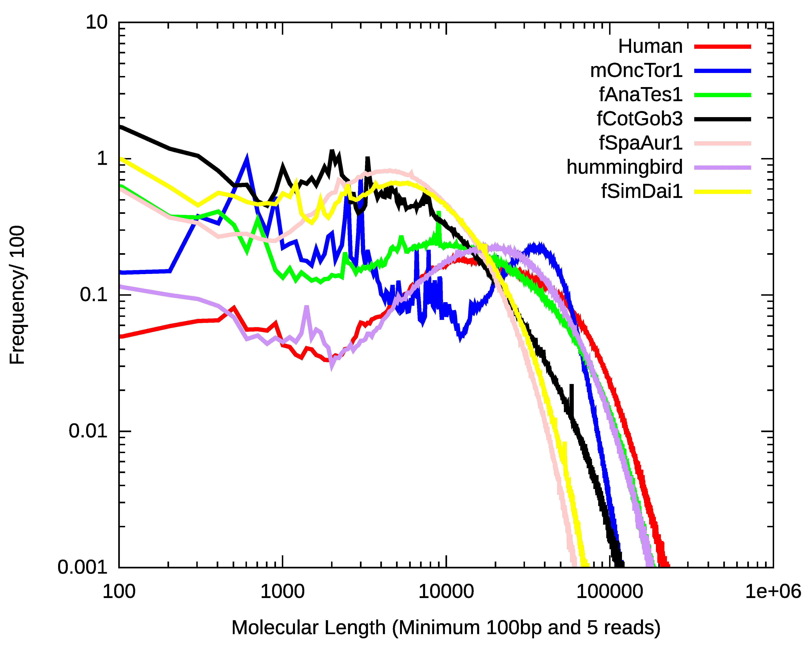

Slide 4
Scaff10X V4.1
Added Scaff_FilePreProcess
(1) Read gzipped files
(2) Processing barcodes
(3) Pipe to BWA for alignment
Input files
Gzipped fastq files, target assembly
10CX Longranger bam file
Previously aligned sam file
Output files
Scaffolded fasta file
Scaffold structure file: AGP?

Slide 5
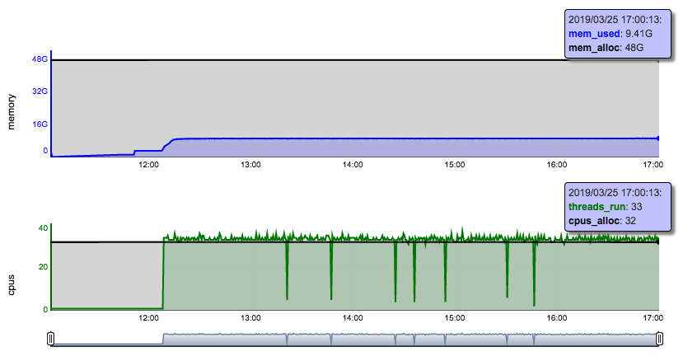
Scaff10X Memory and CPUs

Slide 6
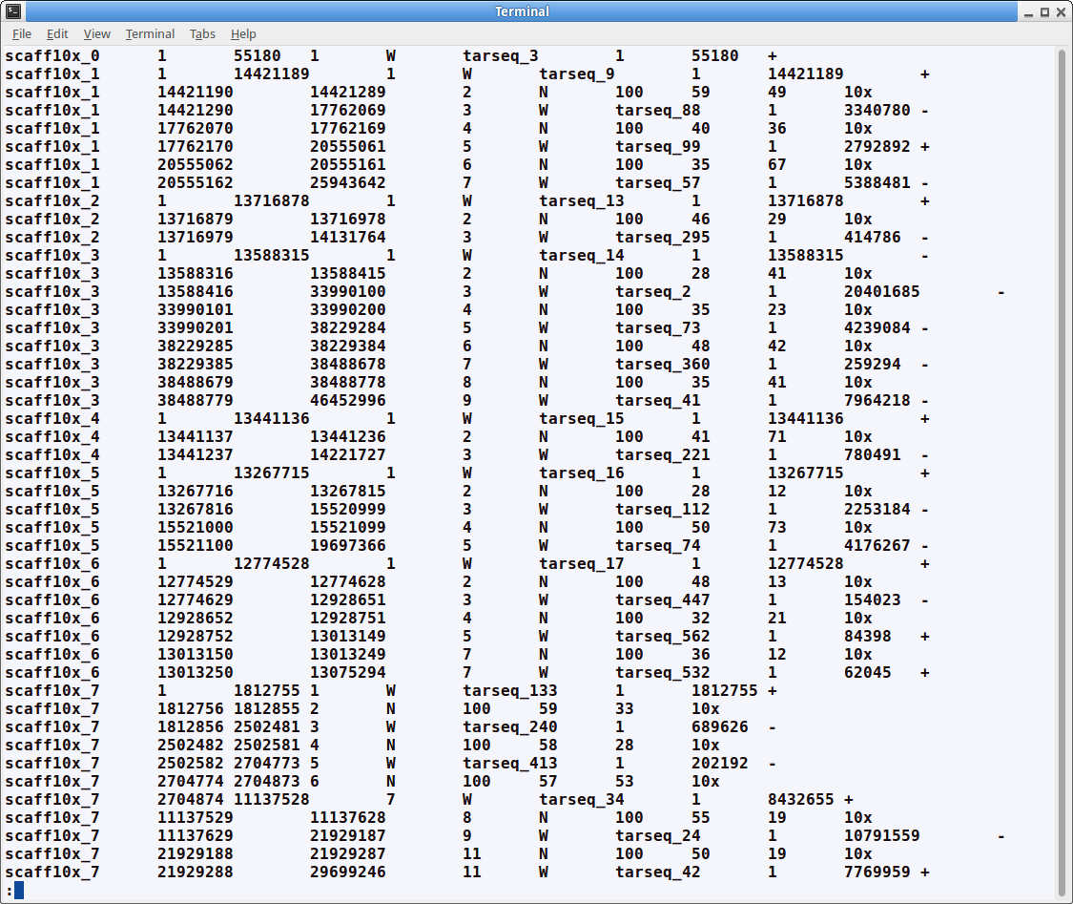

Slide 7
