Slide 1
WormBase ParaSite BioMart

Slide 2
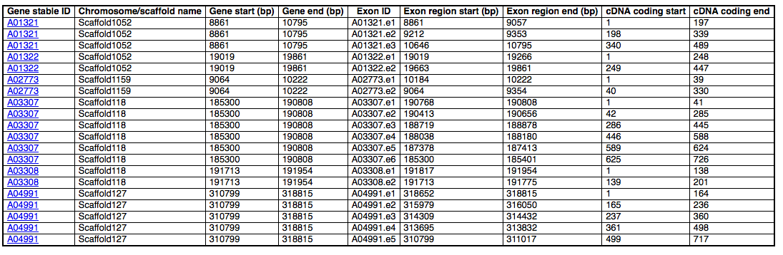
Basics of BioMart
Advanced search and data export tool
Produces tables of data, or files containing sequence
No programming or database knowledge required
Ideal for working with, or generating, lists of data
Notes:
Lists – emphasise lists
Complex queries in a few clicks
Two types of customisable output – tables of data or sequence files.
Power comes from working with lists- eg rather than getting data by navigating to the gene page, can do it for a list of many genes in a few clicks.
Generally speaking, ideal for lists:

Slide 3
Three simple steps…
  Filter the entire database to include only the genomes or genes you are interested in (query can be specific or vague) eg: all clade III nematode genes, all F. hepatica genes on scaffold 309.
  Choose the data you would like to include in the output file eg: start and end coordinates, peptide sequences.
  View or download the results (including direct export to Excel, or CSV for import to R)
Notes:
Specific or vague = list of specific genes, genes meeting protein domain criteria or something as simple as species. Can also search against entire database by not specifying any filters.
Plus videos of how to do the examples are located on our YouTube account
Or come along to a full day workshop

Slide 4
Data available for export
Sequences (genomic, cDNA, UTR, flanking, cDNA, peptide)
Gene IDs, names and descriptions
Identifiers for data from external databases (e.g. UniProt)
Gene structure (e.g. exons)
Protein domains and function (e.g. InterPro, Gene3D, PANTHER etc.)
Gene ontology terms
Orthologues and paralogues (in all nematodes, flatworms and a number of non-worm comparators, e.g. human, mouse and rat)

Slide 5
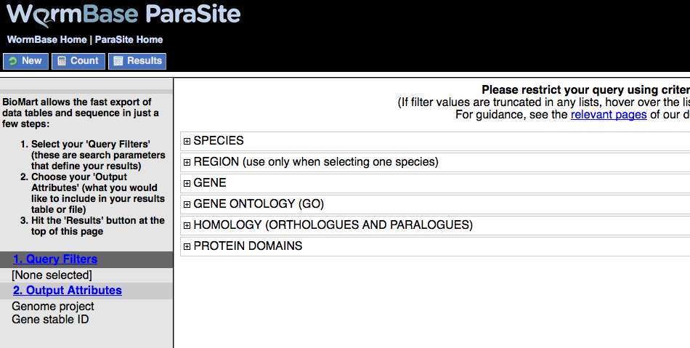
BioMart Interface
Control buttons:
New = reset form
Count = count results
Results = preview results
Query filters = search terms to restrict the query
Output attributes = select data to add into results (i.e. which columns would you like to appear in your table)
Filters and attributes appear here
Notes:
Break up into 3 parts: set filters, set attributes and view results
Also show result export options

Slide 6
BioMart Example – Generating a list
I think a novel drug targets transmembrane signalling receptor activity in Brugia species. I would like to model this in C. elegans.
Therefore I want to generate a list of Brugia genes, which:
Have an orthologue in C. elegans
Do not have an orthologue in humans
Are associated with transmembrane signalling receptor activity

Slide 7
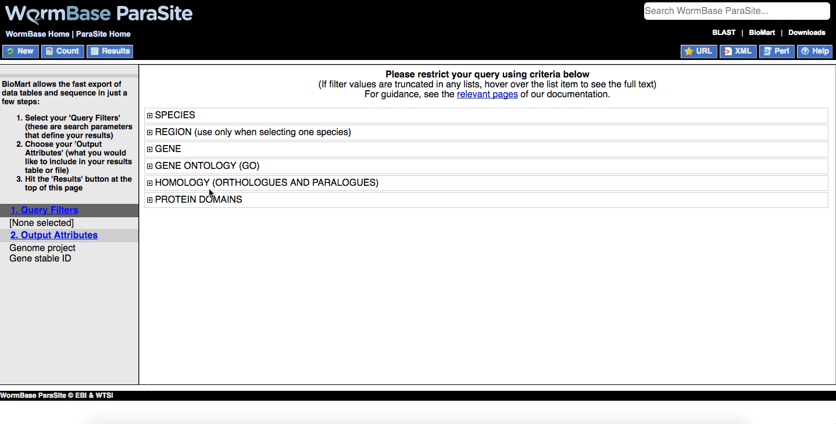
I want to generate a list of Brugia genes, which have an orthologue in C. elegans,
do not have an orthologue in humans and are associated with transmembrane signalling receptor activity

Slide 8
Download the BioMart exercises here:
ftp://ftp.ebi.ac.uk/pub/databases/wormbase/STAFF/fr7/BSP_2018/BSP_2018_biomart_exercises.pdf

